Slide 1
Department of Computer Science and Engineering
Moradabad Institute of Technology
Welcomes
NBA
Expert Team
17th Sep 2021

Slide 2
Department Information
Year 1996 | Establishment of Department with one B. Tech (CS&IT) program with intake of 40 seats. Currently department is running two programs: B. Tech (CSE) with 180 seats from session 2014 – 2015. B. Tech (CSE: AI & ML specialization) with 30 seats from session 2020 – 2021.
Faculty | Department is currently having 32 faculty members. 1 Professor, 3 Associate Professor and 28 Assistant Professor. 4 faculty member with Ph.D and 28 with M.Tech.
Student | Department is currently having 502* students. 172* in 2nd year + 172 in 3rd year + 158 in 4th year
MoU / Tie-ups | Department is currently having 4 MoU/Tie-ups. Innovians Technologies, Noida, Uttar Pradesh. Prutor.ai, IIT Kanpur, Uttar Pradesh. Coursera for Campus - up to 20000 free student licenses – 1 course per student per year. Microsoft VL agreement – 30 MTA/MOS vouchers.
Industry supported Laboratories | Department is currently having 3 Industry supported labs. Internet of Things (IoT) lab supported by Innovians Technologies, Noida. Embedded Systems & Robotics lab supported by e-Yantra Lab Setup Initiative (eLSI) – IIT Bombay. Microsoft Imagine Academy under Microsoft VL agreement.
Infrastructure | 4 Smart rooms with ICT tools, 1 Audio-video room, 1 Seminar hall with Interactive panel, 7 classrooms and 5 tutorial rooms, and 8 well-equipped laboratories.

Slide 3
Department Achievements
NBA accreditation | B.Tech CSE got accreditation 3 times by NBA. 2004 2008 2012
Patents | 4 Patents filed in 2020 - 2021. 1 patent granted (Australian Patent). 3 patent published.
Research Grant | Two Research Project grant under Collaborative Research and Innovation program (CRIP-2019) through TEQIP-III of Dr. A P J Abdul Kalam Technical University. [Rs. 3 Lakh each]
Publications | 115 research papers published in the last four years. 11 are SCI Indexed and 10 are Scopus Indexed.
Smart India Hackathon | Winner in Smart India Hackathon – 2020 in two different problem category.
Retention | 21 faculty members are with the department from more than 5 year, including 16 faculty members from more than 10 years. 7 faculty members from more than 15 year. 2 faculty members from more than 20 year. 1 faculty member from the day one, i.e., more than 25 year with the department.
Alumni | Alumni are working around the globe in different MNC’s.

Slide 4
Faculty Achievements
Board of Studies | Dr. Somesh Kumar inducted as an Expert for BOS of Computer Science and Engineering, Uttaranchal University, Dehradun.
Patents | 1 Patent granted in the name of Ms. Neha Gupta. 3 Patent published by Dr. Somesh Kumar, Dr. Manish Gupta and Mr. Sanjeev Gupta, respectively.
Research Grant | Dr. Somesh Kumar received Research Project grant under Collaborative Research and Innovation program (CRIP2019) through TEQIP-III of Dr. A P J Abdul Kalam Technical University. [Rs.3 Lakh] Dr. L P Verma received Research Project grant under Collaborative Research and Innovation program (CRIP2019) through TEQIP-III of Dr. A P J Abdul Kalam Technical University. [Rs. 3 Lakh]
Publications | Dr. Somesh Kumar got Best Research Paper Award in International Conference (ICCIN-2020). 7 SCI papers by Dr. Manish Gupta, 2 SCI papers by Dr. L. P. Verma, 1 SCI Paper by Mr. Himanshu Agarwal and 1 SCI paper by Mr. Manoj Kumar Singh.
Book/Book Chapter | Mr. Sanjeev Gupta and Ms. Priyanka Goel authored the Book titled as “Machine Learning and Cognitive Intelligence using Python” in year 2020. 1 Book chapter by Dr. Neelaksh Sheel in EAI/Springer Innovation in Communication and Computing(EAISICC).
e-Yantra, IIT Bombay | Dr. Manish Gupta and Mr. Mohd. Ilyas got Class A category award in Task based Training (TBT) - 2019 and got the 1st prize in TBT challenge -2019 organized by e-Yantra, IIT Bombay.
NPTEL | Elite + Gold certification: 12, Elite + Sliver: 23, Elite :14, Total certifications: 69 from 2016-2020.
Social | Dr. Somesh Kumar honored by Nagar Ayukt, Moradabad for his suggestions in Smart City Project.

Slide 5
Student’s Achievements
Smart India Hackathon | Team “Virtual Lords” won 1st Prize in Smart India Hackathon – 2020. Ritvik Dayal, Arpit Tyagi, Nitin Chauhan, Ritvik Rastogi, Shubham Chauhan, Shivangi Arora. Team “Editha” win 1st Prize in Smart India Hackathon – 2020. Abhishek kumar, Ashish, Ritik gupta, Harshita Madhok, Abhishek Khatri, Vaibhav Kumar.
Ideathon | Team “Revolution Virtual Creators” won 1st Prize in Ideathon – 2020, CMR Engineering College, Hyderabad. Geetika Gupta, Anshika Goel, Ayush Sharma, Anubhav Mishra
Research Grant | Shanvi Sharma and Mansi Bhatnagar received research grant under Council of Science and Technology, U.P. Engineering Student’s Project Grant Scheme 2018 - 19. [Rs. 10000]
Publications | 72 research paper published in International journals and conferences in 2016-2021 from their project work.
Start-up | Aezowie Infotech Pvt. Ltd. owned by Surya Pratap Singh and Sparsh Rastogi. Boxinall Softech owned by Siddhant Singh and Sumith Kumar. SiliHat owned by Harshit Agarwal.
NPTEL | Elite + Gold certification: 1, Elite + Sliver: 56, Elite :178 and total certifications: 391 from 2016 - 2021
Extra Curricular | Nikhil Kumar won 1st prize in Badminton Athos-2019, Chitkara University, Himachal Pradesh. Mohit Agarwal won 1st Prize in 4x400m relay race Ariz Anwar, Bilal Malik, Anubhav Mishra and Riyanshi Singhal won 1st Prize in group song Rahul Sukhija and Muskan Mehrotra won 2nd Prize in T-shirt painting Shubham Chauhan won 1st Prize in Coding Contest 80 prizes: within the state 21 prizes: outside the state from 2016 - 2020.
GATE/CAT | 25 students qualified GATE from 2016 – 2021. Ishika Agarwal and Mudrika Mittal qualified CAT2017.
Teams Reached to final round
3 Teams: SIH2020
6 Teams:SIH2018
2Teams: SIH2017
Dr. Abdul Kalam Sports Fest 2019 – 2020 (State-Level)
Dr. Abdul Kalam Arts and Cultural Fest
2019 – 2020 (State Level)
Dr. Abdul Kalam Technical, Literary & Management Fest 2018 – 2019. (Zonal Level)

Slide 6
1. Vision, Mission and Program Educational Objectives

Slide 7
Vision of the Institute | Mission of the Institute
To develop industry ready professionals with values and ethics for global needs. | To impart education through outcome based pedagogic principles. To provide conducive environment for personality development, training and entrepreneurial skills. To induct high professional ethics and accountability towards society in students.
Vision of the Institute | Mission of the Institute
To develop industry ready professionals with values and ethics for global needs. | To impart education through outcome based pedagogic principles. To provide conducive environment for personality development, training and entrepreneurial skills. To induct high professional ethics and accountability towards society in students.
Vision of the Department | Mission of the Department
To develop globally recognized computer science and engineering graduates with ethical values for the need of software industries. | To impart knowledge through well defined instructional objectives in the field of computer science and engineering. To provide learning ambience for skills, innovation, leadership and overall personality development. To inculcate professional ethics, teamwork and responsiveness towards society.
Vision of the Department | Mission of the Department
To develop globally recognized computer science and engineering graduates with ethical values for the need of software industries. | To impart knowledge through well defined instructional objectives in the field of computer science and engineering. To provide learning ambience for skills, innovation, leadership and overall personality development. To inculcate professional ethics, teamwork and responsiveness towards society.

Slide 8
Mission of the Department
M1: To impart knowledge through well defined instructional objectives in the field of computer science and engineering. M2: To provide learning ambience for skills, innovation, leadership and overall personality development. M3: To inculcate professional ethics, teamwork and responsiveness towards society.
Mapping of PEOs with Department Mission
Program Educational Objectives | M1 | M2 | M3
PEO1: The graduates will have entrepreneurial and employable skills in software industries, by adapting themselves in the corporate world by utilizing the defined instructional objectives learnt in the program. | 3 | 2 | 2
PEO2: The graduates will engage in skill enhancement, that would help to work in their own area of interest, individually or in a team. | 2 | 3 | 1
PEO3: The graduates will demonstrate ownership and responsiveness towards the profession and the society. | 2 | 2 | 3

Slide 9
Stakeholders
Internal Stakeholders
Students
External Stakeholders
Parents
Faculty Members
Alumni
Supporting Staff
Industry
Management
Employer

Slide 10
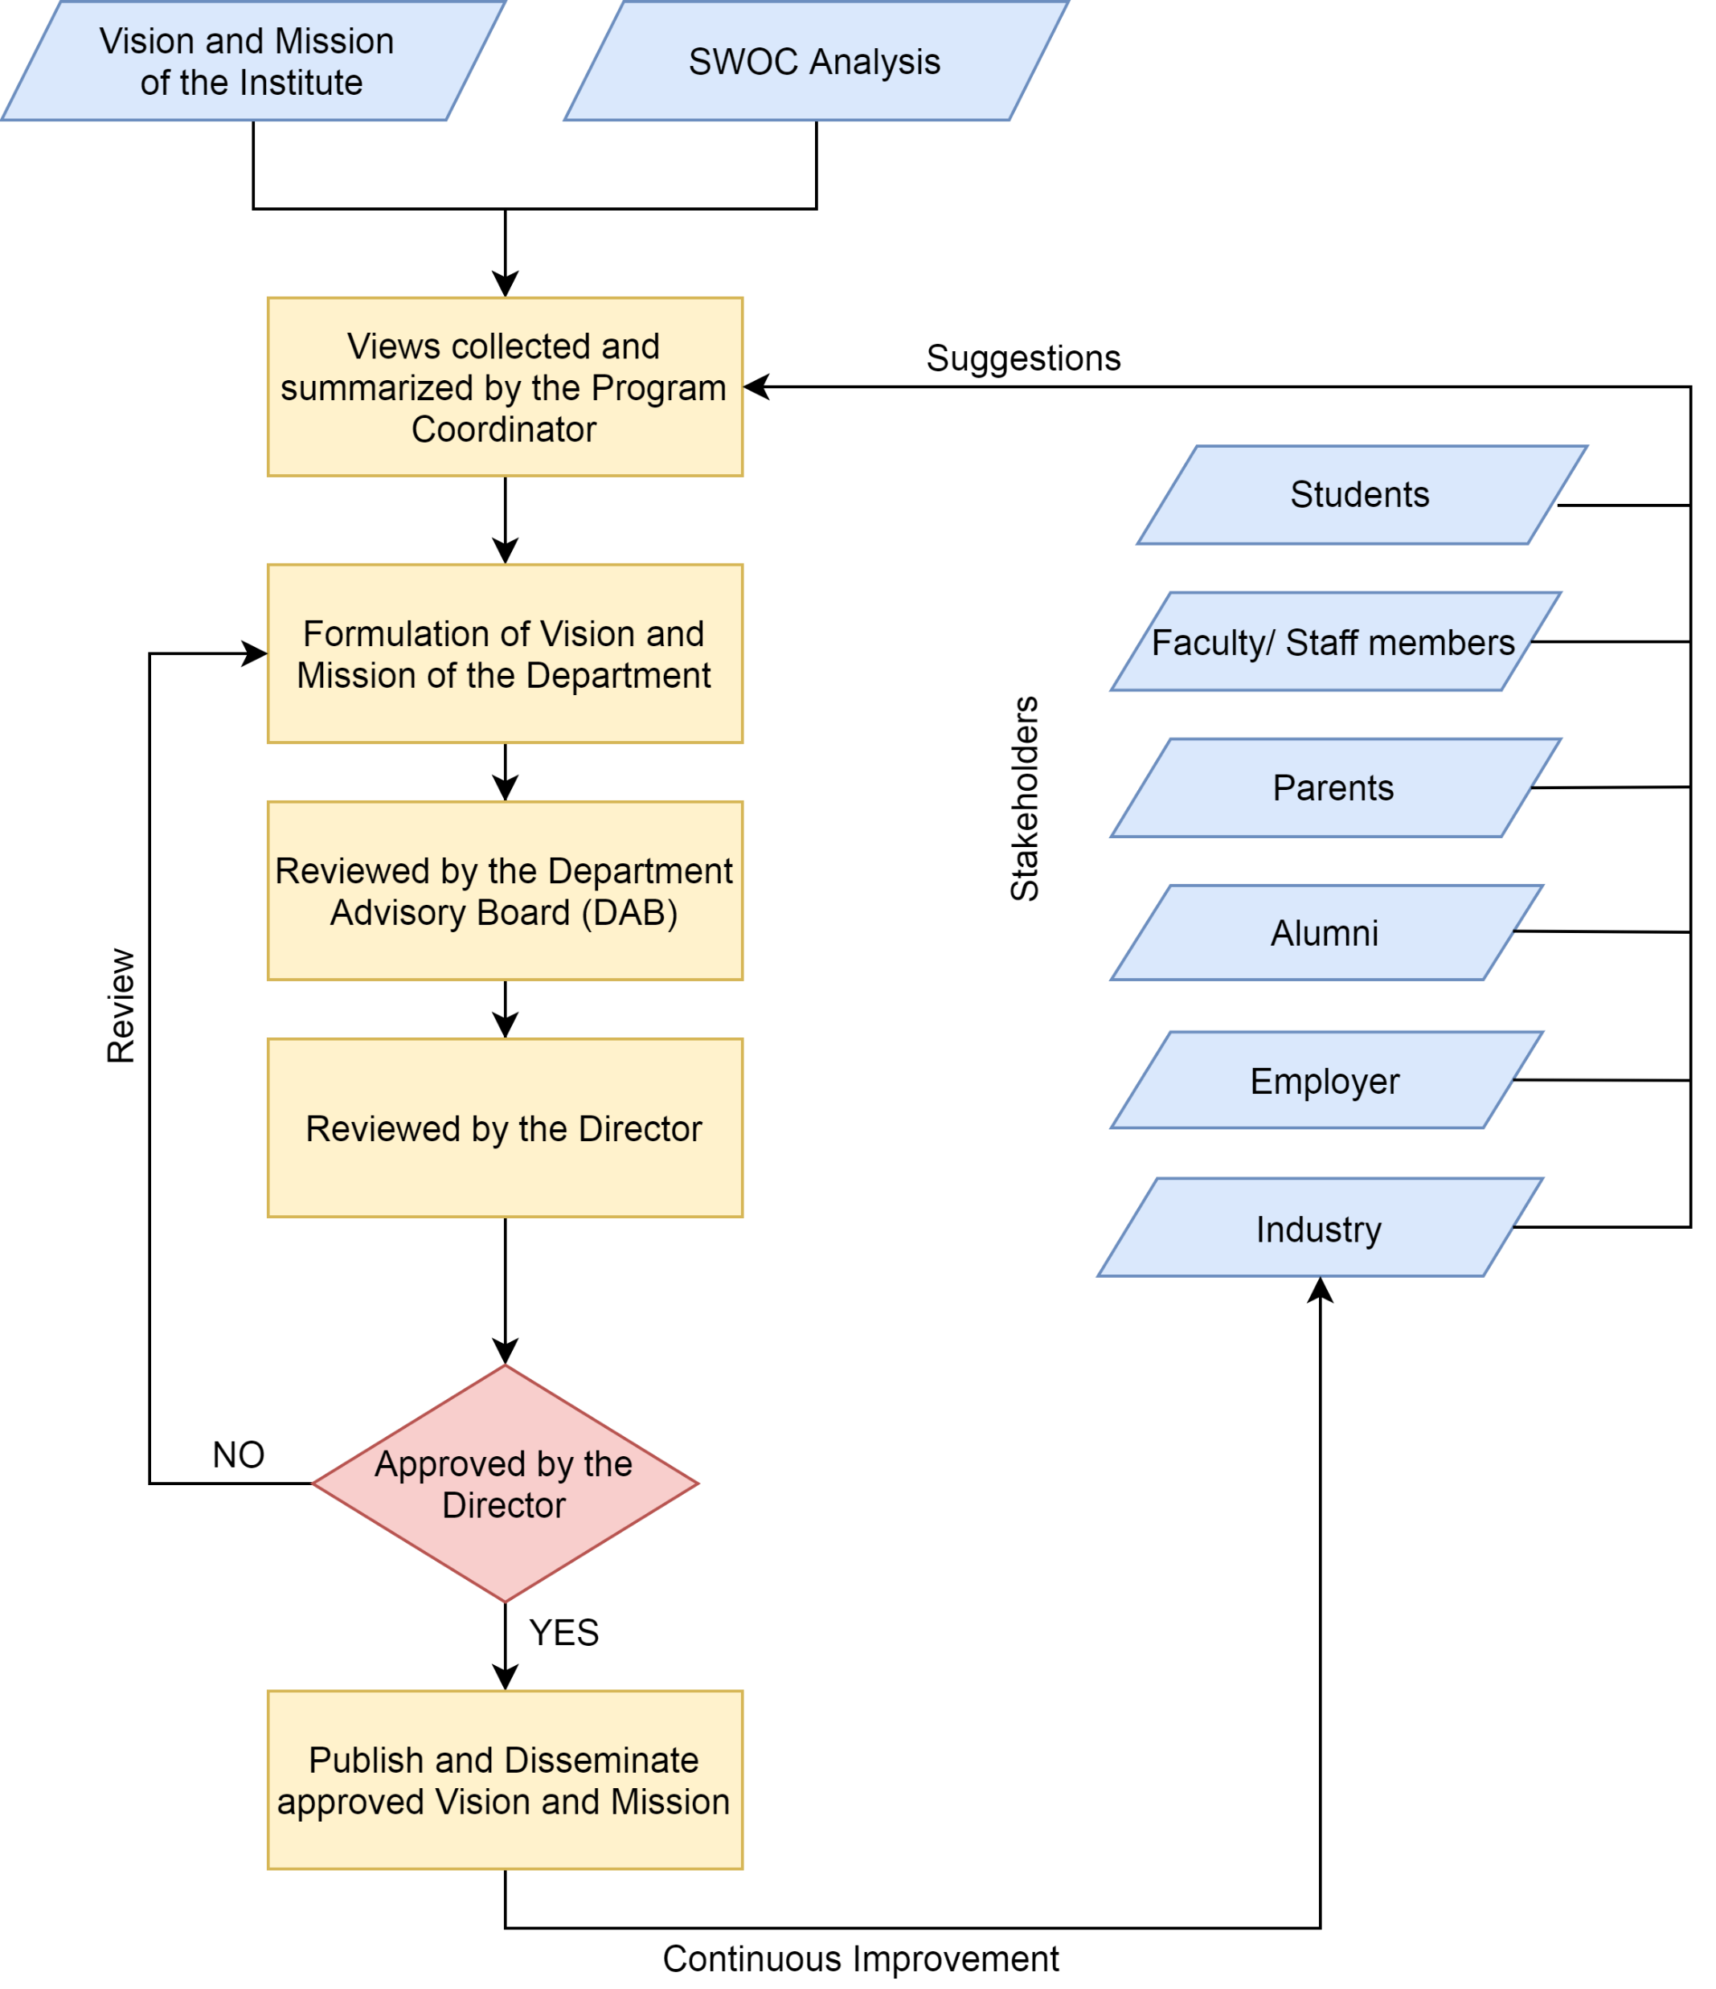
Process for Defining of Vision and Mission of the Department

Slide 11
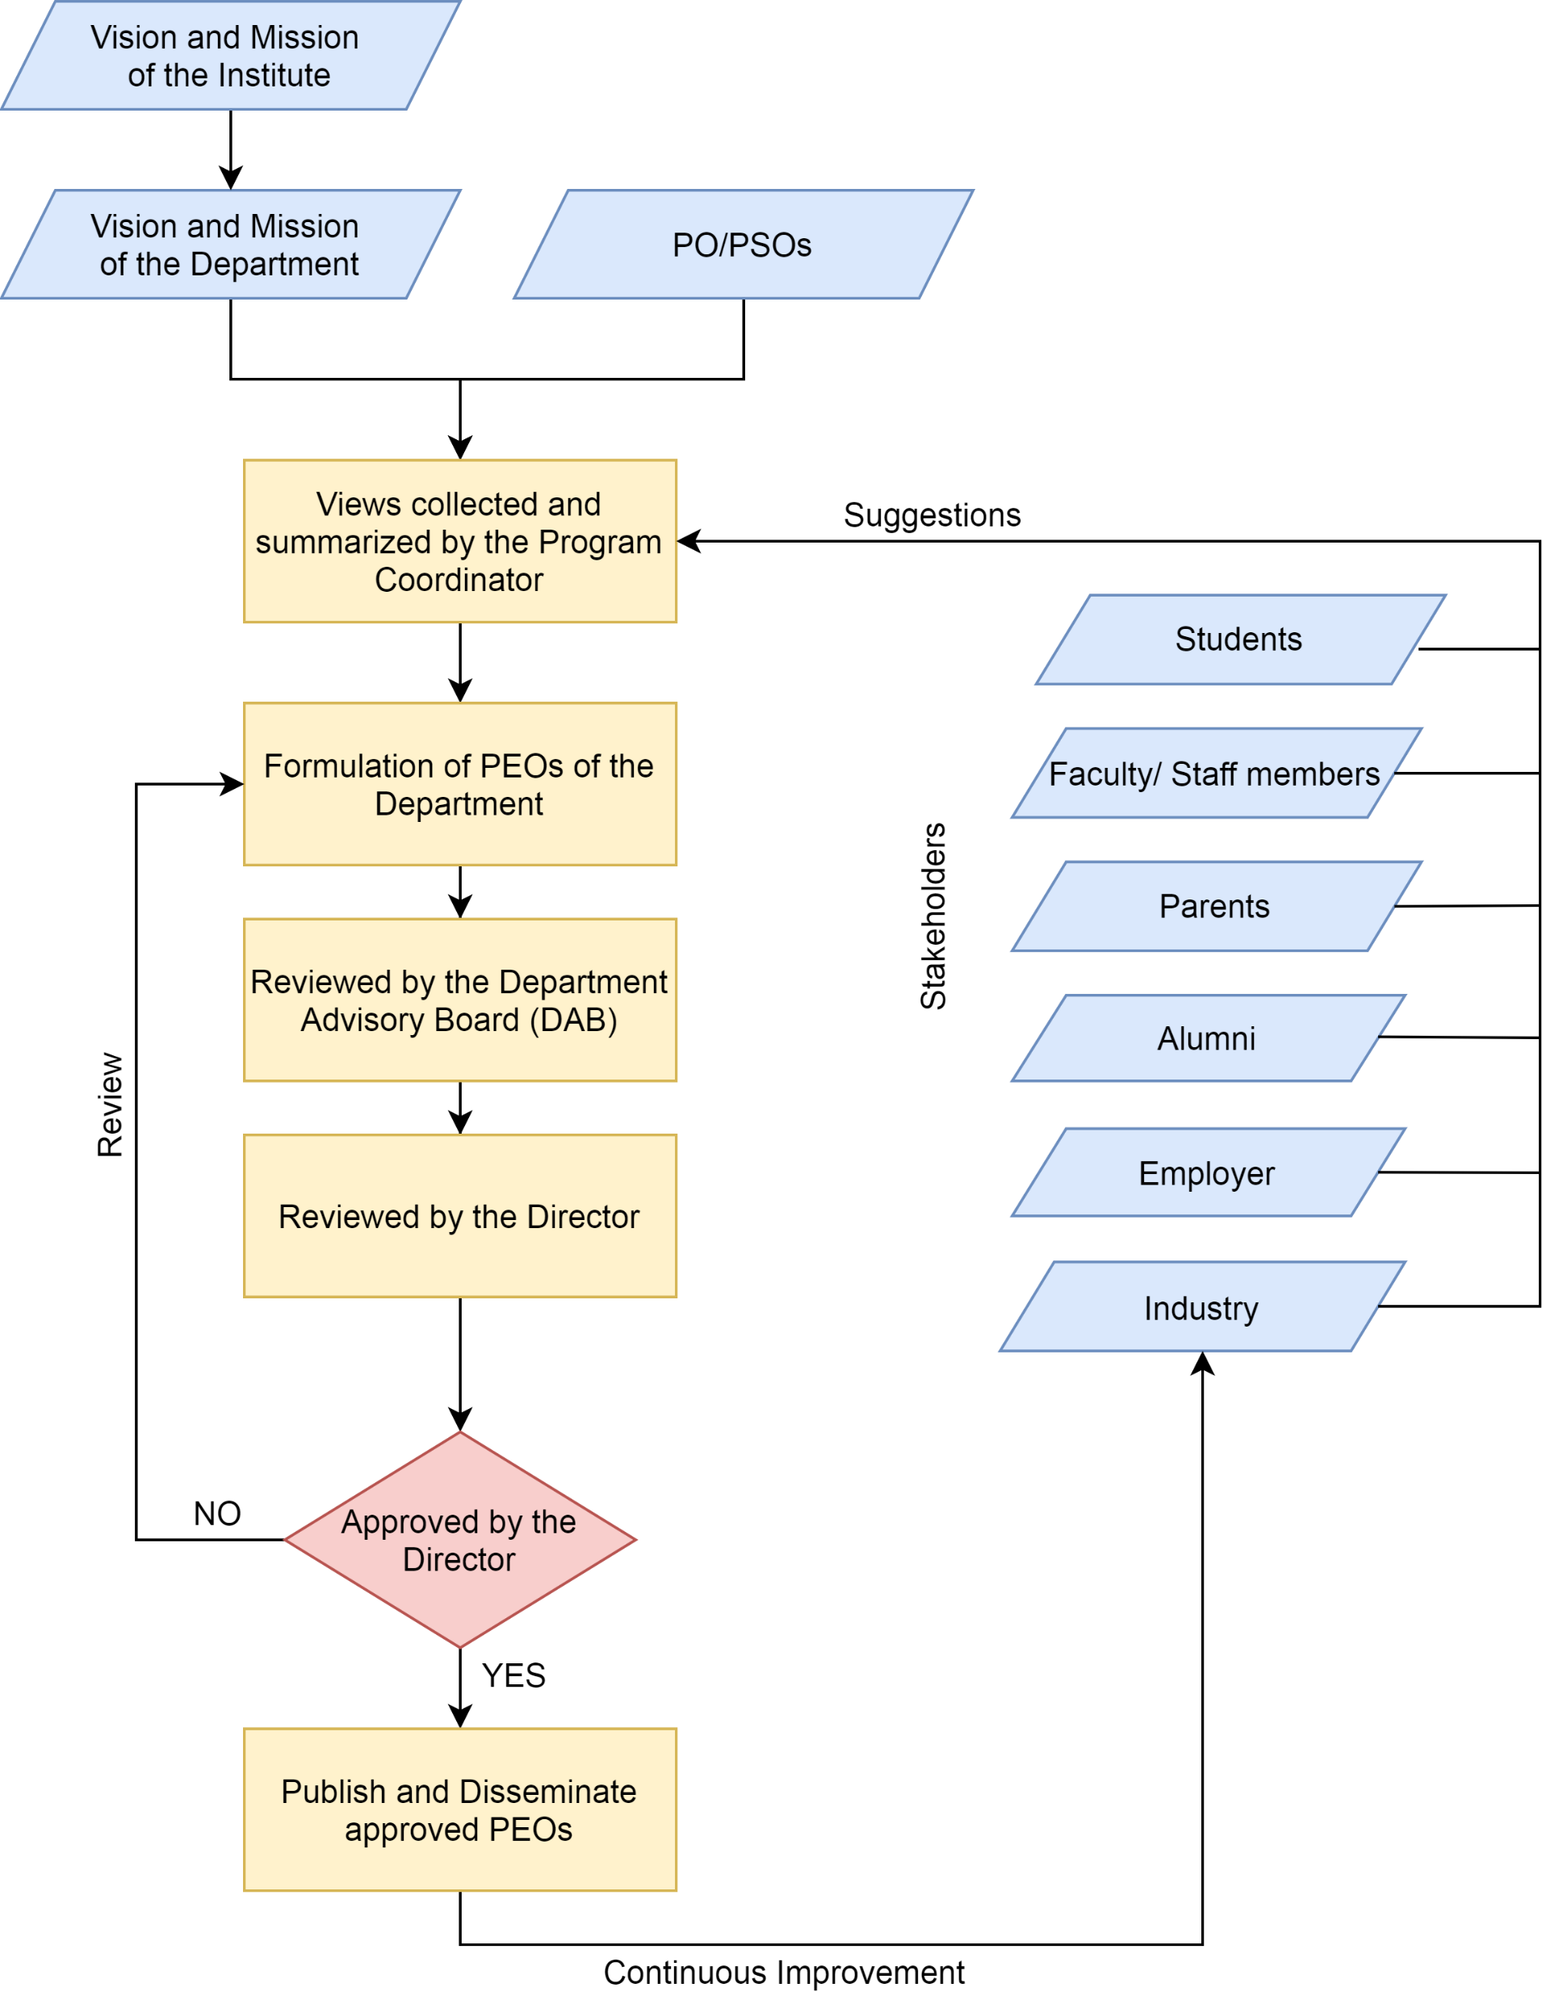
Process for Defining of PEOs of the Department

Slide 12
2. Program Curriculum and Teaching-Learning Processes

Slide 13
Program Curriculum
Moradabad Institute of Technology is affiliated to Dr. APJ Abdul Kalam Technical University, Lucknow, Uttar Pradesh (AKTU).
Program follows the curriculum provided by AKTU.
Structure of Curriculum (Evaluation Scheme and Detailed Syllabus) is as:
  1st Year
  2nd Year
  3rd Year
  4th Year

Slide 14
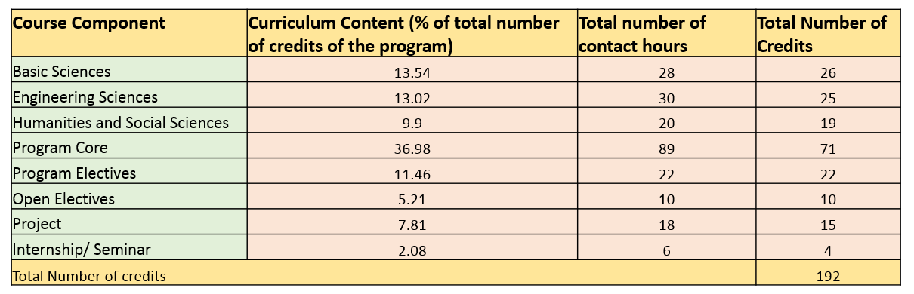
Course Components
Course Component | Curriculum Content (% of total number of credits of the program) | Total number of contact hours | Total Number of Credits
Basic Sciences | 13.54 | 28 | 26
Engineering Sciences | 13.02 | 30 | 25
Humanities and Social Sciences | 9.9 | 20 | 19
Program Core | 36.98 | 89 | 71
Program Electives | 11.46 | 22 | 22
Open Electives | 5.21 | 10 | 10
Project | 7.81 | 18 | 15
Internship/ Seminar | 2.08 | 6 | 4
Total Number of credits |  |  | 192

Slide 15
PO2, PO3, PO4,PO5, PO9, PO11, PO12 and PSO2 lies in 10% of curriculum
PO6, PO7,PO8 and PO10 lies in 10% of curriculum
Major Component, 37%, of curriculum is covering PO1 and PSO1
Compliance of Curriculum to Attainment of POs and PSOs
Curriculum Gap

Slide 16
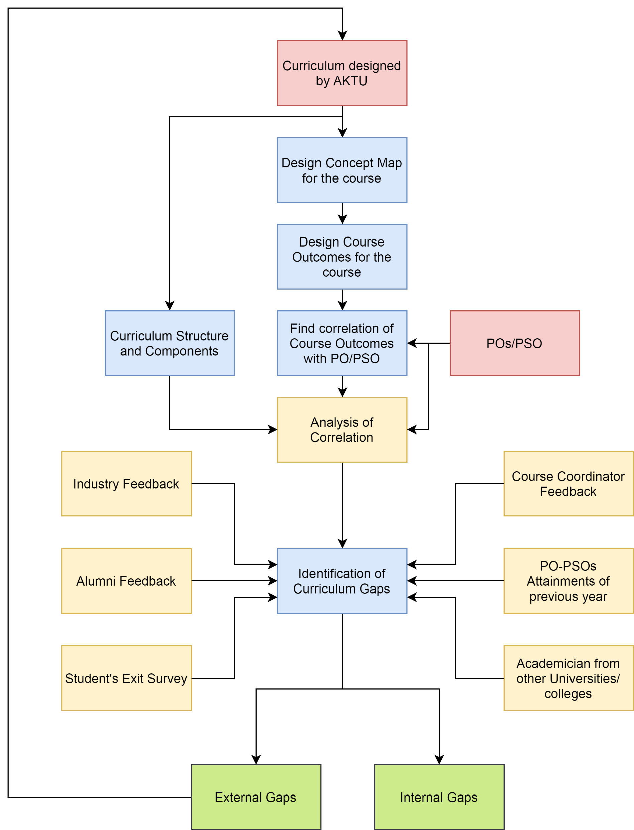
Process to Identify Curriculum Gaps
External Gaps
Internal Gaps
Add on Courses
(Bridge the gap by sending recommendation of Inclusion of new courses in curriculum to AKTU)
Bridge the gap by
Addition of New content.
Workshops/ Training
Industrial Visits
Guest Lectures
NPTEL Videos

Slide 17
Teaching-Learning Processes
Adherence to Academic Calendar
  Institute prepare its academic calendar in alignment of academic calendar of Dr. APJ Abdul Kalam University.
  Department academic calendar derived from the Institute academic calendar.
    It is the mirror of academic activities.
    Ensures effective time management for all activities.
  Department academic calendar
    2020 - 2021 Odd Semester.
    2020 - 2021 Even Semester.
    Updated due to lock down.
University Academic Calendar
Institute Academic Calendar
Department Academic Calendar

Slide 18
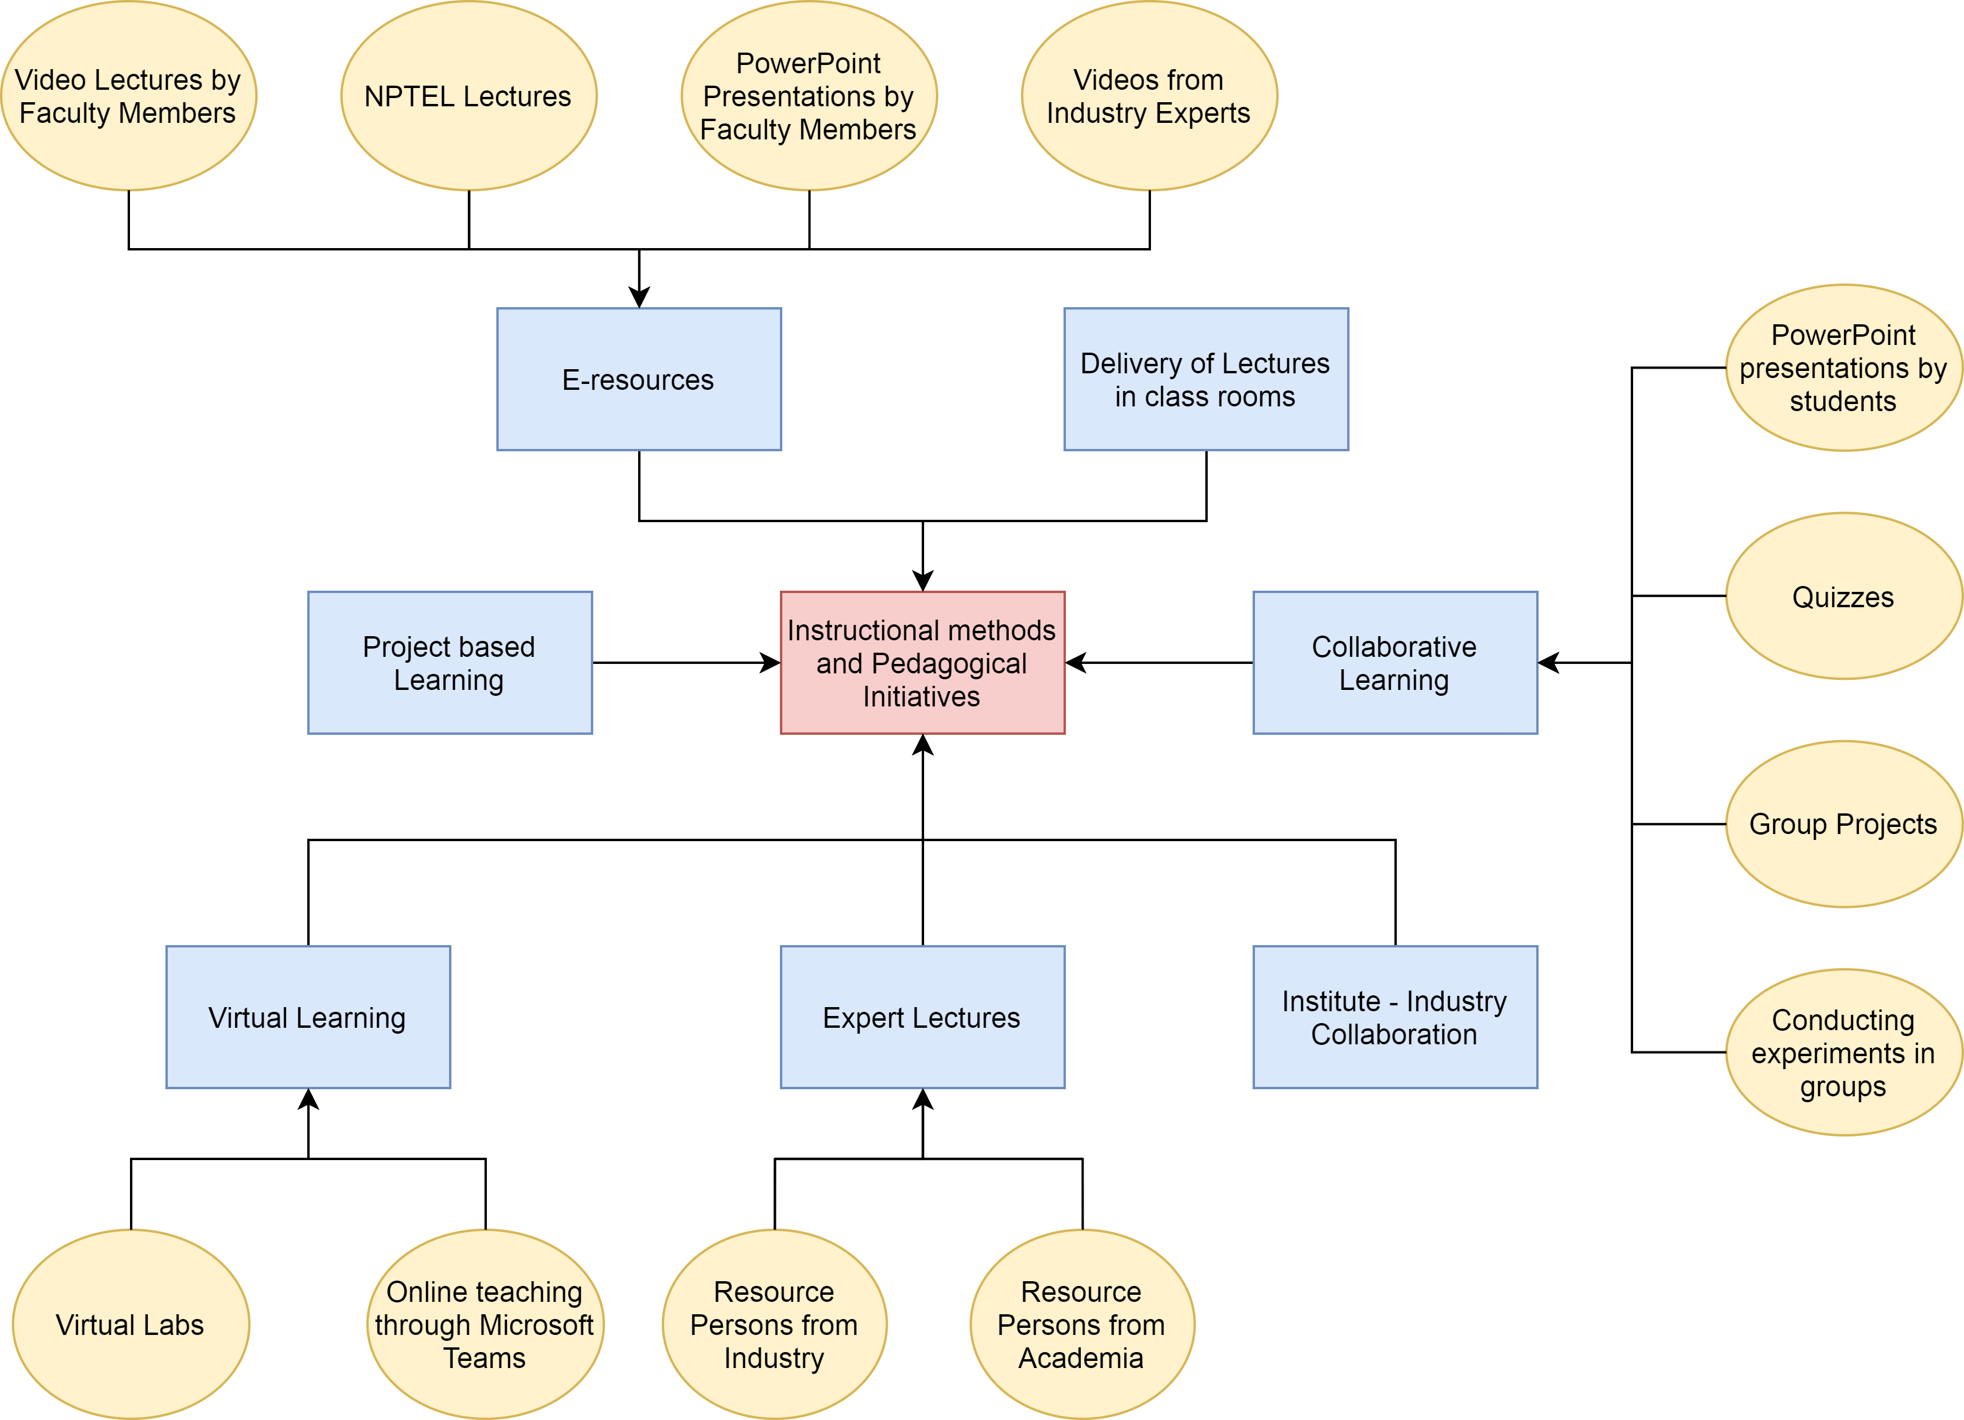
Instructional Methods and Pedagogies

Slide 19
Support to Weak Students
Identified by faculty members during their class room teaching and/or on basis of performance in Class Test-1 and recommended by Mentors.
Separate special classes are arranged for re-explaining difficult topics and clarifying the doubts.
Counseled by Mentor.
Regular monitoring and observing them during teaching-learning.
Providing reading material and lecture notes.
Question bank based on previous years question papers.

Slide 20
Encouragement for Bright Students
Identified from their participation in classroom discussions, questioning and problem solving analysis, and/or result analysis and recommended by Mentors.
Additional book facilities are provided in Library.
Encouraged to publish papers in reputed journals and conferences.
Encouraged to pursue online certifications, such as Swayam-NPTEL, Coursera.
Provided more conceptual question set from GATE previous years and discussed in tutorial classes.

Slide 21
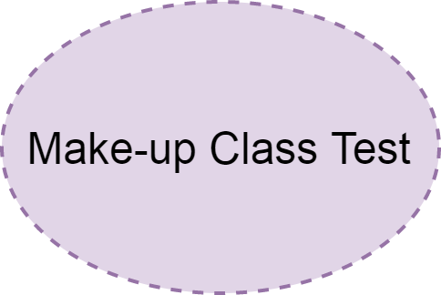
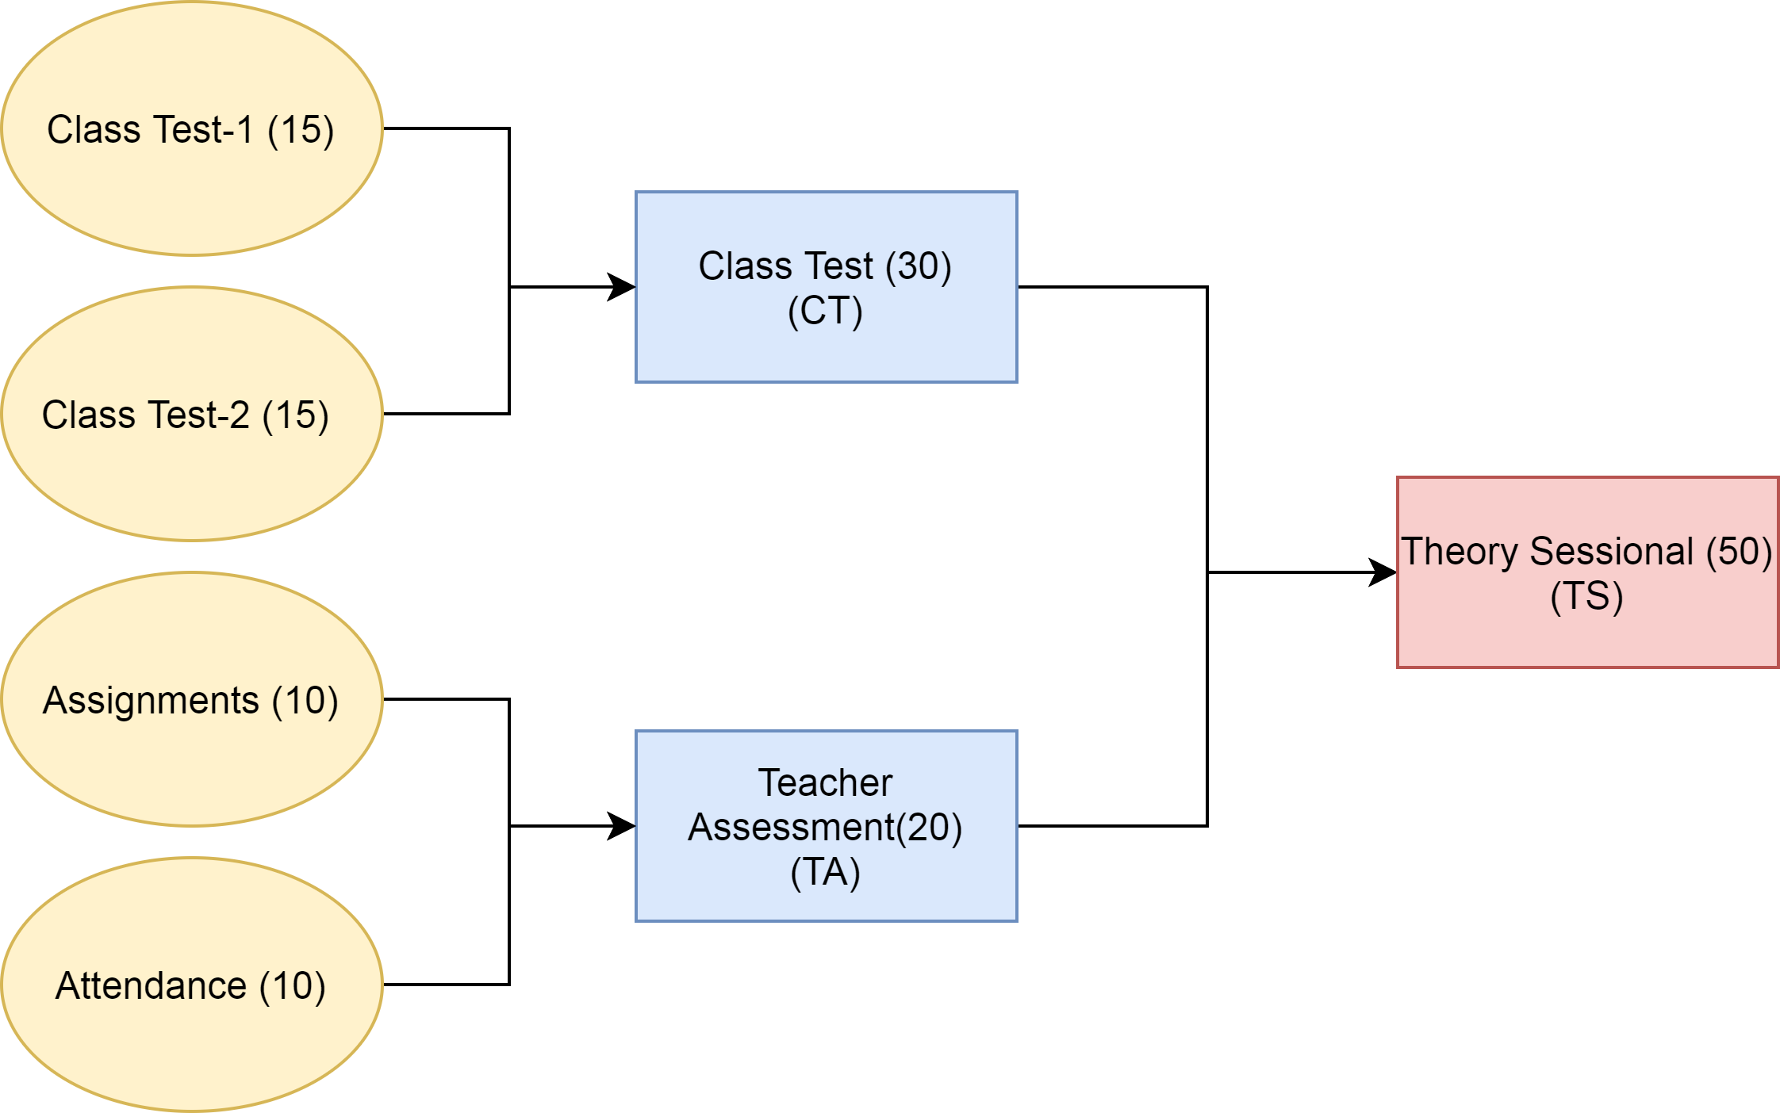
Assessment Plan and Instruments
Theory Subjects
For absentees with prior permission.
Department follow the University Evaluation Scheme.
It is divided into two parts:
  Continuous Internal Examination
  Semester End Examination

Slide 22
Assessment Plan and Instruments
Theory Subjects
Department follow the University Evaluation Scheme.
It is divided into two parts:
  Continuous Internal Examination
  Semester End Examination
Conducted by Dr. APJ Abdul kalam University.
Theory Examination(100)
(TE)

Slide 23
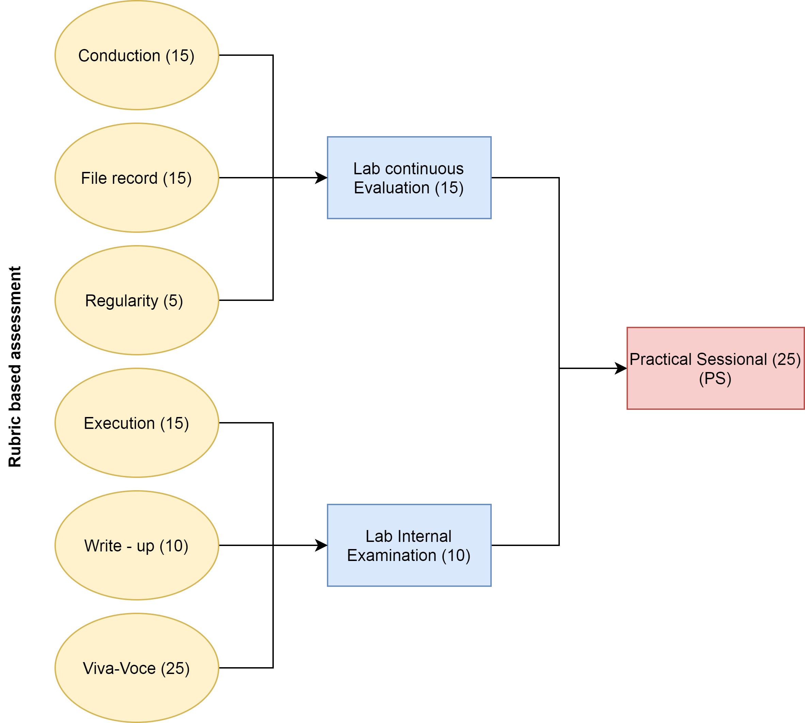
Assessment Plan and Instruments
Practical Subjects
  Continuous Internal Examination
  Semester End Examination

Slide 24
Assessment Plan and Instruments
Practical Subjects
  Continuous Internal Examination
  Semester End Examination
Conducted by Dr. APJ Abdul kalam University.
Practical Examination(25)
(PE)

Slide 25
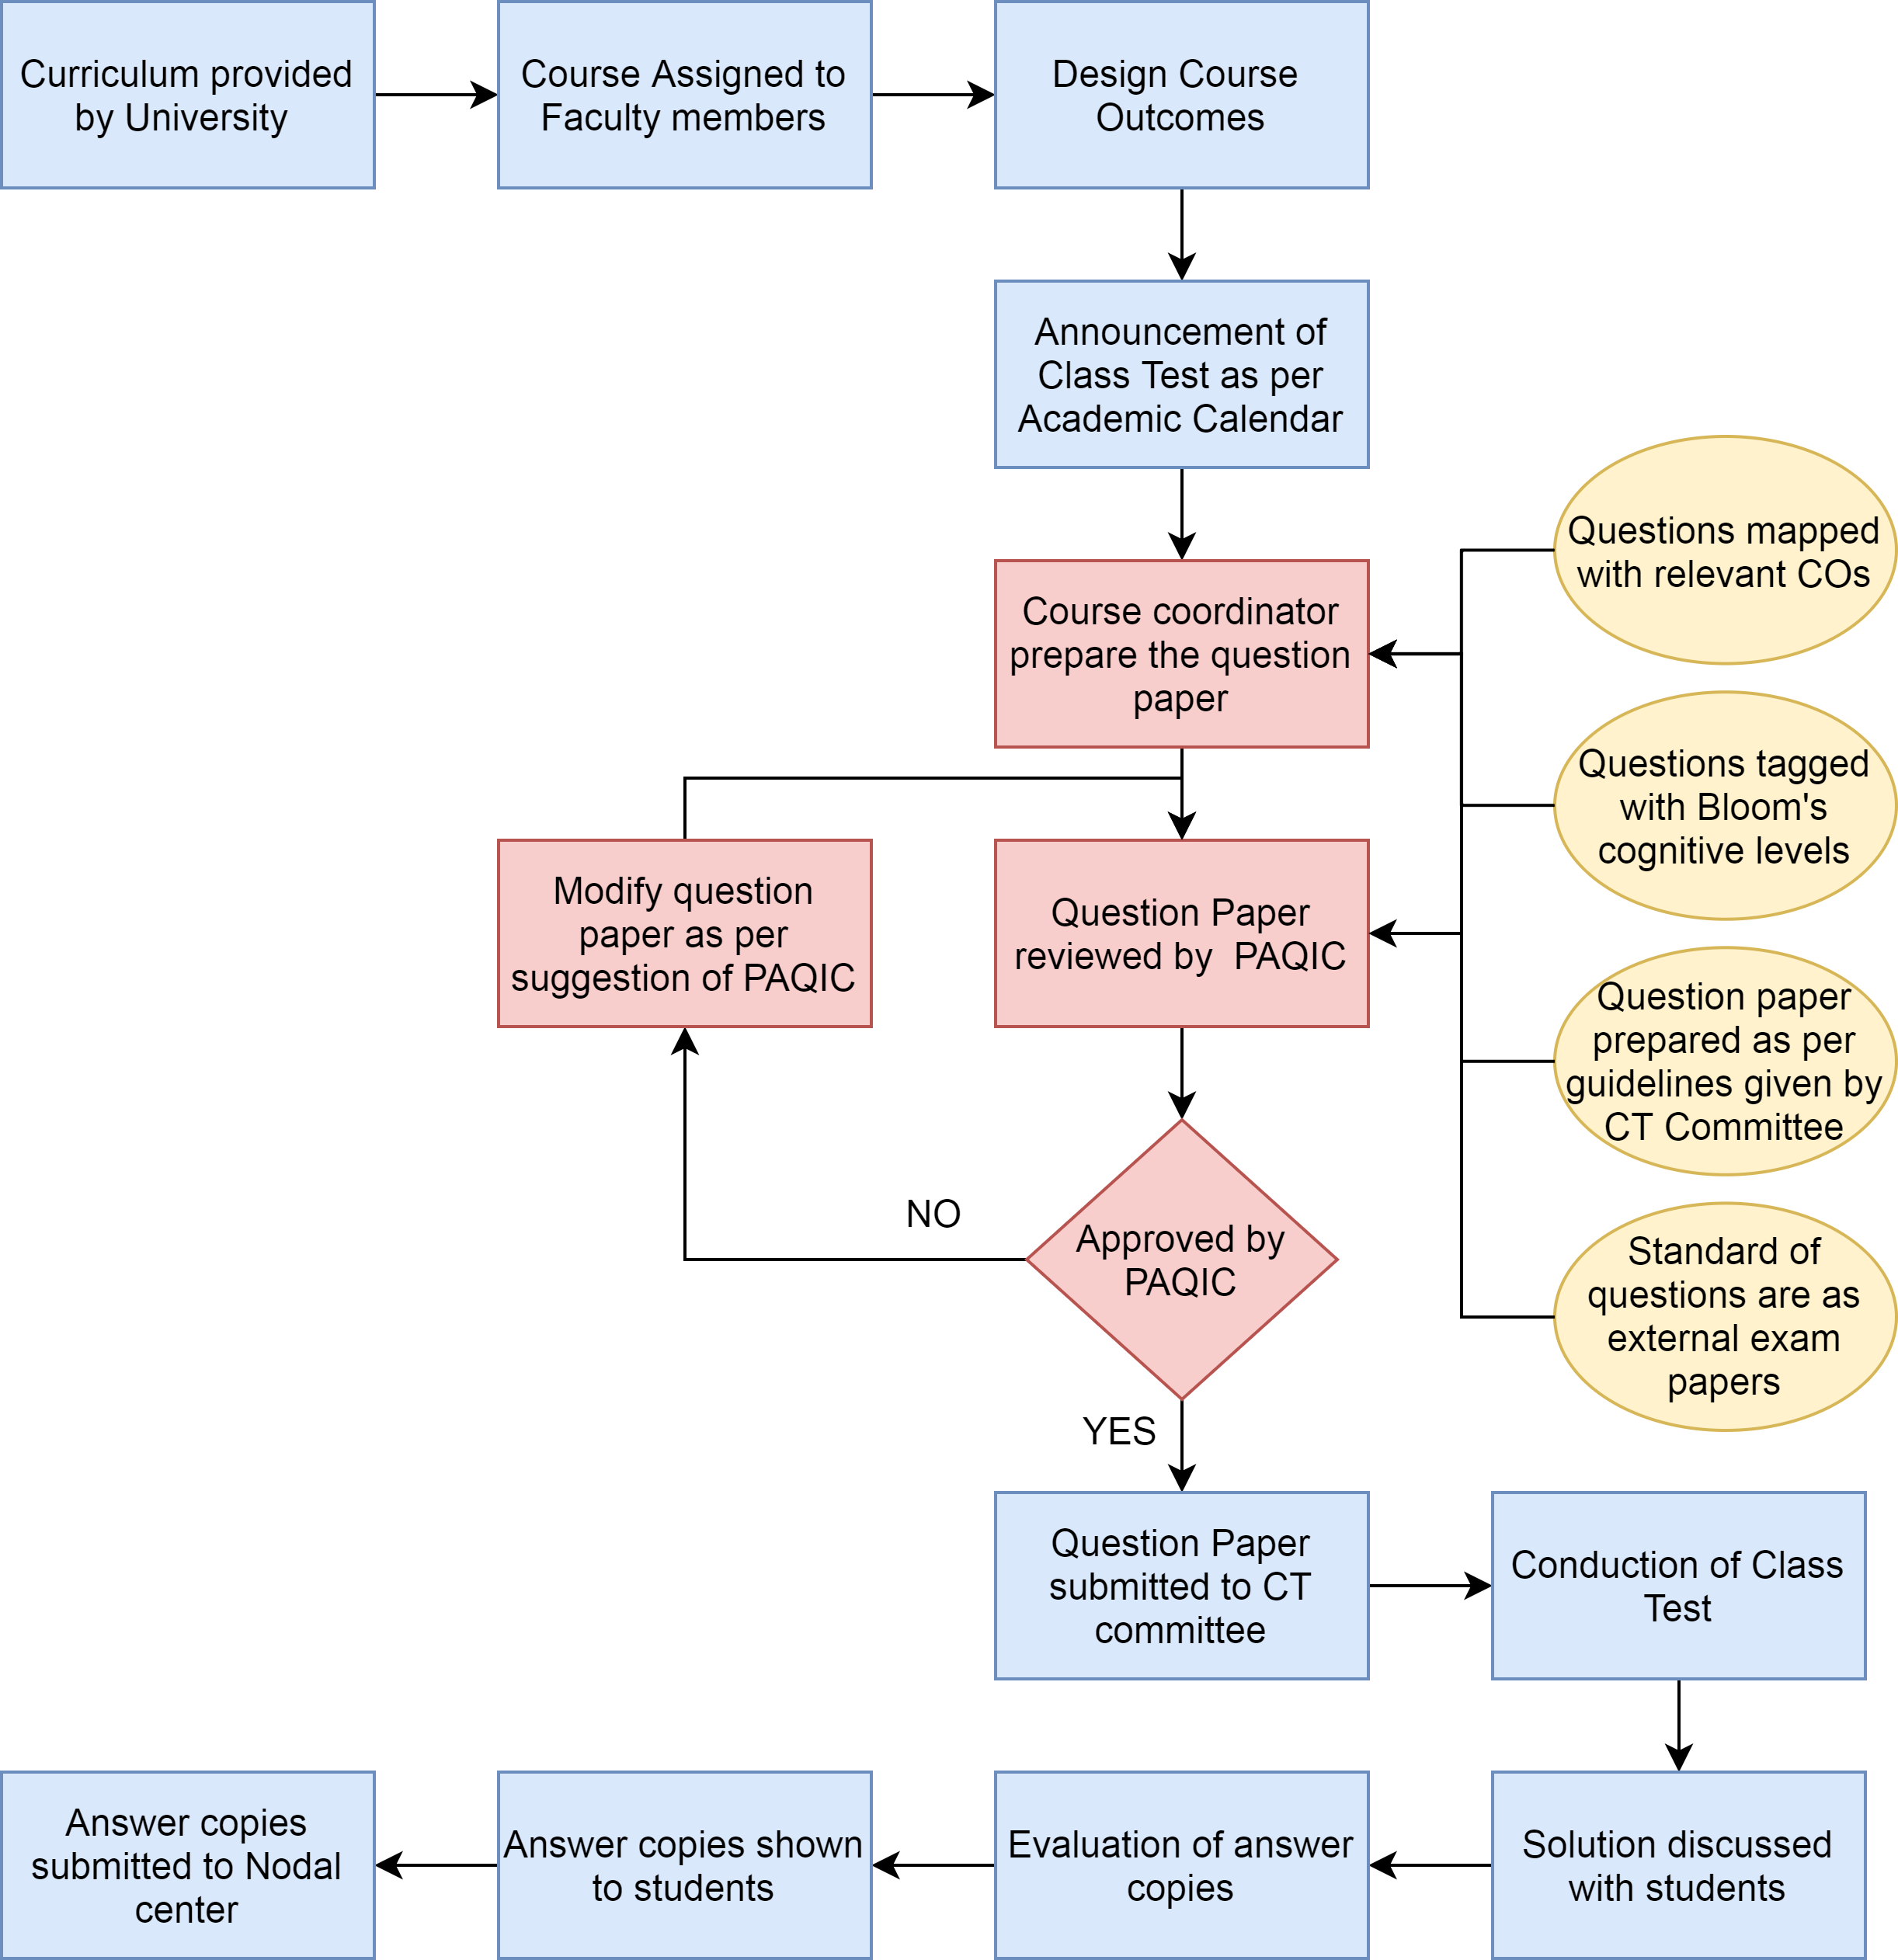
Process for Conduction and Evaluation of Internal Papers
Concept map

Slide 26
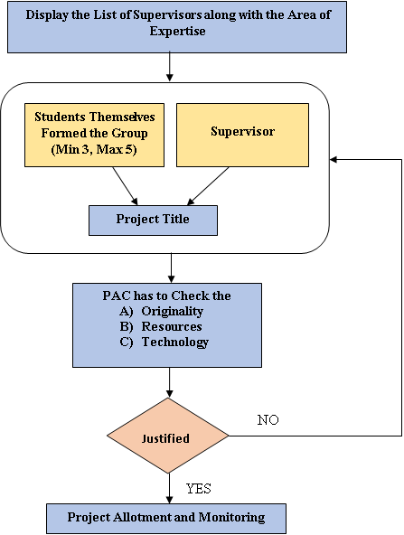
Process for Project Allocations

Slide 27
Rubrics for Project Evaluation
Continuous Internal Evaluation of Project | Rubrics
7th Semester
Evaluation by Project Assessment Committee | Phase 1 | R1:Title & Feasibility
 |  | R2: Abstract & Depth of Knowledge
 |  | R3: Presentation as team and as an Individual
 |  | R4: Questions and Answer
 | Phase 2 | R5:Design, Analysis and Work Distribution among Team Members
 |  | R6: Implementation strategy
 |  | R7: Presentation as team and as an Individual
 |  | R8: Questions and Answer
Evaluation by Project Supervisor | R9: Assessed Project Progress
 | R10: Individual Contribution
 | R11: Sincerity towards Work as Team
 | R12: Questions and Answer
8th Semester
Evaluation by Project Assessment Committee | Phase 1 | R1: Refine the Requirements to Incorporate Suggestions
 |  | R2: Objectives Meet/ Results as per the Expected time plan
 |  | R3: Presentation as team and as an Individual
 |  | R4: Questions and Answer
 | Phase 2 | R5: Final Report
 |  | R6: Final Demonstration
 |  | R7: Presentation as team and as an Individual
 |  | R8: Questions and Answer
 |  | R9: Research Paper Writing Based on Project
Evaluation by Project Supervisor | R10: Assessed Project Progress
 | R11: Development of Prototype/ Model up to satisfaction level
 | R12: Individual Contribution
 | R13: Sincerity towards Work as Team
 | R14: Project Report/Demo Preparation as per guidelines

Slide 28
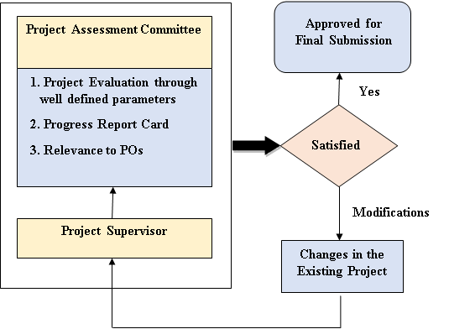
Process for monitoring and evaluation of Projects

Slide 29
3. Course Outcomes and Program Outcomes
OBE Philosophy followed by CSE Department

Slide 30
Attainment Process of Course outcome (CO’s)
Course
  Course : Given by curriculum and allocated to faculty member.

Slide 31
Attainment Process of Course outcome (CO’s)
Course
Concept Map
  Course : Given by curriculum and allocated to faculty member.
  CO’s are framed by faculty member and tagged with the Bloom’s cognitive levels.
has
Course Outcomes

Slide 32
Attainment Process of Course outcome (CO’s)
Course
  Course : Given by curriculum and allocated to faculty member.
  CO’s are framed by faculty member and tagged with the Bloom’s cognitive levels.
  CO’s attainment target is defined in term’s of criteria : % of students getting >= 60% of marks, for each CO.
has
Course Outcomes
Course Outcomes Targets

Slide 33
Attainment Process of Course outcome (CO’s)
Course
  Course : Given by curriculum and allocated to faculty member.
  CO’s are framed by faculty member and tagged with the Bloom’s cognitive levels.
  CO’s attainment target is defined in term’s of criteria : % of students getting >= 60% of marks, for each CO.
  CO’s are assessed as per Assessment plan
  Direct Assessment – Continuous Internal Evaluation and Semester End Examination.
  Indirect Assessment - Course Exit Survey.
has
Course Outcomes
Course Outcomes Targets
are assessed as per
Assessment Plan

Slide 34
Attainment Process of Course outcome (CO’s)
Course
  Course : Given by curriculum and allocated to faculty member.
  CO’s are framed by faculty member and tagged with the Bloom’s cognitive levels.
  CO’s attainment target is defined in term’s of criteria : % of students getting >= 60% of marks, for each CO.
  CO’s are assessed as per Assessment plan
  Direct Assessment (90%)
    Continuous Internal Evaluation (33%)
      Sessional Examination (Class Tests)
      Assignments/ Quizzes.
    Semester End Examination (67%)
      Taken by University
  Indirect Assessment (10%)
    Course Exit Survey
      Taken by Faculty member at the end of course.
has
Course Outcomes
Course Outcomes Targets
are assessed as per
Assessment Plan
determine
Assessment Instruments

Slide 35
Attainment Process of Course outcome (CO’s)
Course
  Course : Given by curriculum and allocated to faculty member.
  CO’s are framed by faculty member and tagged with the Bloom’s cognitive levels.
  CO’s attainment target is defined in term’s of criteria : % of students getting >= 60% of marks, for each CO.
  CO’s are assessed as per Assessment plan
  Direct Assessment
    Continuous Internal Evaluation
      Sessional Examination (Class Tests) and Assignments/ Quizzes.
    Semester End Examination - Taken by University
  Indirect Assessment
    Course Exit Survey -Taken by Faculty member at the end of course.
  For Each CO, Calculating % of students having >= 60% of marks (CO Attainment)
has
Course Outcomes
Course Outcomes Targets
are assessed as per
Assessment Plan
determine
Assessment Instruments
Student’s CO Attainment
determine

Slide 36
Attainment Process of Course outcome (CO’s)
Course
  Course : Given by curriculum and allocated to faculty member.
  CO’s are framed by faculty member and tagged with the Bloom’s cognitive levels.
  CO’s attainment target is defined in term’s of criteria : % of students getting >= 60% of marks, for each CO.
  CO’s are assessed as per Assessment plan
  Direct Assessment
    Continuous Internal Evaluation
      Sessional Examination (Class Tests) and Assignments/ Quizzes.
    Semester End Examination - Taken by University
  Indirect Assessment
    Course Exit Survey -Taken by Faculty member at the end of course.
  For Each CO, Calculating % of students having >= 60% of marks (CO Attainment)
  CO Attainment Gap =
  CO Target – CO Attainment
has
Course Outcomes
Course Outcomes Targets
are assessed as per
Assessment Plan
CO Attainment Gap
determine
determine
Assessment Instruments
Student’s CO Attainment
determine

Slide 37
Attainment Process of Course outcome (CO’s)
Course
  Course : Given by curriculum and allocated to faculty member.
  CO’s are framed by faculty member and tagged with the Bloom’s cognitive levels.
  CO’s attainment target is defined in term’s of criteria : % of students getting >= 60% of marks, for each CO.
  CO’s are assessed as per Assessment plan
  Direct Assessment
    Continuous Internal Evaluation
      Sessional Examination (Class Tests) and Assignments/ Quizzes.
    Semester End Examination - Taken by University
  Indirect Assessment
    Course Exit Survey -Taken by Faculty member at the end of course.
  For Each CO, Calculating % of students having >= 60% of marks (CO Attainment)
  CO Attainment Gap = CO Target – CO Attainment
  If Gap >0, Plan for Closing the Gap
  Otherwise , Increase the Target
has
Course Outcomes
Course Outcomes Targets
are assessed as per
Assessment Plan
CO Attainment Gap
determine
determine
leads to a
Assessment Instruments
Student’s CO Attainment
Action Plan or Enhancement
determine

Slide 38
Attainment Process of Course outcome (CO’s)
Course
  Course : Given by curriculum and allocated to faculty member.
  CO’s are framed by faculty member and tagged with the Bloom’s cognitive levels.
  CO’s attainment target is defined in term’s of criteria : % of students getting >= 60% of marks, for each CO.
  CO’s are assessed as per Assessment plan
  Direct Assessment
    Continuous Internal Evaluation
      Sessional Examination (Class Tests) and Assignments/ Quizzes.
    Semester End Examination - Taken by University
  Indirect Assessment
    Course Exit Survey -Taken by Faculty member at the end of course.
  For Each CO, Calculating % of students having >= 60% of marks (CO Attainment)
  CO Attainment Gap = CO Target – CO Attainment
  If Gap >0, Plan for Closing the Gap, Otherwise , Increase the Target
has
Course Outcomes
Course Outcomes Targets
are assessed as per
Assessment Plan
CO Attainment Gap
determine
determine
leads to a
Assessment Instruments
Student’s CO Attainment
Action Plan or Enhancement
determine

Slide 39
Attainment Process of Program Outcomes (PO’s) and Program Specific Outcomes (PSO’s)
Program
  Program : Computer Science & Engineering

Slide 40
Attainment Process of Program Outcomes (PO’s) and Program Specific Outcomes (PSO’s)
Program
has
  Program
    Program outcomes(PO’s) are given by NBA, and
    Program Specific Outcomes (PSO’s) for program are defined by Department.
PO/PSO

Slide 41
Attainment Process of Program Outcomes (PO’s) and Program Specific Outcomes (PSO’s)
Program
has
  Program
    Program outcomes(PO’s) are given by NBA, and
    Program Specific Outcomes (PSO’s) for program are defined by Department.
    PO/PSO Targets are defined for Program.
PO/PSO
PO/PSO Targets

Slide 42
Attainment Process of Program Outcomes (PO’s) and Program Specific Outcomes (PSO’s)
Program
has
  Program
    Program outcomes(PO’s) are given by NBA, and
    Program Specific Outcomes (PSO’s) for program are defined by Department.
    PO/PSO’s Targets are defined for Program.
  Direct Assessment
  Indirect Assessment
PO/PSO
PO/PSO Targets
are assessed as per
Assessment Plan

Slide 43
Attainment Process of Program Outcomes (PO’s) and Program Specific Outcomes (PSO’s)
Program
has
  Program
    Program outcomes(PO’s) are given by NBA, and
    Program Specific Outcomes (PSO’s) for program are defined by Department.
    PO/PSO’s Targets are defined for Program.
  Direct Assessment
    CO attainment & CO-PO/PSO Mapping for all courses.
  Indirect Assessment
    Student’s Exit Survey
    Alumni Survey
    Employer Survey
PO/PSO
PO/PSO Targets
are assessed as per
Assessment Plan
determine
Assessment Instruments

Slide 44
Attainment Process of Program Outcomes (PO’s) and Program Specific Outcomes (PSO’s)
Program
has
  Program
    Program outcomes(PO’s) are given by NBA, and
    Program Specific Outcomes (PSO’s) for program are defined by Department.
    PO/PSO’s Targets are defined for Program.
  Direct Assessment
    Curriculum given by University is adopted by program.
  Indirect Assessment
PO/PSO
PO/PSO Targets
are assessed as per
Assessment Plan
determine
For Direct Attainment
Assessment Instruments
PO/PSO Attainment
determine

Slide 45
Attainment Process of Program Outcomes (PO’s) and Program Specific Outcomes (PSO’s)
Program
has
  Program
    Program outcomes(PO’s) are given by NBA, and
    Program Specific Outcomes (PSO’s) for program are defined by Department.
    PO/PSO’s Targets are defined for Program.
  Direct Assessment
    Curriculum given by University is adopted by program.
    For each Course,
      Course Outcomes (CO’s) are framed by faculty member and tagged with the Bloom’s cognitive levels.
      CO attainment is computed.
  Indirect Assessment
PO/PSO
PO/PSO Targets
are assessed as per
Assessment Plan
determine
For Direct Attainment
Assessment Instruments
PO/PSO Attainment
determine

Slide 46
Attainment Process of Program Outcomes (PO’s) and Program Specific Outcomes (PSO’s)
Program
has
  Program
    Program outcomes (PO’s) are given by NBA, and
    Program Specific Outcomes (PSO’s) for program are defined by Department.
    PO/PSO’s Targets are defined for Program.
  Direct Assessment
    Curriculum given by University is adopted by program.
    For each Course,
      Course Outcomes (CO’s) are framed by faculty member and tagged with the Bloom’s cognitive levels.
      CO attainment is computed.
      CO-PO and CO-PSO mapping has been done. [3 (High) is the maximum mapping strength]
      Actual Mapping Strength for each PO and PSO is determined.
      Relevant COs for each PO and PSO are identified.
  Indirect Assessment
PO/PSO
PO/PSO Targets
are assessed as per
Assessment Plan
determine
For Direct Attainment
Assessment Instruments
PO/PSO Attainment
determine

Slide 47
Attainment Process of Program Outcomes (PO’s) and Program Specific Outcomes (PSO’s)
Program
has
  Program
    Program outcomes (PO’s) are given by NBA, and
    Program Specific Outcomes (PSO’s) for program are defined by Department.
    PO/PSO’s Targets are defined for Program.
  Direct Assessment
    Curriculum given by University is adopted by program.
    For each Course,
      Course Outcomes (CO’s) are framed by faculty member and tagged with the Bloom’s cognitive levels.
      CO attainment is computed.
      CO-PO and CO-PSO mapping has been done. [3 (High) is the maximum mapping strength]
      Mapping Strength for each PO and PSO is determined.
      Relevant COs for each PO and PSO are identified.
      For each PO/PSO, Direct attainment = (Actual Mapping Strength / Maximum Mapping Strength)* average of attainment of relevant CO’s.
  Indirect Assessment
PO/PSO
PO/PSO Targets
are assessed as per
Assessment Plan
determine
For Direct Attainment
Assessment Instruments
PO/PSO Attainment
determine

Slide 48
Attainment Process of Program Outcomes (PO’s) and Program Specific Outcomes (PSO’s)
Program
has
  Program
    Program outcomes (PO’s) are given by NBA, and
    Program Specific Outcomes (PSO’s) for program are defined by Department.
    PO/PSO’s Targets are defined for Program.
  Direct Assessment
    Curriculum given by University is adopted by program.
    For each Course,
      Course Outcomes (CO’s) are framed by faculty member and tagged with the Bloom’s cognitive levels.
      CO attainment is computed.
      CO-PO and CO-PSO mapping has been done. [3 (High) is the maximum mapping strength]
      Mapping Strength for each PO and PSO is determined.
      Relevant COs for each PO and PSO are identified.
      For each PO/PSO, Direct attainment = (Actual Mapping Strength / Maximum Mapping Strength)* average of attainment of relevant CO’s.
    From all courses, Direct Attainment = average of attainments for each PO and PSO.
  Indirect Assessment
PO/PSO
PO/PSO Targets
are assessed as per
Assessment Plan
determine
For Direct Attainment
Assessment Instruments
PO/PSO Attainment
determine

Slide 49
Attainment Process of Program Outcomes (PO’s) and Program Specific Outcomes (PSO’s)
Program
has
  Program
    Program outcomes (PO’s) are given by NBA, and
    Program Specific Outcomes (PSO’s) for program are defined by Department.
    PO/PSO’s Targets are defined for Program.
  Direct Assessment
    Curriculum given by University is adopted by program.
    For each Course,
      Course Outcomes (CO’s) are framed by faculty member and tagged with the Bloom’s cognitive levels.
      CO attainment is computed.
      CO-PO and CO-PSO mapping has been done.(3 (High) is the maximum mapping strength]
      Mapping Strength for each PO and PSO is determined.
      Relevant COs for each PO and PSO are identified.
      For each PO/PSO, Direct attainment = (Actual Mapping Strength / Maximum Mapping Strength)* average of attainment of relevant CO’s.
    From all courses, Direct Attainment = average of attainments for each PO and PSO.
  Indirect Assessment
    Student’s Exit Survey
    Alumni Survey
    Employer Survey
PO/PSO
PO/PSO Targets
are assessed as per
Assessment Plan
determine
For Indirect Attainment
Assessment Instruments
PO/PSO Attainment
determine

Slide 50
Attainment Process of Program Outcomes (PO’s) and Program Specific Outcomes (PSO’s)
Program
has
  Program
    Program outcomes (PO’s) are given by NBA, and
    Program Specific Outcomes (PSO’s) for program are defined by Department.
    PO/PSO’s Targets are defined for Program.
  Direct Assessment
    Curriculum given by University is adopted by program.
    For each Course,
      Course Outcomes (CO’s) are framed by faculty member and tagged with the Bloom’s cognitive levels.
      CO attainment is computed.
      CO-PO and CO-PSO mapping has been done.(3 (High) is the maximum mapping strength]
      Mapping Strength for each PO and PSO is determined.
      Relevant COs for each PO and PSO are identified.
      For each PO/PSO, Direct attainment = (Actual Mapping Strength / Maximum Mapping Strength)* average of attainment of relevant CO’s.
    From all courses, Direct Attainment = average of attainments for each PO and PSO.
  Indirect Assessment
    Student’s Exit Survey
    Alumni Survey
    Employer Survey
    For each PO/PSO, Indirect attainment = 70% of Student’s Exit Survey + 20% of Alumni Survey + 10% of Employer Survey
PO/PSO
PO/PSO Targets
are assessed as per
Assessment Plan
determine
For Indirect Attainment
Assessment Instruments
PO/PSO Attainment
determine

Slide 51
Attainment Process of Program Outcomes (PO’s) and Program Specific Outcomes (PSO’s)
Program
has
  Program
    Program outcomes PO’s are given by NBA, and
    Program Specific Outcomes (PSO’s) for program are defined by Department.
    PO/PSO’s Targets are defined for Program.
  Direct Assessment
    Curriculum given by University is adopted by program.
    For each Course,
      Course Outcomes are (CO’s) are framed by faculty member and tagged with the Bloom’s cognitive levels.
      CO attainment is computed.
      CO-PO and CO-PSO mapping has been done.(3 (High) is the maximum mapping strength]
      Mapping Strength for each PO and PSO is determined.
      Relevant COs for each PO and PSO are identified.
      For each PO/PSO, Direct attainment = (Actual Mapping Strength / Maximum Mapping Strength)* average of attainment of relevant CO’s.
    From all courses, Direct Attainment = average of attainments for each PO and PSO.
  Indirect Assessment
    Student’s Exit Survey
    Alumni Survey
    Employer Survey
    For each PO/PSO, Indirect attainment = 70% of Student’s Exit Survey + 20% of Alumni Survey + 10% of Employer Survey
  For each PO/PSO, Attainment = 80% of Direct attainment + 20% of Indirect Attainment.
PO/PSO
PO/PSO Targets
are assessed as per
Assessment Plan
determine
Assessment Instruments
PO/PSO Attainment
determine

Slide 52
Attainment Process of Program Outcomes (PO’s) and Program Specific Outcomes (PSO’s)
Program
has
  Program
    Program outcomes PO’s are given by NBA, and
    Program Specific Outcomes (PSO’s) for program are defined by Department.
    PO/PSO’s Targets are defined for Program.
  Direct Assessment
    Curriculum given by University is adopted by program.
    For each Course,
      Course Outcomes ( CO’s) are framed by faculty member and tagged with the Bloom’s cognitive levels.
      CO attainment is computed.
      CO-PO and CO-PSO mapping has been done.(3 (High) is the maximum mapping strength]
      Mapping Strength for each PO and PSO is determined.
      Relevant COs for each PO and PSO are identified.
      For each PO/PSO, Direct attainment = (Actual Mapping Strength / Maximum Mapping Strength)* average of attainment of relevant CO’s.
    From all courses, Direct Attainment = average of attainments for each PO and PSO.
  Indirect Assessment
    Student’s Exit Survey
    Alumni Survey
    Employer Survey
    For each PO/PSO, Indirect attainment = 70% of Student’s Exit Survey + 20% of Alumni Survey + 10% of Employer Survey
  For each PO/PSO, Attainment = 80% of Direct attainment + 20% of Indirect Attainment.
  PO/PSO Attainment Gap = PO/PSO Target – PO/PSO Attainment
PO/PSO
PO/PSO Targets
are assessed as per
Assessment Plan
PO/PSO Attainment Gap
determine
determine
Assessment Instruments
PO/PSO Attainment
determine

Slide 53
Attainment Process of Program Outcomes (PO’s) and Program Specific Outcomes (PSO’s)
Program
has
  Program
    Program outcomes PO’s are given by NBA, and
    Program Specific Outcomes (PSO’s) for program are defined by Department.
    PO/PSO’s Targets are defined for Program.
  Direct Assessment
    Curriculum given by University is adopted by program.
    For each Course,
      Course Outcomes (CO’s) are framed by faculty member and tagged with the Bloom’s cognitive levels.
      CO attainment is computed.
      CO-PO and CO-PSO mapping has been done.(3 (High) is the maximum mapping strength]
      Mapping Strength for each PO and PSO is determined.
      Relevant COs for each PO and PSO are identified.
      For each PO/PSO, Direct attainment = (Actual Mapping Strength / Maximum Mapping Strength)* average of attainment of relevant CO’s.
    From all courses, Direct Attainment = average of attainments for each PO and PSO.
  Indirect Assessment
    Student’s Exit Survey
    Alumni Survey
    Employer Survey
    For each PO/PSO, Indirect attainment = 70% of Student’s Exit Survey + 20% of Alumni Survey + 10% of Employer Survey
  For each PO/PSO, Attainment = 80% of Direct attainment + 20% of Indirect Attainment.
  PO/PSO Attainment Gap = PO/PSO Target – PO/PSO Attainment
  If Gap >0, Plan for Closing the Gap, Otherwise , Increase the Target
PO/PSO
PO/PSO Targets
are assessed as per
Assessment Plan
PO/PSO Attainment Gap
determine
determine
leads to a
Assessment Instruments
PO/PSO Attainment
Action Plan or Enhancement
determine

Slide 54
Attainment Process of Program Outcomes (PO’s) and Program Specific Outcomes (PSO’s)
Program
has
  Program
    Program outcomes PO’s are given by NBA, and
    Program Specific Outcomes (PSO’s) for program are defined by Department.
    PO/PSO’s Targets are defined for Program.
  Direct Assessment
    Curriculum given by University is adopted by program.
    For each Course,
      Course Outcomes (CO’s) are framed by faculty member and tagged with the Bloom’s cognitive levels.
      CO attainment is computed.
      CO-PO and CO-PSO mapping has been done.(3 (High) is the maximum mapping strength]
      Mapping Strength for each PO and PSO is determined.
      Relevant COs for each PO and PSO are identified.
      For each PO/PSO, Direct attainment = (Actual Mapping Strength / Maximum Mapping Strength)* average of attainment of relevant CO’s.
    From all courses, Direct Attainment = average of attainments for each PO and PSO.
  Indirect Assessment
    Student’s Exit Survey
    Alumni Survey
    Employer Survey
    For each PO/PSO, Indirect attainment = 70% of Student’s Exit Survey + 20% of Alumni Survey + 10% of Employer Survey
  For each PO/PSO, Attainment = 80% of Direct attainment + 20% of Indirect Attainment.
  PO/PSO Attainment Gap = PO/PSO Target – PO/PSO Attainment
  If Gap >0, Plan for Closing the Gap, Otherwise , Increase the Target
PO/PSO
PO/PSO Targets
are assessed as per
Assessment Plan
PO/PSO Attainment Gap
determine
determine
leads to a
Assessment Instruments
PO/PSO Attainment
Action Plan or Enhancement
determine

Slide 55
4. Student’s Performance

Slide 56
Student’s Intake and Enrollment in Program

Slide 57
Success Rate
Success Rate in stipulated period of time
Number of students graduated in stipulated period of time
Number of students graduated without backlogs

Slide 58
Average Performance Index (API)
Third Year
Second Year

Slide 59
Student Placement
Higher Studies
Entrepreneur

Slide 60
IEEE, Student Branch
Publications
Magazine
VOYAGER
Professional Societies
Newsletter
BITS & BYTES
CS Students Society
Journal
MIT Transactions
Institution of Engineers, India (IEI)
Journal
MIT IJCSIT

Slide 61
5. Faculty Information And Contributions

Slide 62
Student-Faculty Ratio

Slide 63
Faculty Qualification
Faculty Cadre Proportion
Faculty Retention

Slide 64
Research paper publications
Year | Journals |  | Conferences |  | Total
 | International Journals | National Journals | International Conferences | National Conferences
2020-21 | 22 | - | 14 | - | 36
2019-20 | 18 | 01 | 03 | 15 | 37
2018-19 | 11 | - | 03 | - | 14
2017-18 | 08 | - | 03 | 17 | 28
2016-17 | 04 | - | 04 | 02 | 10
Total | 63 | 01 | 27 | 34 | 125
  Faculty Participation in FDP/STTPs

Slide 65
Modern Teaching Aid
PhD awarded while working in the Institute
Concept Maps
Charts
Sponsored Research
Innovation by Faculty in Teaching and Learning
Collaborative learning
E-learning
Books/Book Chapters
Technical Memes
Visiting Faculty
YouTube Channels and recorded lectures
Project based learning
Development Activities

Slide 66
6. Facilities and Technical Support

Slide 67
Laboratories and technical manpower
8 well equipped laboratories with 10 dedicated technical manpower.
Three project labs.
e-Yantra Robotics Lab and Internet of Things Lab as additional facilities for enhancing quality of learning experience in laboratories.
One lab Technician/Assistant is assigned for two lab.
Laboratories run on a centralized online UPS of 40 KVA.

Slide 68
Project laboratory
The department has three project labs.
The project labs have licensed software such as Turbo C++,Oracle, Adobe Photoshop, GIF Animator Pro, PDC Visual Prolog 7.0, Microsoft Campus Agreement, Antivirus software, etc.
We also promote the use of open source software such as Ubuntu, Python, Java, Network Simulators-2, Network Simulators-3, Wireshark, MySql, SWI-Prolog, Atanua-logic simulator, etc.
Sr. No. | Name of equipment | Number of equipment’s | Lab Name | Model and specification
1 | Computers | 35 | Project Lab 1 (B-106) | Computer System (Hewlett Packard Core i7, 8GB RAM, 120 GB SSD, HP 18” TFT, USB Keyboard, USB Mouse)
2 | Computers | 25 | Project Lab 2 (B-103) | Computer System (Core i5 CPU 2.90 GHz, 8 GB RAM, 120 GB SSD Hard Disk, 19.5” TFT ACER, USB Keyboard 15, HCL PS2 Keyboard 10, USB MOUSE)
3 | Computers | 25 | Project Lab 3 (B-109) | Computer System(Acer Core i5, 4GB DDR-3 Ram, 500GB HDD SATA, Acer TFT 18.5”, USB Keyboard, USB Mouse)

Slide 69
Additional facilities
S. No. | Facility Name | Details
1 | Internet | Internet facility with 300Mbps bandwidth is provided in every computer lab.
2 | Projector | Projectors are installed and operative in computer labs.
3 | White Boards | White boards have been fixed in every lab.
4 | Robotics Lab | Spark V Robot, Fire Bird V 2560, Raspberry-Pi3, AVR Studio, Keil, Flash Magic, Sensors, etc.
5 | Internet of Things Lab | Raspberry Pi Kit, Raspberry Pi Box, Arduino Uno, Arduino Mega, Node MCU, Memory cards, LCDs, Breadboards, Sensors, etc. and Computer Systems.

Slide 70
7. Continuous Improvement

Slide 71
Continuous Improvement
For each of the POs/PSOs, based on their attainment levels, gaps are identified and actions has been planned and taken to bridge the gaps.
Academic Audit
Program Assessment and Quality Improvement Committee (PAQIC) conduction two academic audits in each semester.
  Just before the beginning of the semester to check readiness.
  Just before the end to the semester to check the effectiveness and implementation of Teaching-learning processes.
Academic audit with external members are also conducted time to time by IQAC.

Slide 72
Placements, Higher Studies and Entrepreneur
 |  | 2020 -21 | 2019-20 | 2018-19 | 2017-18
UPSEE State Entrance Examination | Number of students admitted | 43 | 45 | 56 | 54
 | Opening Rank | 9291 | 7268 | 7105 | 5370
 | Closing Rank | 72456 | 81614 | 99999 | 98935
UPSEE for Lateral Entry | Number of students admitted | 3 | 1 | 1 | 2
 | Opening Rank | 3921 | 4329 | 2283 | 4205
 | Closing Rank | 7183 | 4329 | 2283 | 6189
Average CBSE/Any other board result of admitted students(Physics, Chemistry & Mathematics) |  | 68 | 65 | 67 | 73
Quality of Students admitted

Slide 73
Thank You

