Slide 1

MORADABAD INSTITUTE OF TECHNOLOGY
In pursuit of excellence
Welcomes
Honorable Chairman
&
Members of NBA expert Team
17th Sep 2021

Slide 2
CONTENTS
S.NO. | INFORMATION | S.NO. | INFORMATION
1 | Promoters | 9 | Faculty Centric Policies
2 | Board of Governors | 10 | Student Centric Policies
3 | Vision & Mission | 11 | Quality Assurance Initiative
4 | Constituent Institutions of Trust | 12 | Curriculum & Teaching – Learning Process
5 | About MIT | 13 | Faculty Information and Contribution
6 | Institute Achievements | 14 | Student Performance
7 | Faculty Achievements | 15 | Facilities and Technical Support
8 | Student Achievements | 16 | Institutional Support and Financial Resources

Slide 3
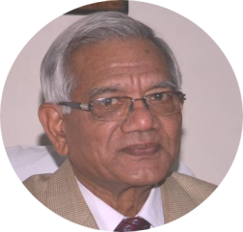
Promoters
Sh. Arvind Kumar Goel
Vice- Chairman
Sh. Adarsh Kumar Agarwal
Secretary
Sh. Y. P. Gupta
Vice-Chairman
Sh. Neeraj Kumar Agarwal
Treasurer
Sh. Anil Kumar Agarwal
Trustee
Sh. Pradeep Jain
Trustee
Sh. Sudhir Gupta
Chairman

Slide 4
Board of Governors
Name | Designation | Status
Sh. Sudhir Gupta | Chairman | Nominated by Registered Trust
Other Trust Members | Trustee | Nominee of Registered Society /Trust
Dr. S.K. Agarwal | Industrialist | Industrialist / Educationist
Prof. S.K. Awasthi | Professor | Nominee of the Affiliating University
Dr. R.K. Baslas | Ex. Director Higher Education U.P. | Nominee of the State Government-Director of Technical Education
Prof. (Dr.) S. P. Gupta | Educationist | Industrialist / Educationist
Prof. (Dr.) Rohit Garg | Director | Principal/Director of the concerned technical institution
Dr. Munish Chabhra | Professor & Head, ME | Faculty member to be nominated from the regular staff
Mr. Vikas Kumar | Associate Professor, CSE | Faculty member to be nominated from the regular staff

Slide 5


Vision & Mission
To develop industry ready professionals with values and ethics for
global needs.
To impart education through outcome based pedagogic principles.
To provide conducive environment for personality development, training and entrepreneurial skills.
To induct high professional ethics and accountability towards society in students.

Slide 6
Dissemination of Vision, Mission
Institute website (www.mitmoradabad.edu.in)
First Year Induction Program
Display Boards: Department Main Corridors, Class Rooms, , Library, Mess, Cafeteria
Interaction Meetings
Brochure

Slide 7
Constituent Institutions of Trust
Institution Code | Institution Name | Year
082 | Moradabad Institute of Technology | 1996
598 | MET Faculty of Pharmacy | 2009
631 | MET College of Architecture | 2009
702 | MIT College of Management | 2010
046 | MIT College of Pharmacy | 2019

Slide 8


About MIT
APPROVALS AND AFFILIATIONS
TOTAL LAND AREA – 13.012 Acres consisting of four academic blocks and other buildings
Institute has been accredited by NAAC with B++ (3.00 CGPA) grade in 2021.
Moradabad Institute of Technology (MIT), is one among the first batch of three self financing institutions in U.P. established in 1996.
CS, ME and EC branches have been accredited thrice by NBA. Last accreditation was done in 2013 for a period of two years from
2013-2015.
All India Council for Technical Education (AICTE)
New Delhi
Dr. A.P.J. Abdul Kalam Technical University, Uttar Pradesh

Slide 9
Current AICTE approved intake for B. Tech Courses
B.TECH. | INTAKE
Computer Science & Engineering | 180
Electronics & Communication Engineering | 60
Mechanical Engineering | 60
Computer Science & Engg. (AI & ML) | 30
Civil Engineering | 30
Electrical Engineering | 30
Total Intake | 390

Slide 10
Organization Chart
BOARD OF GOVERNORS
DIRECTOR
DEAN OF STUDENT WELFARE
Controller of Examination
REGISTRAR
DEAN ACADEMICS
Center Superintendent
Departmental HOD’s
CHIEF WARDEN
CHIEF PROCTOR
SOCIETY INCHARGE
O.S. ACADEMICS
FACULTY & STAFF
WARDEN BOYS
PROCTOR
CULTURAL
WARDEN GIRLS
SPORTS
Staff
MESS WARDEN
LITERARY
ACCOUNTS OFFICER
OFFICE INCHARGE
STORE INCHARGE
ASSISTANT REGISTRAR
HOBBIES
Staff

Slide 11
Institute Achievements...(1/2)
1 | Thirteen Entrepreneurship Awareness Camp (EAC) were organized by ED Cell, sponsored by various agencies like NISBUD, EDII etc. under the scheme of DST-NIMAT.
2 | Institute is recognized as Local Chapter for NPTEL since 2018 and Nodal Centre for Value Education Cell since 2017 AKTU Lucknow.
3 | NSS Unit of MIT, Moradabad is working since November 2004 and was appreciated on 2nd October,2019 for adopting six nearby villages and five students suffering from Tuberculosis .
4 | Institute is selected as Evaluation Centre by the university since 2015.
5 | MSME, Govt. of India, has chosen MIT as one of the Business Incubator Center and sanctioned a grant of Rs. 6 Lakhs per project.
6 | MIT has been awarded with an Outstanding Institution Award by Rotary Club-East on 15th August 2021

Slide 12
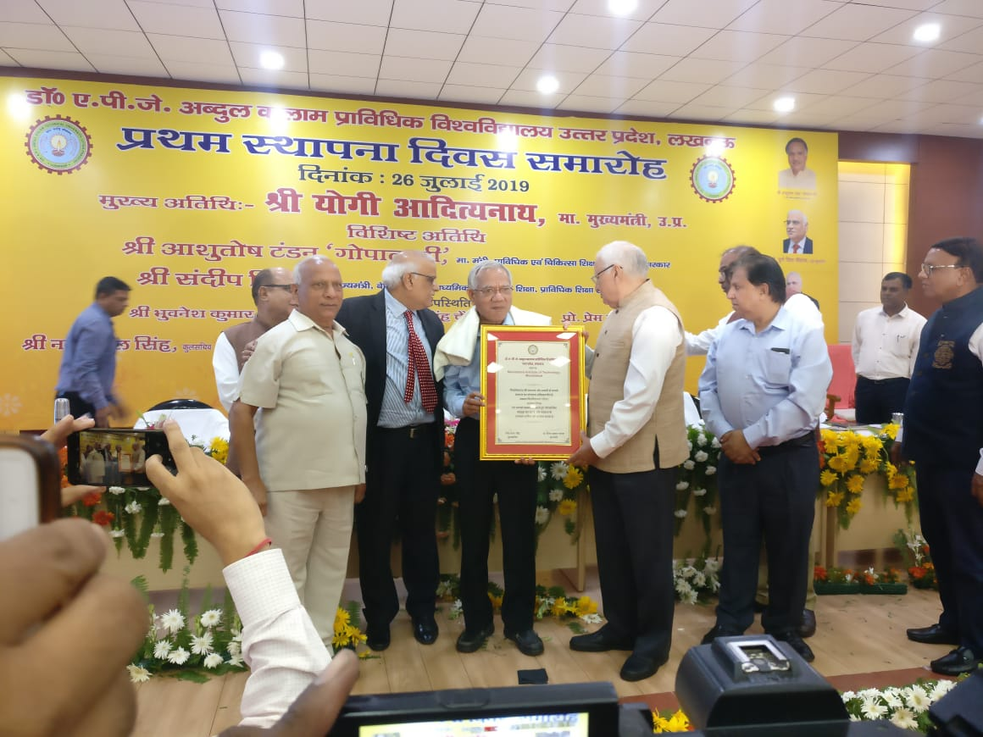
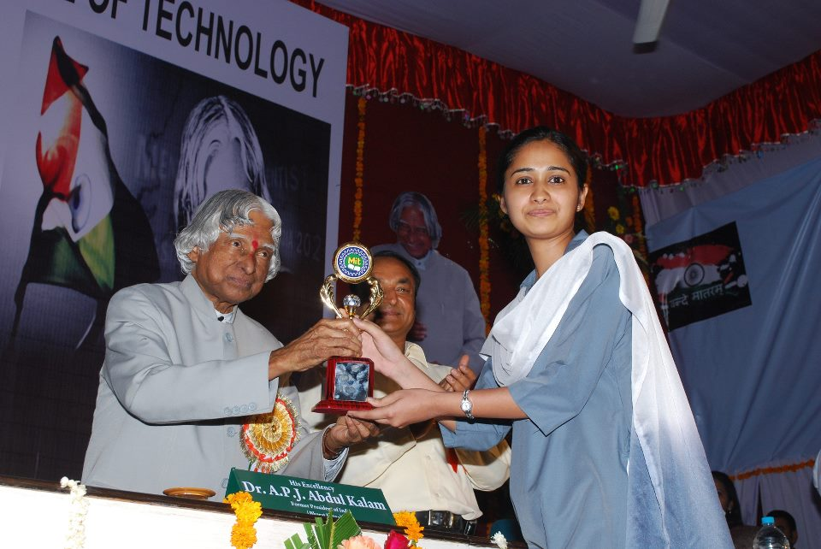
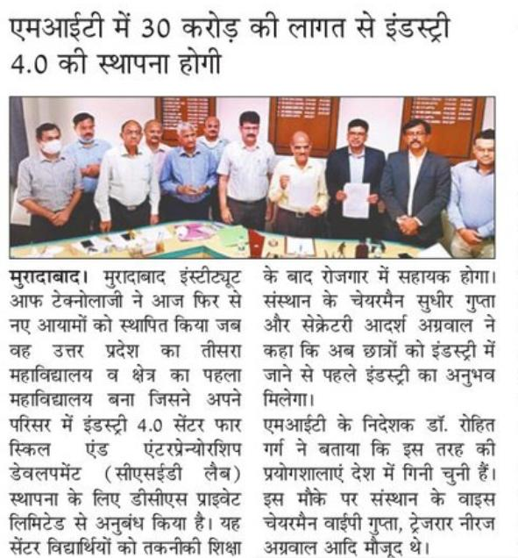
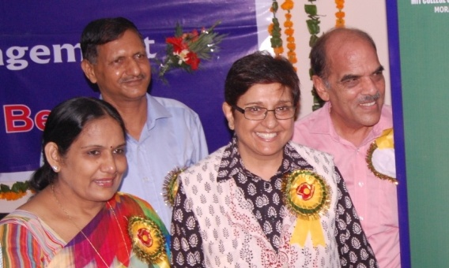
Institute Achievements…(2/2)
7 | Visit of eminent personalities in institute campus like His Excellency Dr. A P J Abdul Kalam, Dr. Kiran Bedi, Dr. Harsh Vardhan(Union Minister), Prof. Vinay Pathak (Vice Chancellor, AKTU Lucknow), Dr. Mangu Singh,(Director, DMRC).
8 | Institute was awarded on AKTU FOUNDATION DAY, 26th July, 2019 for its excellent contribution and support for making AKTU a renowned university.
9 | Institute is developing center for skill and entrepreneurship development in association with DCS with total project cost of Rs. 30 Crores.

Slide 13
Faculty Achievements…(1/4)
1 | 25 patents have been filed by the faculty members of different departments.
2 | Dr. Amit Saxena & Dr. Kshitij Shinghal of EC dept. were awarded by Viklang Seva Samiti, Moradabad for developing a project for handicapped people in session 2016-2017.
3 | AKTU has sanctioned Rs. 4,80,000/- to Dr. Nitin Agarwal of ME dept. as Principal investigator for his project., entitled “To improve the efficiency of a solar photovoltaic using metallic fins filled with Phase change material” under the Visvesvaraya Research Promotion Scheme for session 2017-18.
4 | Dr. Kshitij Shinghal and Dr. Amit Saxena of EC dept. were awarded with certificate of appreciation by DST and Texas Instruments in event IICDC 2018 for fostering an ecosystem bridging government, industry and academia in 2018.
5 | Dr. Manish Gupta and Mr. Mohd. Ilyas of CS dept, Mr. Manas Singhal of EC dept. and Mr. Deepak Singh of ME dept. got Class A category award in Task based Training (TBT) - 2019 and got the 1st prize in TBT challenge -2019 organized by e-Yantra, IIT Bombay.
6 | Dr. Somesh Kumar of CS dept. received a grant of Rs. 3 lakhs each under “Collaborative Research and Innovation Program funding through TEQUIP-III of AKTU” on 24th July 2019.

Slide 14
Faculty Achievements…(2/4)
7 | Dr. Lal Pratap Verma of CS dept. received a grant of Rs. 3 lakhs each under “Collaborative Research and Innovation Program funding through TEQUIP-III of AKTU” on 24th July 2019.
8 | Dr. Kshitij Shinghal and Dr. Amit Saxena of EC dept. were awarded with certificate of appreciation from DST, AICTE and IIM Bangalore and nominated as a member of prestigious “Confederation of Elite Academicians of IICDC” in 2019.
9 | Dr. Parul Gupta of ME dept. has been awarded from Dr. APJ AKTU Lucknow on the Foundation Day of the University on 26th July 2019 for his contributions to the Technical Education for 20 years in MIT Moradabad.
10 | Dr. Kshitij Shinghal of EC dept. was awarded for his contribution in Research & Academics in university campus on the occasion of Teacher’s Day by Honourable Vice Chancellor on 26th July, 2019.
11 | Dr. Parul Gupta of ME dept. has been awarded for excellence in Young Researcher in Mechanical Engineering during 3rd Global outreach research summit on 31th July 2019 at Bangalore.

Slide 15
Faculty Achievements…(3/4)
12 | Dr. Munish Chhabra of ME dept. has been awarded with an Excellence Award for the Year 2020 on 05th September 2020 for his outstanding contribution in the field of education by Rotary Club Moradabad East.
13 | Dr. Kshitij Shinghal of EC dept. and Dr. Somesh Kumar of CS dept. was awarded with certificate of appreciation from CEO/Nagar Ayukt, Moradabad Smart City Ltd., Moradabad on 17th August ,2020.
14 | Mr. Sanjeev Gupta and Ms. Priyanka Gupta of CS dept. published a book on Machine Learning on 23rd Nov. 2020 and Dr. Neelaksh Sheel of CS dept. has written one Book chapter in EAI/Springer Innovation in Communication and Computing(EAISICC)
15 | Total number of Papers published in various reputed Journal and conference by faculty is 306 during last 5 years.
16 | Dr. Rohit Garg, Director MIT and Mohd. Talha Khan of ME dept. are nominated as Member of Board of studies, Dr. APJ AKTU Lucknow with effect from session 2020-21 till date.

Slide 16
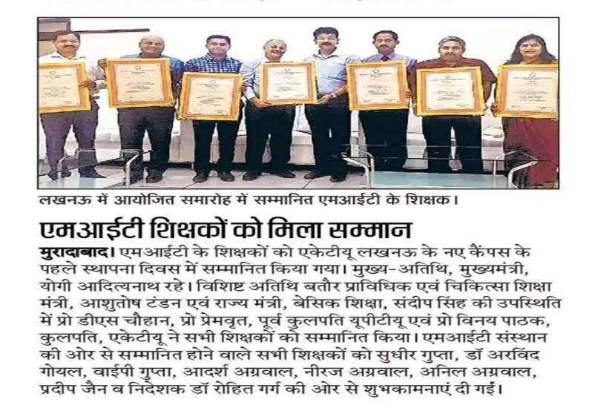
Faculty Achievements…(4/4)
17 | Three Consultancy projects undertaken by Mohd. Talha Khan of ME dept.
18 | Mr. Pavnender Kumar of ME dept. is nominated as Resource Person for conduction workshops on Universal Human Values at National level by AICTE .
19 | Dr. Kshitij Shinghal of EC dept. has published ten books for different core subjects of U.G. students.
Institute has very good retention and for that Seven Senior Faculty members were awarded by the university to provide their constant support and guidance to the MIT for more than twenty years on 05 September,2019.

Slide 17
Student Achievements…(1/2)
Sharad Chandra Singh, ME Department received a financial grant of Rs. 10,000/- from Council of Science & Technology, UP Engineering Students Project Grant Scheme 2017-18 for his project.
Ms. Priya Agarwal of B.Tech of EE Branch has secured 2nd Position in University Merit List (2018 passout).
Manish Bhardwaj, Deepika, Abhishek Arya, students of EC participated in Council of Science & Technology, UP Engineering Students Project Grant Scheme & won third prize of Rs. 50,000 /- on 6 May 2018.
Yash Khanna, Tanuj Tandon & Utkarsh Gupta, EC Department, received a grant of Rs. 12,000 /- on 4 May 2018 from Innovation Gallery at Dr. APJ Abdul Kalam Technical University, Lucknow for their project.
Two teams of CS dept. won 1st prize in Smart India Hackathon in 2020 and two teams of EC dept. won 2nd and 3rd prize in 2018.
One team of CS dept. won 1st prize in Ideathon held by CMR Engineering College, Hyderabad, Telangana in 2020.
Ubaid Ur Rehman, ME Department received a financial grant of Rs 20,000/- from Council of Science & Technology, UP Engineering Students Project Grant Scheme in session 2019-20 for his project.

Slide 18
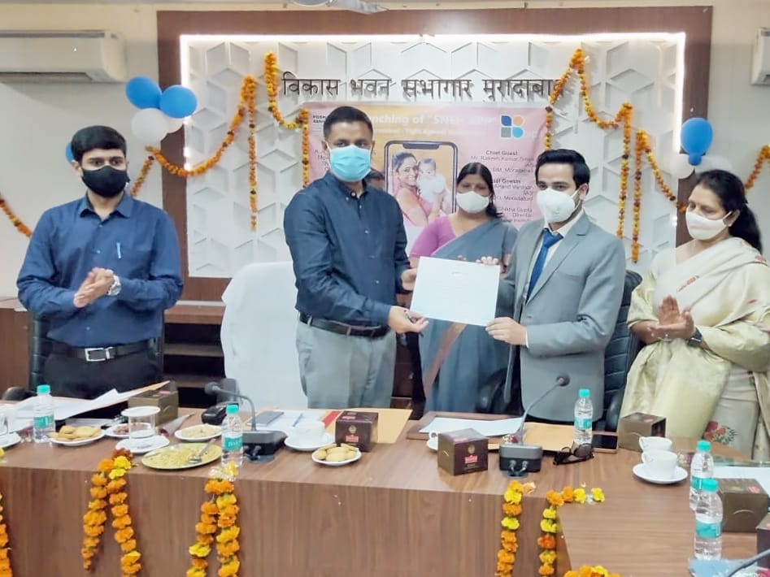
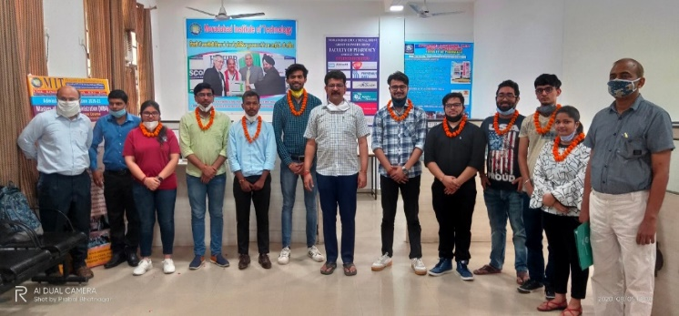
Student Achievements…(2/2)
Yashika Agarwal, student of EC, 2020 batch has published a book of poetry titled “Happily Sad: A Project Resurrection” on 15 Aug 2020 and it ranked upto No.1 Best-Seller-Rank in poetry category(free) on amazon.in on 21 Aug 2020.
Mr. Surya Pratap, student of CS Department received appreciation award from Sri Rakesh K Singh, DM Moradabad for the launch of his startup app “Sneh” on 5 March,2021 for serving malnourished children.
Nuzaif Khan, ME Department received a financial grant of Rs 11,000 /- from AKTU, Lucknow on 20 May 2020, financial grant of Rs. 6000/- from PSIT Kanpur and grant of Rs. 5000/-from KIET Ghaziabad for his project.
Shahbaz khan, student of EC got Appreciation Award in Innovations for Prevention and Protection from COVID-19 Pandemic, organized by AKTU on 20 May 2020 and received a grant of Rs. 16,000 /-.

Slide 19
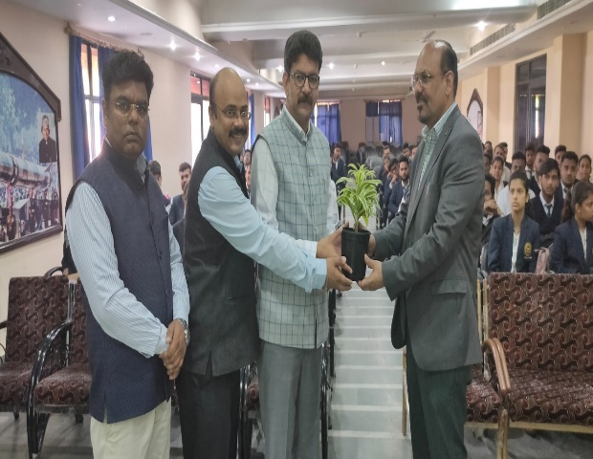
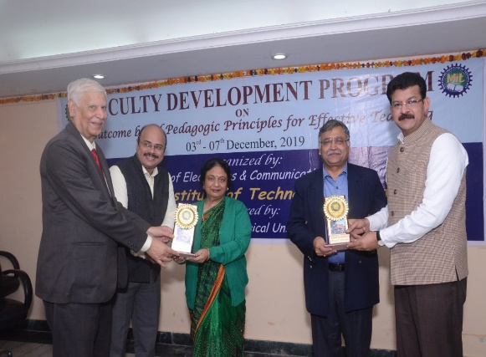
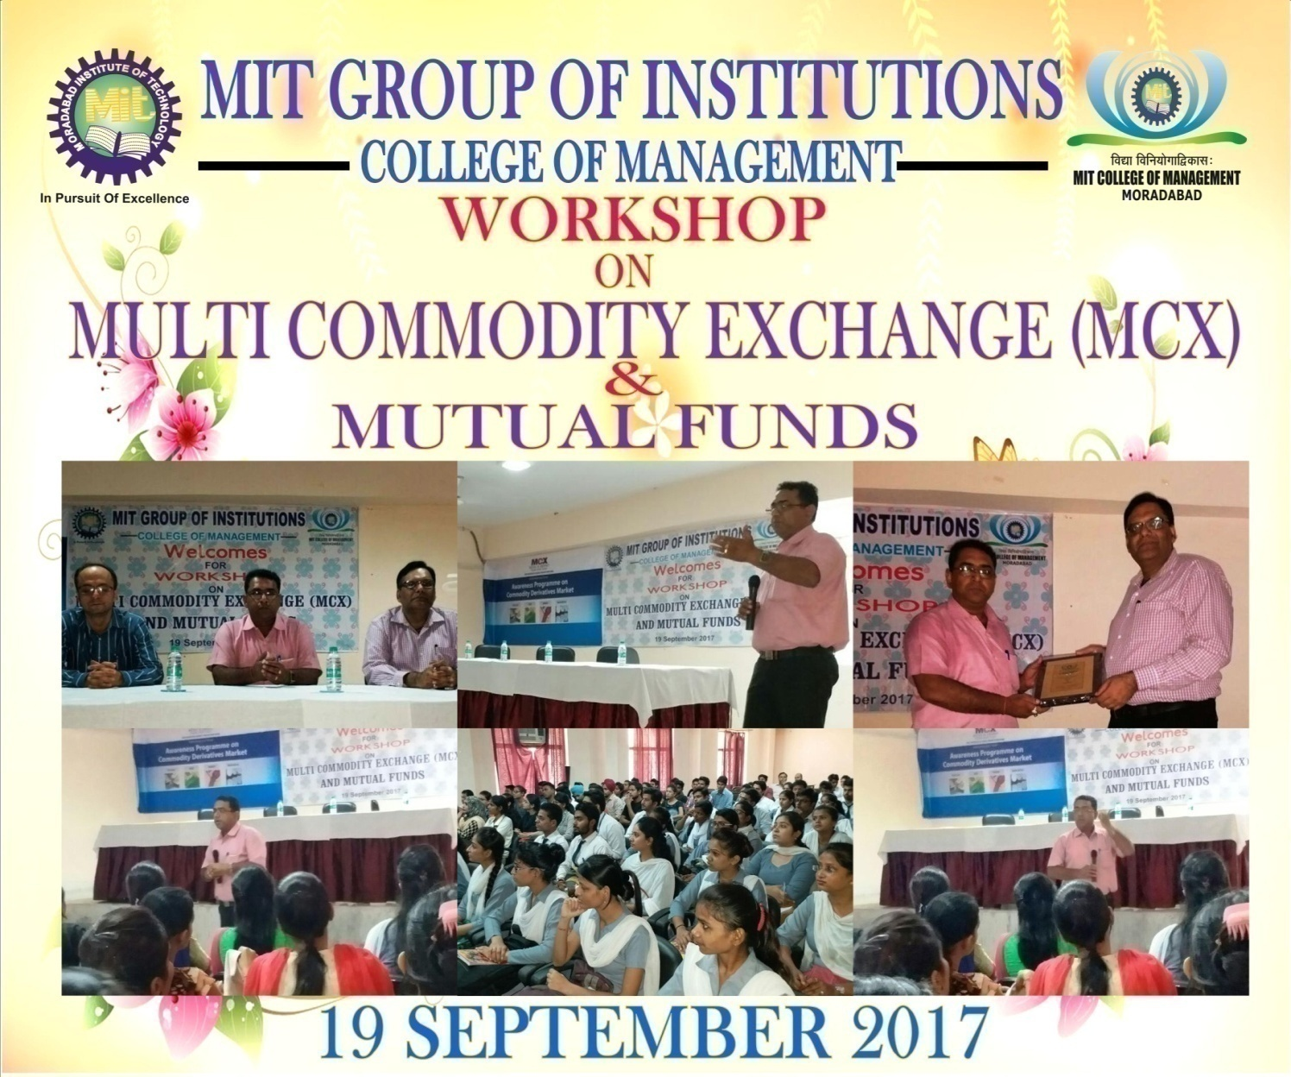
Faculty Centric Policies…(1/2)
Grant of various Leaves like Paid Maternity leave, Medical leave and Study Leave, Winter Break, Summer Break, EL,CL etc.
Grant of leaves and financial assistance attending Conferences, Seminars, FDPs, Trainings and Workshops.
Frequent Expert Lectures from industry and academia on latest technical topics.
Organization of National and International Conferences.

Slide 20
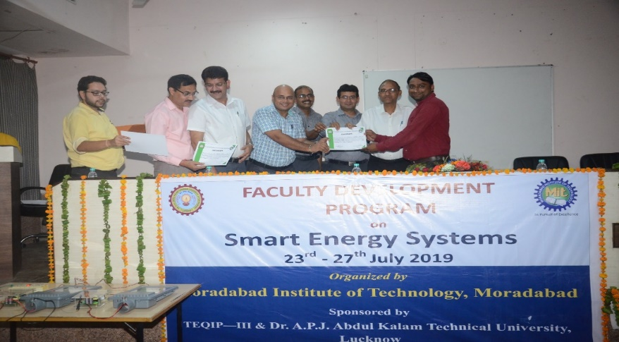
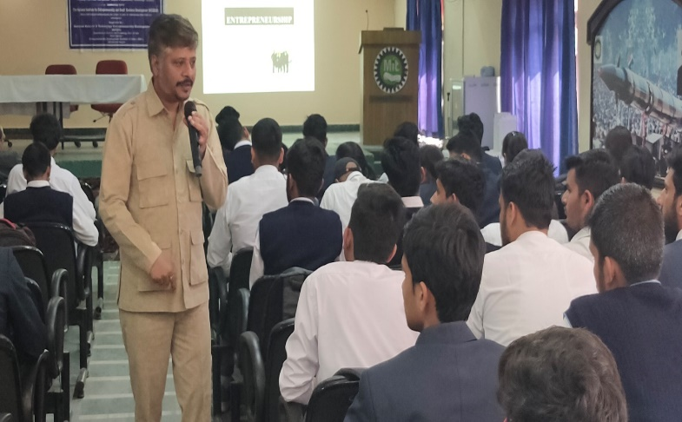
Faculty Centric Policies…(2/2)
Full financial assistance for filing patents.
Incentives for quality publication and research work in reputed journals.
Insurance of all the Faculty and Staff members.
Provision for Gratuity as per norms.
Medical Facility to all Faculty and Staff members.

Slide 21
Student Centric Policies
Facility of Book bank. Group Insurance Policy.
Toppers are awarded with Director’s and Chairman’s Gold Medal.
Financial assistance is given to students for participation in curricular and extra curricular activities.
Organization of Industrial visits.
Full time Medical facility in the campus.
Scholarship scheme for economically weaker and meritorious students.
Honour to the Meritorious students who will secure among first ten positions in the university in each year.

Slide 22
Quality Assurance Initiative
NAAC Accredited Institute with B++ grade (3.00 CGPA), however institute has appealed for upgradation of the grade.
IQAC Cell monitors all academic and administrative activities of the institute.
Continuous Student Feedback are conducted on teaching-learning process, infrastructure and other amenities.
Well defined process of Academic Audit to evaluate the performance of different departments.
Mentor guide the students regularly to improve their academic and overall performance.

Slide 23
Curriculum…(1/2)
(As per Dr. A.P.J. Abdul Kalam Technical University, Lucknow )
Choice Based Credit System (effective from 2016-17) provides a choice based system in which the students can take courses of their choice, learn at their own pace, undergo additional courses and acquire more than the required credits, and adopt an interdisciplinary approach to learning.
The curriculum also includes subjects for sensitizing students towards environment and sustainability and developing human values and professional ethics.

Slide 24
Curriculum Designed by AKTU University
Curriculum…(2/2)
(Process to Identify
Curriculum Gap)
Design Concept Map for the Course
Design Course Outcomes for the Course
Find Correlation of Course Outcomes With PO/PSO
PO/PSO
Analysis of Correlation
Course Coordinator Feedback
Exit Survey
Identification of Curriculum Gaps
Academician from other Universities/Colleges
Alumni Feedback
External Gaps
Internal Gaps
Industry Feedback
Add on Courses ( Bridge the gaps by sending recommendation of inclusion of new course in Curriculum to AKTU University)
Bridge the Gaps by
1. Addition of new Contents
(Contents beyond syllabus)
2. Guest Lectures
3. Workshops / Training
4. Industrial Visits
5. NPTEL Videos

Slide 25
Teaching – Learning Process (Implementation Details)…(1/2)
1 | Academic calendar is prepared according to university academic calendar in each semester by the Dean Academics of the Institute.
2 | Subject choice is taken from each faculty member of department.
3 | Subject allotment is done on the basis of experience and expertise of an individual decided by the Head of the Department on the basis of choices given by the faculty.
4 | Timetable Coordinator of individual department prepares the class-wise and faculty-wise timetable as per the university guidelines for the number of credit hours for each subject prior to the commencement of the semester.
5 | Lecture Plan and Course file are prepared.
6 | Modern teaching aids such as Smart Boards(07), Multimedia Video room(01), Smart Lecture rooms(11) and Wi-Fi & Excellent Internet facility in campus are used for effective course delivery.
7 | Identification of slow learner students is done on the basis of their performance in class test 1. The students generally securing less than 40% marks and on the basis of report received from their mentors, they are considered as slow learners.

Slide 26
Teaching – Learning Process (Implementation Details)…(2/2)
8 | Students attendance and their performance in Class Tests is monitored regularly.
9 | To improve the performance of weak students remedial classes are conducted.
10 | Feedback from students on all subjects are regularly taken and analyzed.
11 | Parents are informed about the performance and attendance of their ward at regular interval by the department.
12 | Regular monitoring of course coverage and student attendance is done.
13 | Personality Development Classes are organized for students to strengthen their overall personality.
14 | MOOCs platform such as NPTEL, Spoken tutorials and Coursera are used to enhance their technical knowledge.
15 | Expert lectures by personnel from academic institutions, research organizations and industries are regularly held.
16 | Lab experiments are conducted in accordance with the university curriculum and also beyond the curriculum.
17 | Fully functional Mentor- Mentee system in which one Mentor is appointed for every 15-20 students who is responsible for their academic and overall performance.

Slide 27
Infrastructure
Facilities | Count
Class Rooms | 44
Smart Classrooms | 18
Laboratories | 40
Conference room/Seminar hall | 03
Auditorium | 01
Multimedia Room | 01
Computer Center | 01
Workshop | 01
Central Library | 01

Slide 28
Faculty Information
Department | Total | Total | Total | Total
 | 2019-2020 | 2018-2019 | 2017-2018 | 2016-2017
AS&H | 21 | 26 | 26 | 45
CS&E | 28 | 29 | 30 | 40
ECE | 17 | 27 | 27 | 45
EE | 13 | 18 | 26 | 30
ME | 20 | 21 | 27 | 42
CE | 12 | 17 | 19 | 22
Total | 114 | 141 | 155 | 224

Slide 29
Faculty Contribution in Research…(1/2)
Academic Year | SCI | SCOPUS | Conference | Other UGC Approved Journals | Total
2016 - 17 | 8 | 6 | 17 | 13 | 44
2017 - 18 | 4 | 6 | 38 | 28 | 76
2018 - 19 | 4 | 22 | 21 | 10 | 57
2019 - 20 | 13 | 19 | 37 | 33 | 102

Slide 30
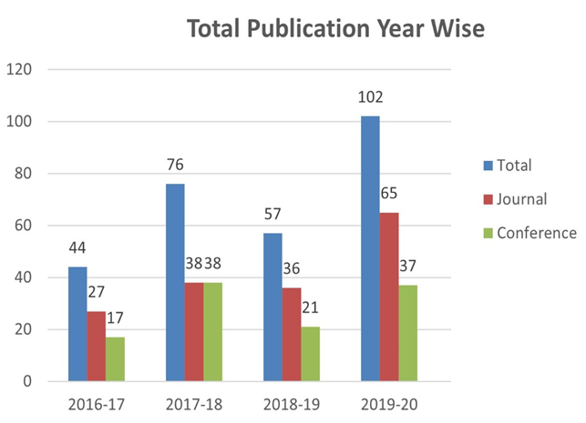
Faculty Contribution in Research…(1/2)

Slide 31
MoU/Tie-Ups with Industries…(1/2)
S.No. | Name of the Company /Industry | Address | Activity
1 | Prutor.ai | IIT Kanpur, Kalyanpur, Kanpur | Online Training Courses
2 | Coursera for Campus | California, United States | Training Courses
3 | Microsoft VL Agreement | DLF Building No. 5, Gurugram, Haryana | Certification Courses
4 | Innovians Technologies | C-56/11, C Block, Phase 2, Industrial Area, Sector 62, Noida, Uttar Pradesh 201301 | IoT Lab Set-up Summer Training
5 | Softcon India Pvt.Ltd. | 705, Pearl Omaxe, Netaji Subhash Place, Pitampura, New Delhi- 110034 | Seminar
6 | Sainik Enterprise | Khushalpur, Moradabad, UP | Placement Expert Talk

Slide 32
MoU/Tie-Ups with Industries…(2/2)
S.No. | Name of the Company /Industry | Address | Activity
7 | Metal Handicrafts Service Centre | Ram Ganga Bridge, Pital Nagri, Moradabad, UP | Project Work Industrial Visit Expert Talk
8 | AKGES Skills Pvt. Ltd. | Delhi-Meerut Expy,Ghaziabad, UP | Industrial Trainings
9 | Excelling Technologies | Deen Dayal Nagar, Moradabad, UP | Training Courses
10 | Dysmech Consultancy Services | 425, Pride Purple Square, Kalewadi Chowk, PUNE, Maharastra | Recently Signed MOU
11 | Tenso | TNS, H-34, Sector-63, Noida | Recently Signed MOU
12 | CodeQuotient Pvt. Ltd. | F429, Phase 8B, Industrial Area Sector 74, SAS Nagar, Punjab | Recently Signed MOU

Slide 33
Student Performance-First Year Academics
Academic Performance | 2016-17 | 2017-18 | 2018-19 | 2019-20
Total no. of Successful Students | 410 | 311 | 250 | 236
Total no. of Students appeared in the Examination | 420 | 314 | 269 | 236
Pass Percentage of Students | 97.6% | 99.04% | 92.93% | 100%
API | 7.09 | 7.15 | 6.14 | 7.05

Slide 34
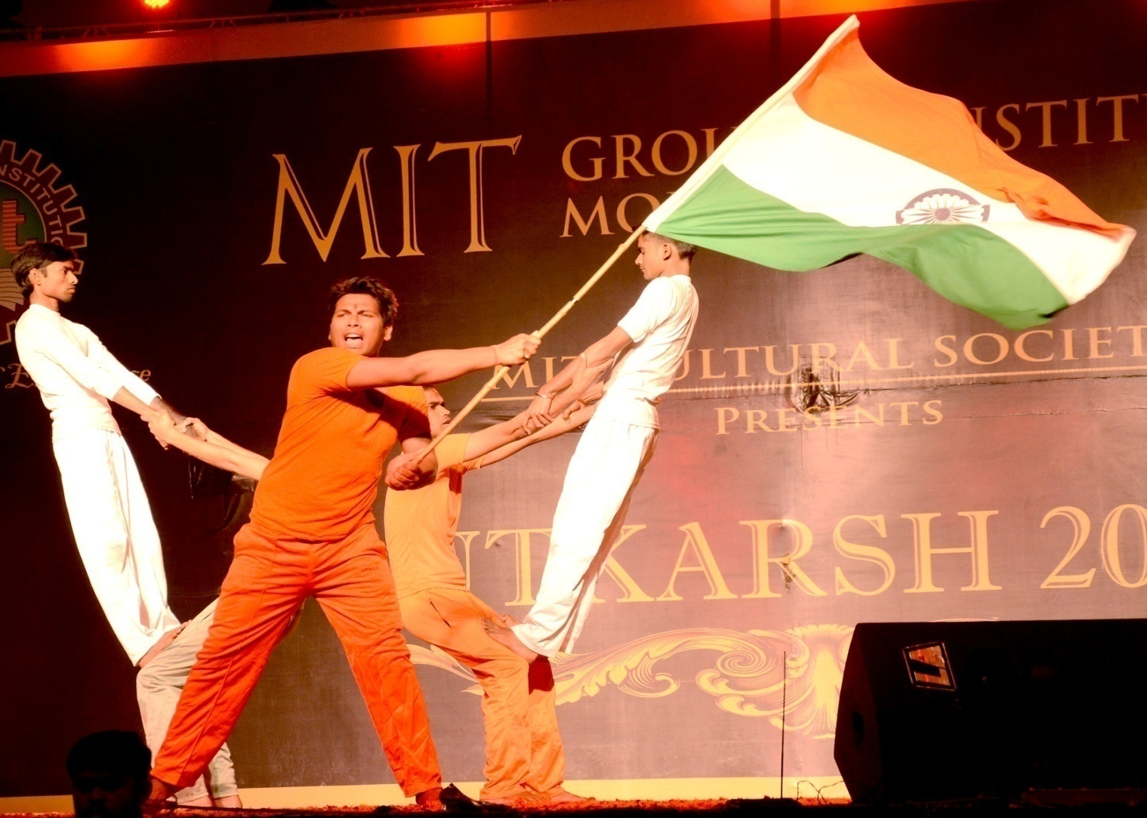
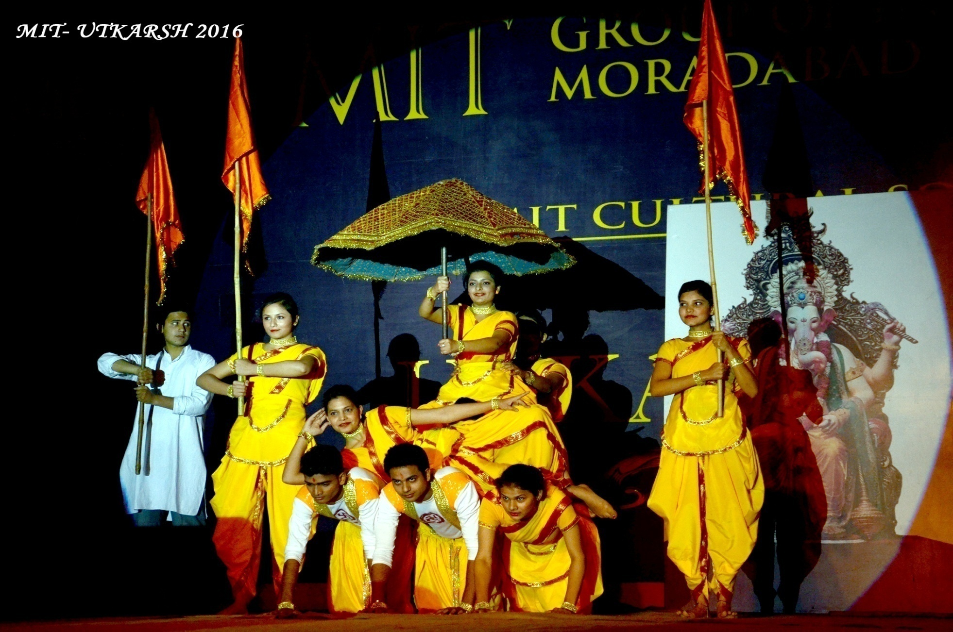
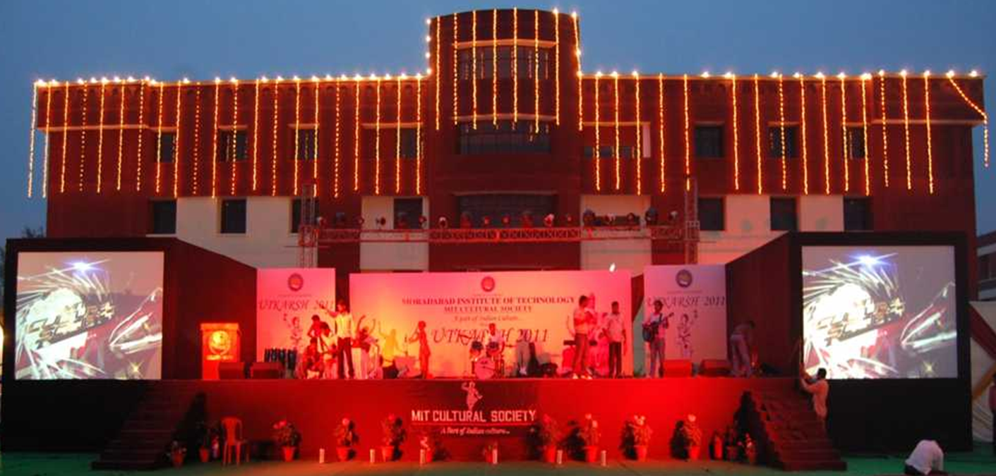
Student Performance-Under Cultural Society
Number of Winners | 2016-17 | 2017-18 | 2018-19 | 2019-20
Zonal Level | 08 | 07 | 10 | 13
State Level | 04 | 01 | - | 03
National Level | - | 01 | 01 | -

Slide 35
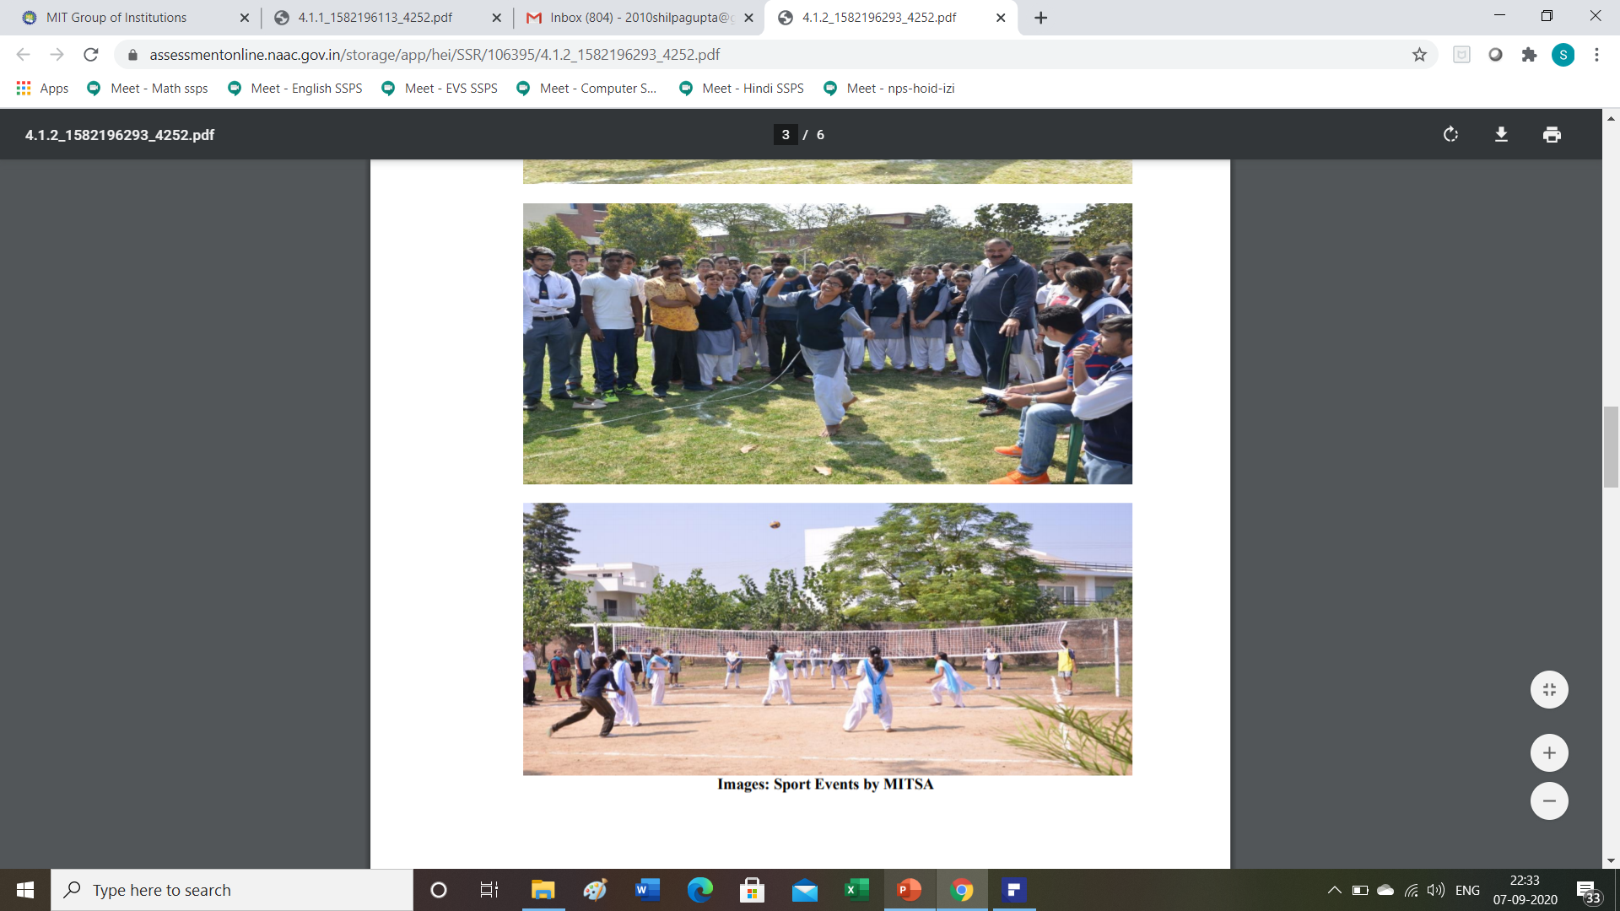
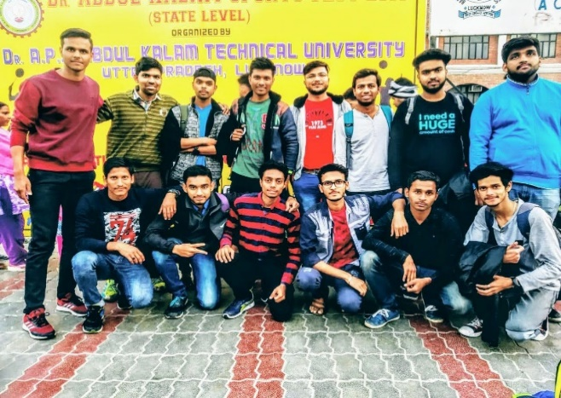
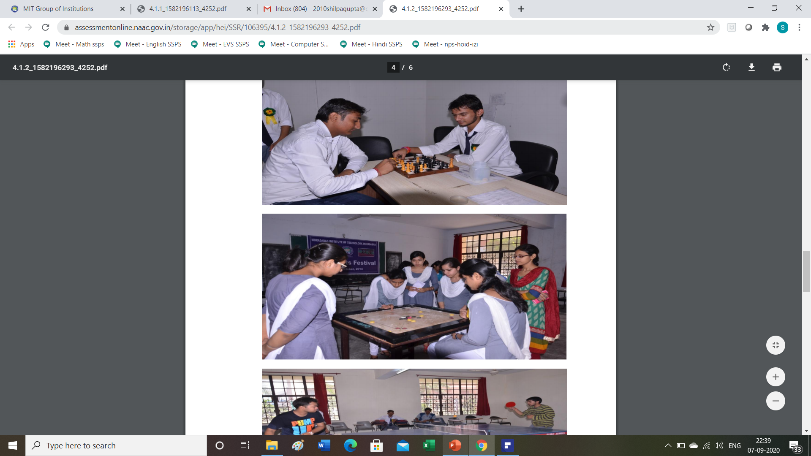
Student Performance-Under MITSA Sports Society
Number of Winners | 2016-17 | 2017-18 | 2018-19 | 2019-20
Zonal Level | 19 | 06 | 14 | 58
State Level | 04 | 11 | 18 | 12
National Level | - | 10 | 22 | -

Slide 36
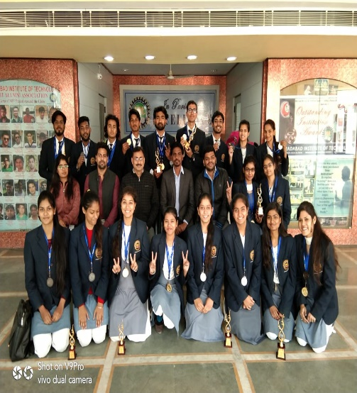
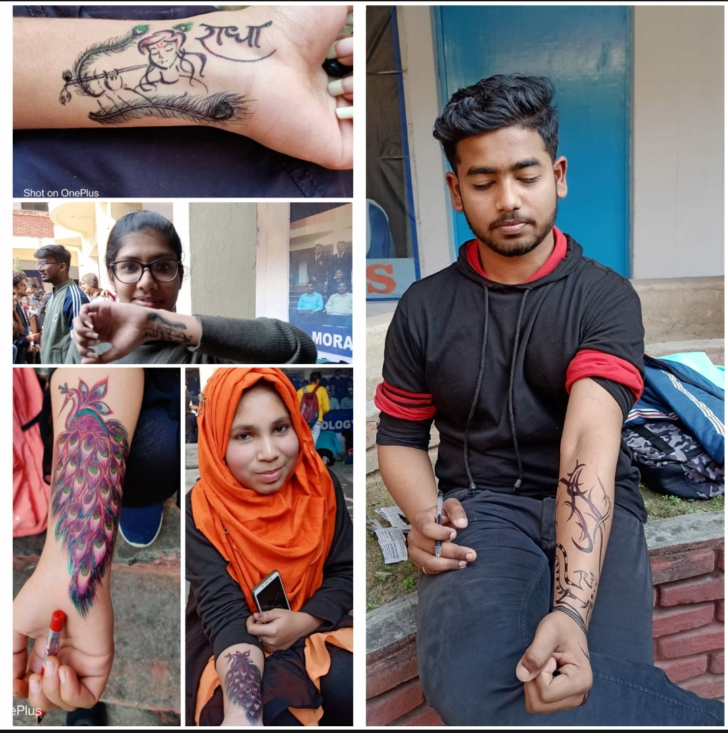
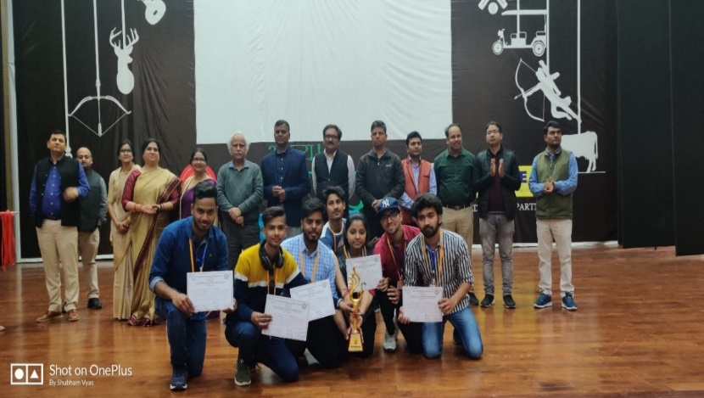
Student Performance-Under Literary Society
Number of Winners | 2016-17 | 2017-18 | 2018-19 | 2019-20
Zonal Level | 05 | 07 | 06 | 09
State Level | 02 | 02 | 03 | 01

Slide 37
















Top Recruiters

Slide 38
Placement at a Glance
2021 Batch:
Total No. of Students Placed- 236
2020 Batch:
Total No. of Students Placed- 271
2019 Batch:
Total No. of Students Placed- 306
2018 Batch:
Total No. of Students Placed- 229
2017 Batch:
Total No. of Students Placed- 379
Details

Slide 39
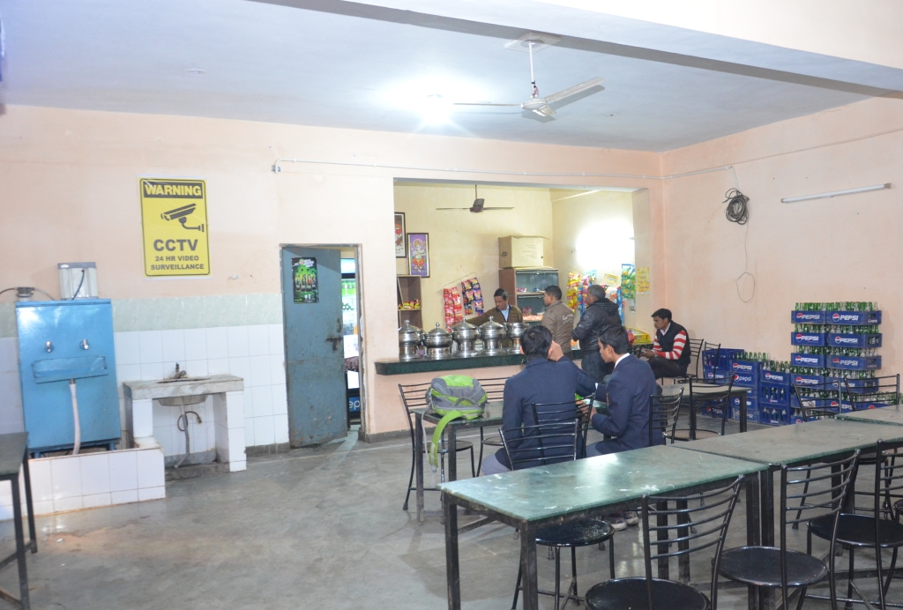
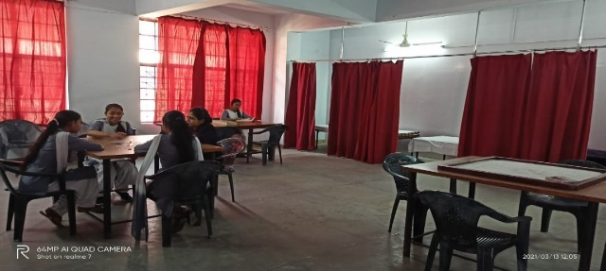
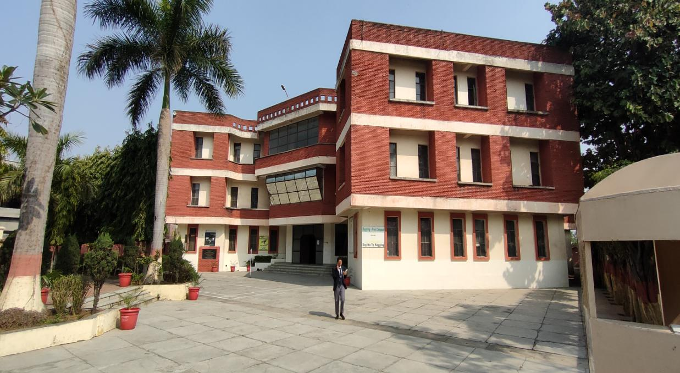
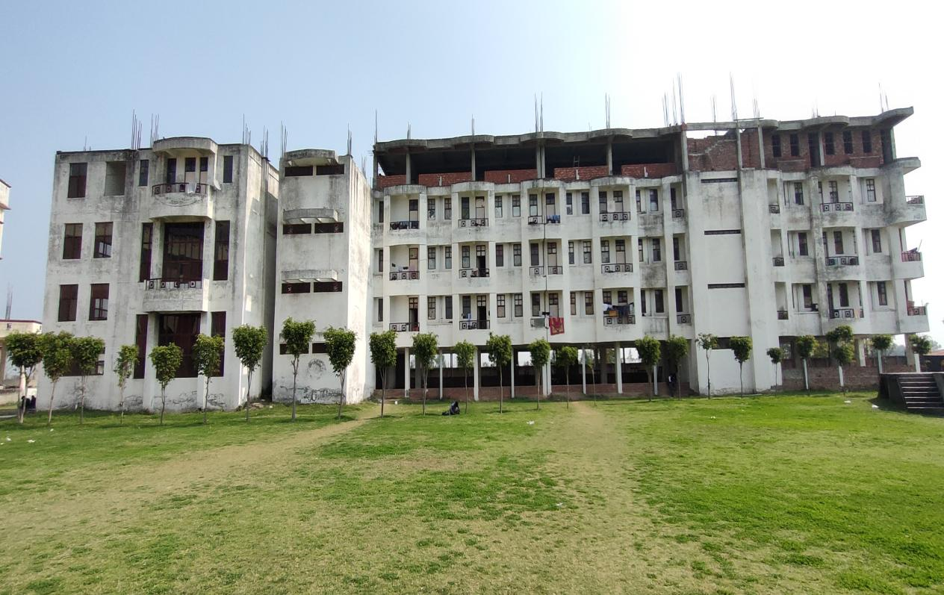
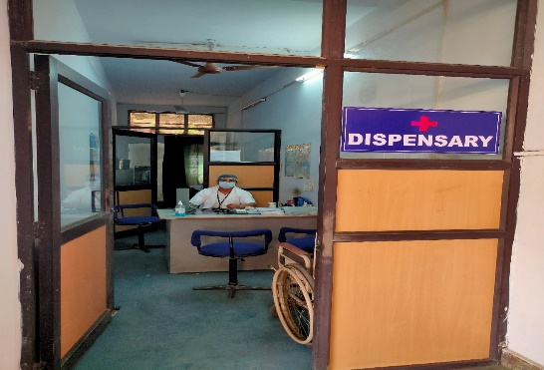
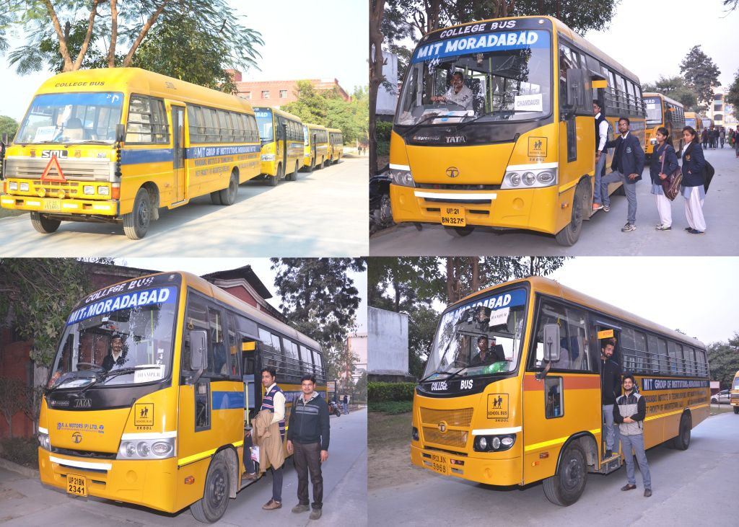
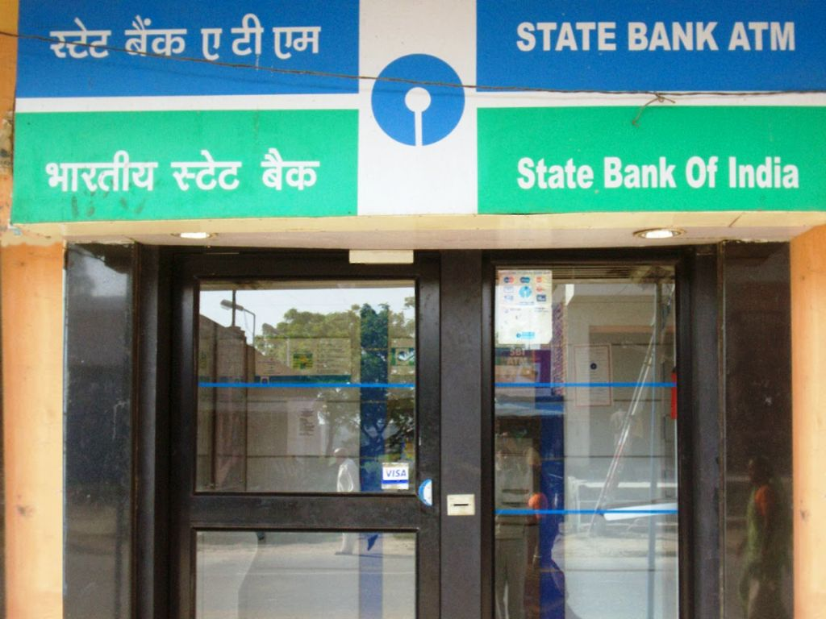
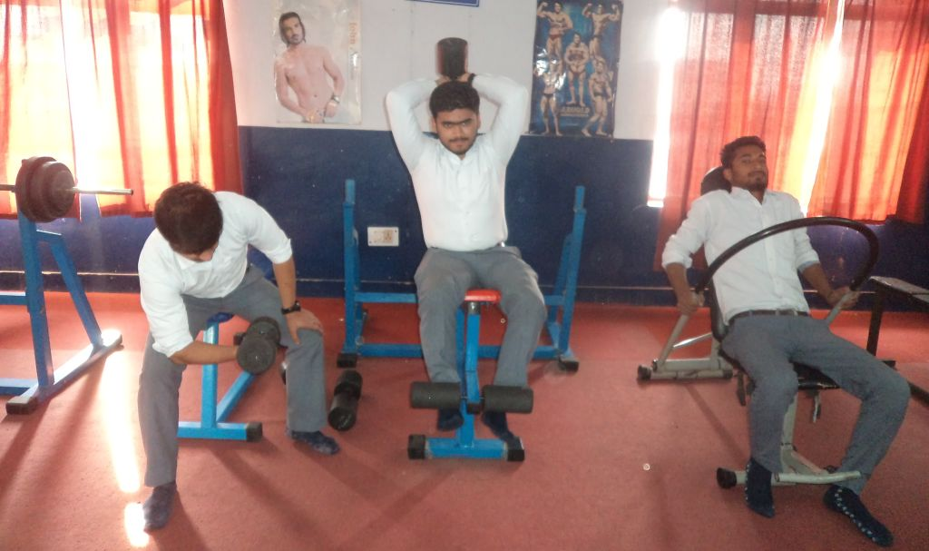
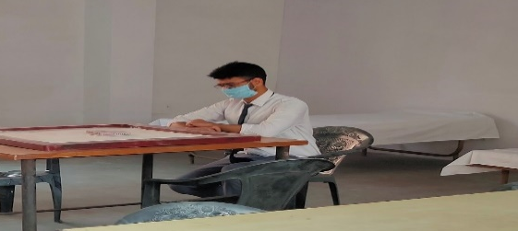
Other Facilities
Cafeteria
Girls Common Room
Girls Hostel
Boys Hostel
Medical Facility
Transport Facility
ATM Facility
Gymnasium
Boys Common Room

Slide 40
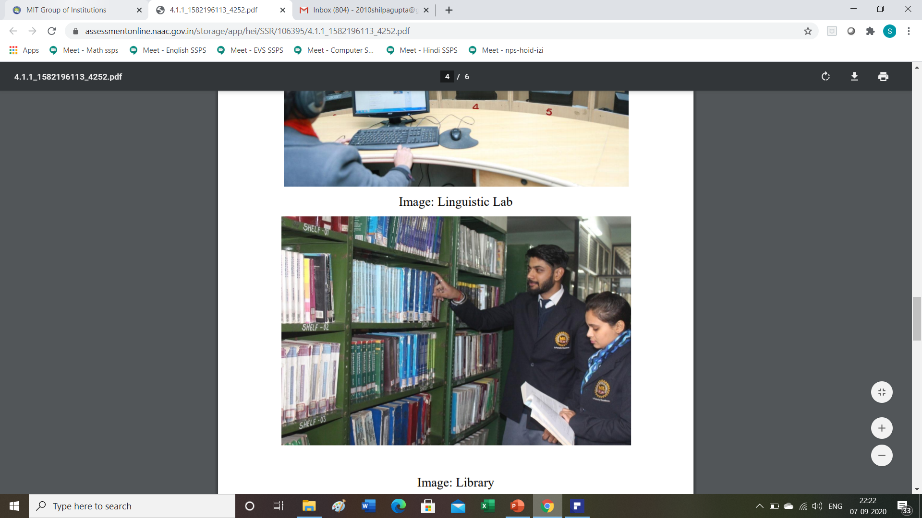
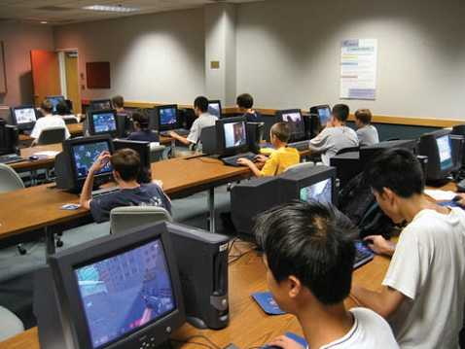
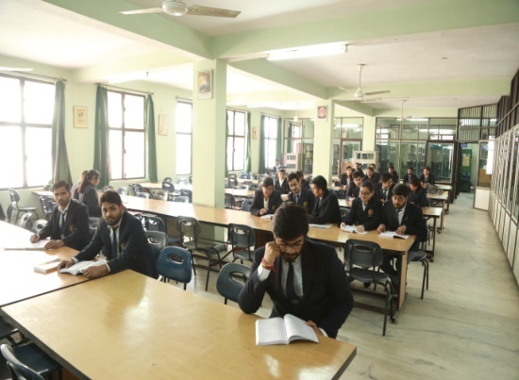
Facilities and Technical Support
Adequate and well equipped laboratories and technical manpower
Additional facilities like Departmental library, LAN/Wi-Fi facility with ILL bandwidth of 300 Mbps and 34 access point are created for improving the quality of learning experience.
Safety measures such as fire extinguisher, water house reels, first-aid box etc. are provided in the labs.

Slide 41
Central Library…(1/2)
Library Details and Facilities | No. Available
Titles | 8216
Volumes | 82861
No. of National Journals | 38
No. of International Journals(E-Journals) | 21338
Total no. of magazines procuring regularly | 22
No. of Newspapers procuring regularly | 8
No. of Multimedia PC’s | 25
Automation Status (Using Library Management software Libsys) | Fully Computerized
Digital Library facilities with multimedia facility | Available
Seating Capacity (Seats in number) | 180

Slide 42
Central Library…(2/2)
S.No. | No. of E-Journals |  | No. of E-Books
1 | Elsevier Science Direct Engineering Collection | 296 | TAYLOR & FRANCIS | 12600
2 | Springer Nature Engineering (5 subject collection) | 739 | Springer Nature | 4248
3 | EMERALD (Management Database) | 212 | Mcgraw-Hill | 159
4 | Taylor Francis (Engineering & Allied Science) | 578 | Pearson | 94
5 | J-Store (Complete Collection) | 3000 | Cambridge Core | 1666
6 | Wiley Online Library | 450 | - | -
 | Total | 5257 | Total | 18767

Slide 43
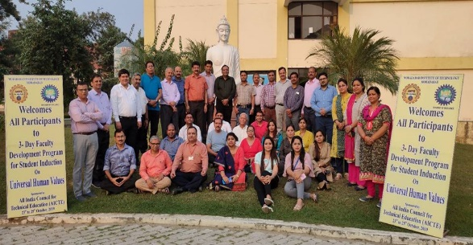
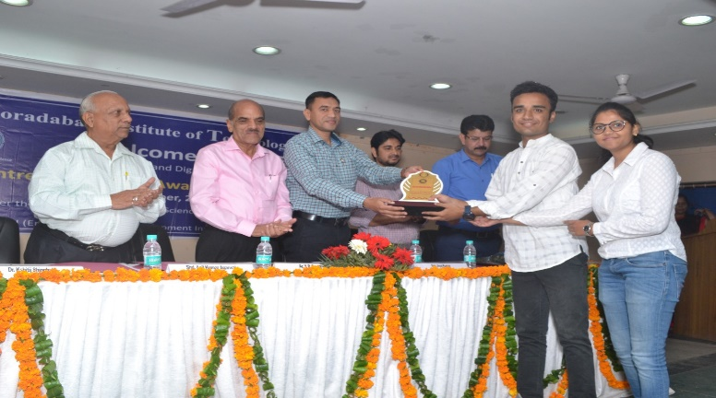
Institutional Support…(1/2)
Various committees/Cells for activities at institute are as follows:
IQAC Cell
Grievance Redressal Cell
Startup Cell
Research and Development Cell
Entrepreneurship and Development Cell
Value Education Cell
Training and Placement Cell

Slide 44
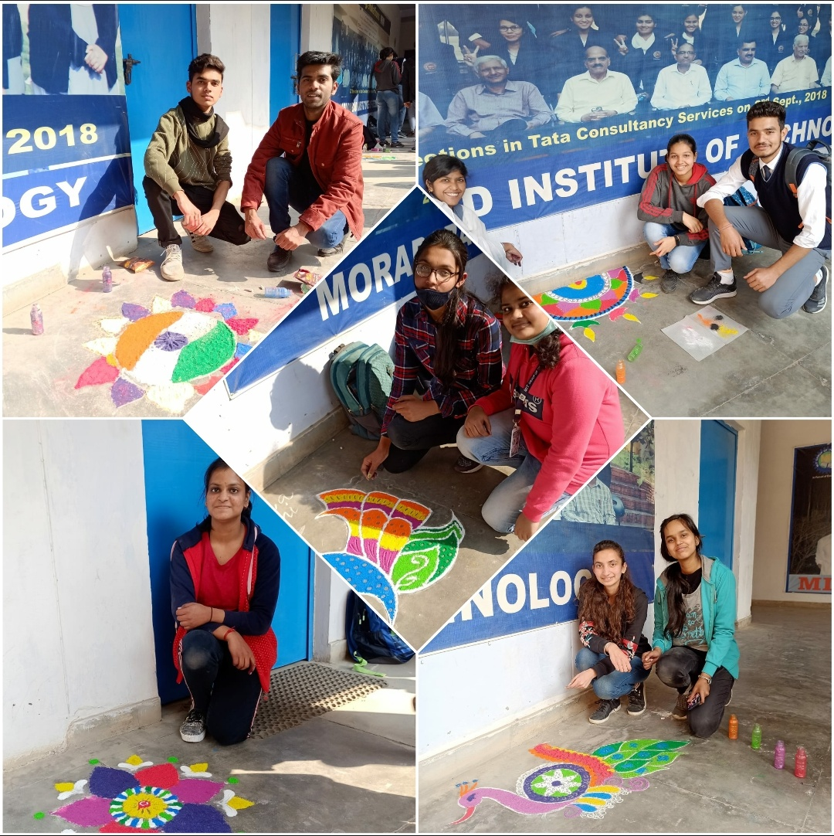
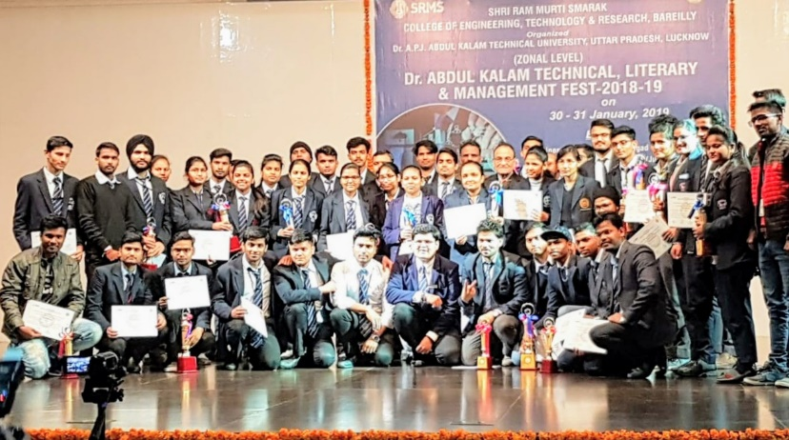
Institutional Support…(2/2)
Internal Complaint Committees
Literary Society
Cultural Society
Sports Committee
Hobbies Club
Student Counselling Cell

Slide 45
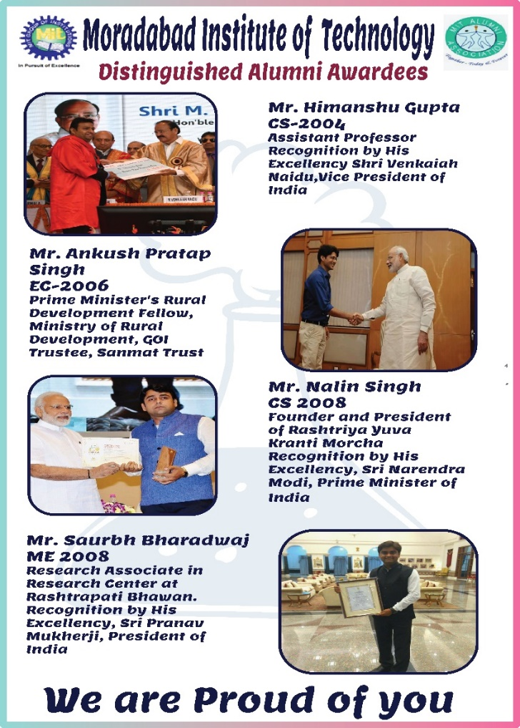
MIT Alumni Association
Established in 2005, MIT Alumni Association creates and maintains a life-long connection between the Institute and its alumni, whose number is more than 9,000.
The Alumni Association works to connect alumni, support students and build an unforgettable Institute experience through a diversity of events like alumni meet, guest lectures, interactive sessions, placement support etc.
The mission of the Association is to foster strong bonds between alumni, students and the Institute.

Slide 46
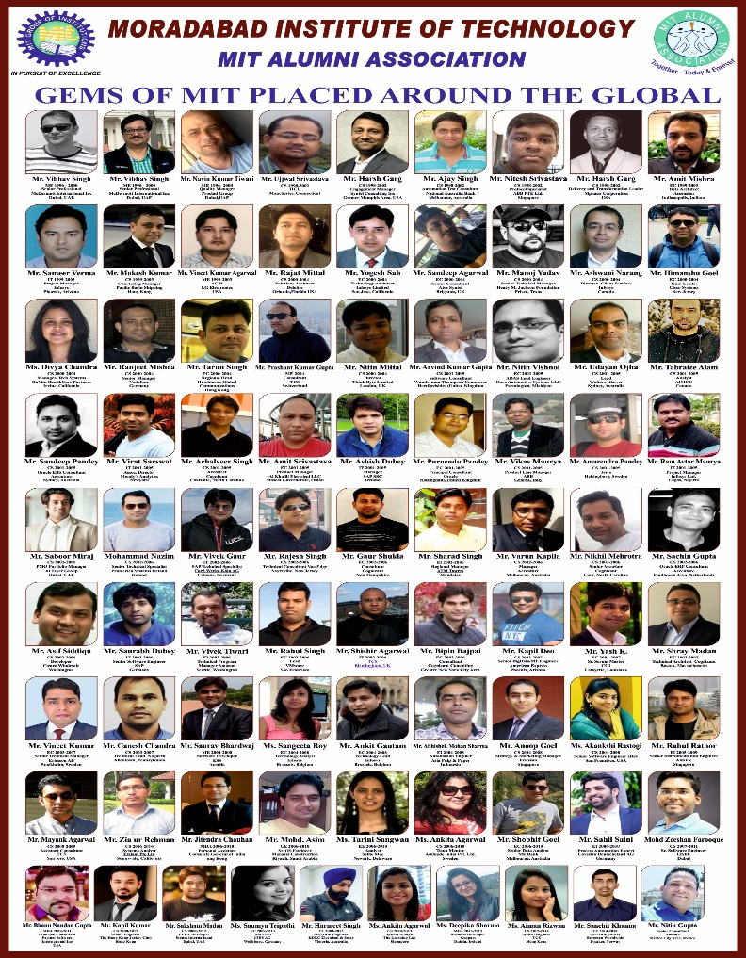
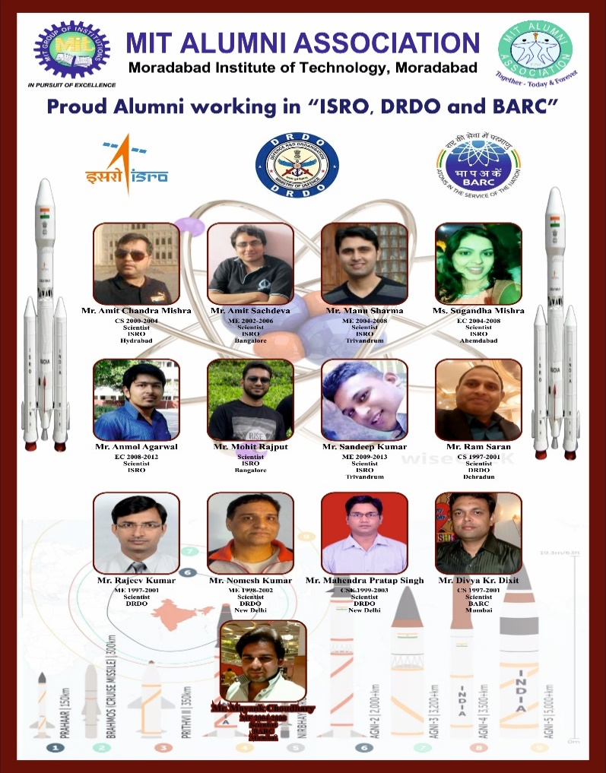
MIT Alumni Association

Slide 47
Budget & Expenditure Details
Items | Budget in 2020-21 | Expense in 2020-21 | Budget in 2019-20 | Expense in 2019-20 | Budget in 2018-19 | Expense in 2018-19 | Budget in 2017-18 | Expense in 2017-18
Infrastructure Built-Up | 15,00,000 | 12,07,287.00 | 30,00,000 | 29,72,619.00 | 100,00,000 | 91,75,032.00 | 5,50,000 | 2,00,740.00
Library | 2,50,000 | 88,990.00 | 5,00,000 | 4,74,060.00 | 3,00,000.00 | 2,35,845.00 | 4,50,000 | 3,42,399.00
Laboratory equipment | 10,00,000 | 9,62,664.00 | 33,10,000 | 30,94,039.00 | 4,00,000.00 | 3,11,133.00 | 2,00,000 | 19,761.00
Laboratory consumable | 3,00,000 | 2,06,889.00 | 5,00,000 | 5,62,257.00 | 3,00,000.00 | 2,10,293.23 | 3,00,000 | 1,59,428.90
Salary | 950,00,000 | 958,05,001.00 | 1000,00,000 | 1039,44,698.00 | 1200,00,000 | 1230,89,632 | 1500,00,000 | 1506,55,287.00
Maintenance and spares | 125,00,000 | 119,62,917.00 | 150,00,000 | 148,20,789.00 | 200,00,000 | 176,96,279.81 | 130,00,000 | 126,46,856.65
R & D | 5,00,000 | 3,72,699.00 | 10,00,000 | 11,17,314.00 | 10,00,000 | 14,23,306.86 | 4,50,000 | 4,23,683.48
Training and Travel | 100,00,000 | 90,92,362.00 | 130,00,000 | 104,23,330.00 | 150,00,000 | 138,70,146.13 | 150,00,000 | 142,48,853.82
Miscellaneous expenses | 10,00,000 | 5,76,226.00 | 10,00,000 | 8,22,851.62 | 10,00,000 | 7,73,508.82 | 8,00,000 | 7,17,061.03
Others | 206,35,000 | 195,40,080.44 | 292,30,000 | 244,43,190.32 | 392,90,000 | 388,34,684.42 | 322,40,000 | 286,85,410.84
Total | 1426,85,000 | 1398,15,115.44 | 1665,40,000 | 1626,75,147.94 | 2072,90,000 | 2056,19,861.27 | 2129,90,000 | 2080,99,481.72

Slide 48


