Slide 1

Jmd jgd jsr ons bjkbmsgmkj ssdnom
MORADABAD INSTITUTE OF TECHNOLOGY
DEPARTMENT OF MECHANICAL ENGINEERING
Welcomes
National Board of Accreditation Team
(17.09.21 – 19.09.21)

Slide 2
DEPARTMENT OF MECHANICAL ENGINEERING
Introduction
Year of Establishment: 1996
Affiliated to Dr. APJ Abdul Kalam Technical University, Lucknow
Present Intake: 60
NBA Accredited: 2004, 2008, 2013
Competent and well qualified faculty members
Skilled technical staff
Well equipped laboratories
Adequate infrastructure (Smart class rooms, Internet facility etc.)
Conducive environment for teaching-learning and overall development of students

Slide 3
Department Achievements
Organised one week FDP on “Advances in Thermal Science & Technology” sponsored by Dr. APJ AKTU Lucknow for session 2016-17.
Organised one week FDP on “Green Tribology” sponsored by Dr. APJ AKTU Lucknow for session 2018-19.
Organised two weeks FDP on “Emerging Trends in Mechanical Engineering Science & Green Energy” sponsored by AICTE for session 2019-20.
Received research project grant of Rs. 4,80,000.00 funded by Dr. AKTU Lucknow under Visvesvaraya Research Promotion Scheme (2017-2018) for 3 years for project titled “To improve the efficiency of a solar photovoltaic using metallic fins filled with Phase change material” (Status- Completed).
Formation of student chapter of Institutions of Mechanical Engineers (ImechE) on 24 Feb 2019.
MOUs with industries and training organisations: 6
Completed AICTE sponsored Research project and three MODROBs

Slide 4
Faculty Achievements
Dr. Munish Chhabra has been awarded with an Excellence Award for the Year 2020 on Teacher’s Day for his outstanding contribution in the field of education by Rotary Club Moradabad East.
Dr. Parul Gupta has been awarded from Dr. APJ AKTU Lucknow on the Foundation Day of the University on 26th July 2019 for his contributions to the Technical Education for 20 years in MIT Moradabad.
Dr. Parul Gupta has been awarded for excellence in Young Researcher in Mechanical Engineering during 3rd Global outreach research summit on 31 July 2019 at Bangalore.
Mr. Pavnender Kumar is nominated as Resource Person for conduction workshops on Universal Human Values by AICTE.
Mohd. Talha Khan is nominated as Co-Convener of Board of studies, Dr. APJ AKTU Lucknow.
Research paper published in SCI and Scopus Journals by faculty members : 20
Research paper published in Scopus International Conferences by faculty members: 8
Dr. Parul Gupta filed 11 Patents.
NPTEL Course completed by Faculty members: 26
Consultancy project undertaken by faculty members
S.N. | Title | Faculty | Amount (Rs.) | Funding Agency/ Organization | Completed (Yes/No)
1. | Advanced welding centre of Excellence in ITI Bilari Moradabad | Dr. Parul Gupta | 1% of funding amount of Rs. 90 Lakhs | Fronius India Pvt. Ltd. New Delhi | Ongoing
2 | To study the effect of squeeze casting parameters on mechanical properties of Brass | Mohd Talha Khan | 4,500 | AB Handicrafts, Moradabad | Yes
3 | Fabrication of Dust Collection Unit for MHSC, Moradabad | Mohd Talha Khan | 15,000 | Metal Handicraft Service Centre, Moradabad | Yes
4 | Material Testing | Mohd Talha Khan | 5000.00 per visit | KVS Castings, Kashipur | Ongoing

Slide 5
Students Achievements
Ubaid Ur Rehman, Project title “Effective use of Thermal Potential of Solar Photovoltaic Module: An approach to Solar PVTE Hybrid System” received a financial grant of Rs. 20,000.00 from Council of Science & Technology (CST) U.P. ENGINEERING STUDENT’S PROJECT GRANT SCHEME 2019-20.
Nuzaif Khan, Project title “Design & fabrication of electrical controlled Robotic Arm”, received a financial grant of Rs 11,000.00 from Dr. A.P.J. AKTU, Lucknow on 20 May 2020. Received a financial grant of Rs. 6000.00 from PSIT Kanpur and Rs. 5000.00 from KIET Ghaziabad.
Also participated in Smart India Hackathon -2020.
Shyam Sunder Yadav, Project title, “Fabrication and control of compressor less refrigerator with the help of IOT, participated in Kalam Annual Project and Poster Technical Competition, sponsored by TEQIP-III & Dr. A.P.J. AKTU, Lucknow 2018-19.
Also participated in Smart India Hackathon 2019 and in the technical presentation competition Speak Out For Engineering -2019 organized by IMechE, India
Sharad Chandra Singh, Project title “Fabrication and Optimization of the Performance of a Solar Air Heater by Changing the Shape, Size as well as Materials of Absorber Plate.” received a financial grant of Rs. 20,000.00 from CST UP ENGINEERING STUDENT’S PROJECT GRANT SCHEME 2017-18.

Slide 6
Students Achievements cont…
Extra Curricular Activities: Received awards in the events organized by other institutes
Academic Year | 2019-2020 | 2018-2019 | 2017-2018
Number of Students | 07 | 20 | 16
GATE qualified by students from 2016-17 to 2020-21 | 26
Shivam Saxena secured All India Rank 96 in GATE 2019
Mohd. Javed (2019-20 pass out) pursuing Master Degree in Univ. of Windsor, Canada
Yasharth Gautam (2019-20 pass out) pursuing Master Degree from Univ. of Houston, Texas
Jatin Kr. Singh (2018-19 pass out) pursuing Master Degree from Michigan Tech. University, Houghton
Start-up | Sridama das (2017- 18 pass out) registered his Enterprise “MOTIONPI” in MSME
Spoken Tutorial Programme (IIT Bombay) completed by students | 111
NPTEL Course completed by students | 35
Paper Publications by students | 21

Slide 7
Vision and Mission of the Institute
Vision
To develop industry ready professionals with values and ethics for global needs.
Mission
M1: To impart education through outcome based pedagogic principles.
M2: To provide conducive environment for personality development, training and entrepreneurial skills.
M3: To induct high professional ethics and accountability towards society in students.

Slide 8
Vision and Mission of the Department
Vision
To develop competent and skilled Mechanical Engineers having moral values and ethics for the fulfilment of fast changing global needs.
Mission
M1:To nurture continuous enhancement in teaching learning process for imparting strong fundamental knowledge of core, engineering science, and interdisciplinary subjects to students.
M2:To provide state-of-the-art laboratories for providing hand-on experience of technology, and to provide platforms for leadership and overall personality development.
M3:To develop strong mentor-mentee relationship for the professional and personal growth of students and also to inculcate moral values and ethics for serving the society.

Slide 9
Programme Educational Objectives
The objectives of the Department are to produce graduates who will have the:
PEO 1: Employability & entrepreneurial skills for making career in industries, academia, government services and as an entrepreneur.
PEO 2: Potential to apply fundamental concepts of mechanical engineering, engineering science and practical training in solving engineering problems and to contribute in development of technologies.
PEO 3: Skills to apply leadership, managerial and administrative qualities to lead the projects professionally and ethically.
Consistency of PEOs with Mission of the Department
1: Slight (Low) 2: Moderate (Medium) 3: Substantial (High)
PEO | Department Mission
 | M1:To nurture continuous enhancement in teaching learning process for imparting strong fundamental knowledge of core, engineering science, and interdisciplinary subjects to students. | M2:To provide state-of-the-art laboratories for providing hand-on experience of technology, and to provide platforms for leadership and overall personality development. | M3:To develop strong mentor-mentee relationship for the professional and personal growth of students and also to inculcate moral values and ethics for serving the society
PEO 1 | 3 | 3 | 2
PEO 2 | 3 | 3 | 2
PEO 3 | 1 | 3 | 3

Slide 10
CRITERIA-2
Program Curriculum and Teaching–Learning Processes
Dr. A.P.J. Abdul Kalam Technical University (AKTU), Uttar Pradesh, Lucknow
(Formerly U.P. TECHNICAL UNIVERSITY, LUCKNOW)
STUDY EVALUATION SCHEME, B. TECH. : MECHANICAL ENGINEERING
YEAR - I, SEMESTER - I , (SESSION: 2015-16)
S. No. | Subject Code | Name of the Subject | Periods
 |  |  | L | T | P | Credits | Subject Type
THEORY SUBJECTS
1. | NAS-103 | Engg Mathematics I | 3 | 1 | 0 | 4 | Basic science
2. | NEC-101 | Electronics Engg | 3 | 1 | 0 | 4 | Engineering Science
3. | NAS-102 | Engg. Chemistry | 3 | 1 | 0 | 4 | Basic science
4. | NEE-101 | Basic Electrical Engg | 3 | 1 | 0 | 4 | Engineering Science
5. | NAS-101 | Engg Physics I | 2 | 1 | 0 | 3 | Basic science
6. | NME101 | Basic Manufacturing Processes | 2 | 0 | 0 | 2 | Professional Core Subject
PRACTICAL/DESIGN/DRAWING SUBJECTS
7. | NAS-152 | Engg. Chemistry Lab | 0 | 0 | 2 | 1 | Basic science
8. | NEE-151 | Basic Electrical Engg. Lab | 0 | 0 | 2 | 1 | Engineering Science
9. | NWS151 | Workshop Practice | 0 | 1 | 3 | 2 | Professional Core Subject
10. | NAS-151 | Engg Physics Lab | 0 | 0 | 2 | 1 | Basic science
AKTU curriculum
Effective from session 13-14
AKTU curriculum
Effective from session 16-17
AKTU curriculum
Effective from session 18-19

Slide 11
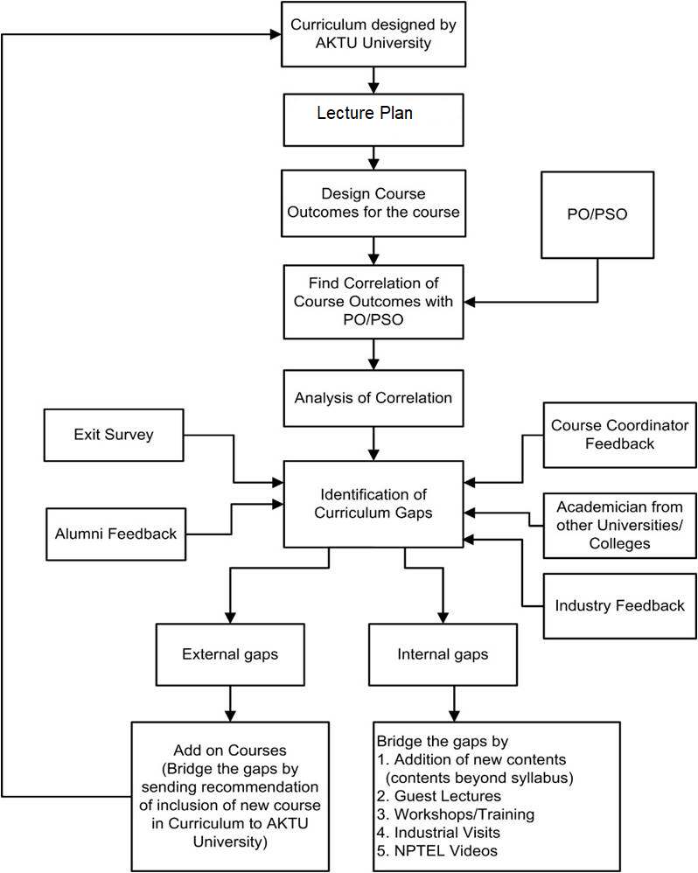
Processes used to identify the curriculum gaps for attaining POs and PSOs

Slide 12
Gaps identified in the curriculum of the AKTU for the attainment of POs and PSOs
Delivery details of content beyond the syllabus for the attainment of POs and PSOs
S. No. | GAP | Action Taken | Date | Resource Person with Designation | Relevance to POs, PSOs
1 1.1 | CONTENT BEYOND THE SYLLABUS | Expert lecture | 26.02.2018 | Prof. S.K. Saha, IIT, Delhi | PO1, PO2, PO3, PO4, PSO1,PSO2
 | Machine design-I : Innovative Product Development
1.2 | Manufacturing Science -I : Micro Manufacturing | Expert lecture | 07.10.2017 | Dr. Akshay Dvivedi IIT, Roorkee | PO1, PO2, PO3, PSO2
1.3 | Manufacturing Science –I: Practical aspects of arc welding | Industrial Expert lecture | 17.04.18 | Mr. S. C. Sundrani, Director Param Engineers Pvt. Ltd. | PO1, PO2, PO3, PSO2
1.4 | Industrial exposure to conversion of raw material to finished product. | Industrial Visit | 10-10-2017 | Parle Biscuits Pvt. Ltd. Pantnagar | PO1, PO5, PO6, PO12, PSO2
2 | Societal health and safety issues | Plantation on 15th August | 15-08-17 | Dr. Manuj Agarwal Convener NSS | PO6, PO7, PO8, PO9, PO12
3 | Team Building & Leadership | Teacher’s Day celebration | 05-09-17 | Mr. Pravesh Chandra (MESS) | PO9, PO10, PO 12
 |  | ROBOTEK Event | 14-03-18 | Mr. Pravesh Chandra (MESS)
4 | Soft skills and personality development | PDP Classes | 01/09/2017 | Ms. Ravneet Kaur Mr. Mandeep | PO9, PO10, PO 12
5 | Gap identified in Univ. Curriculum 1. Additive manufacturing 2. Industrial Engineering | Letter to University | 21-05-2018 | Registrar, MIT Moradabad | PO1, PO2, PO3, PO4, PSO1, PSO2

Slide 13
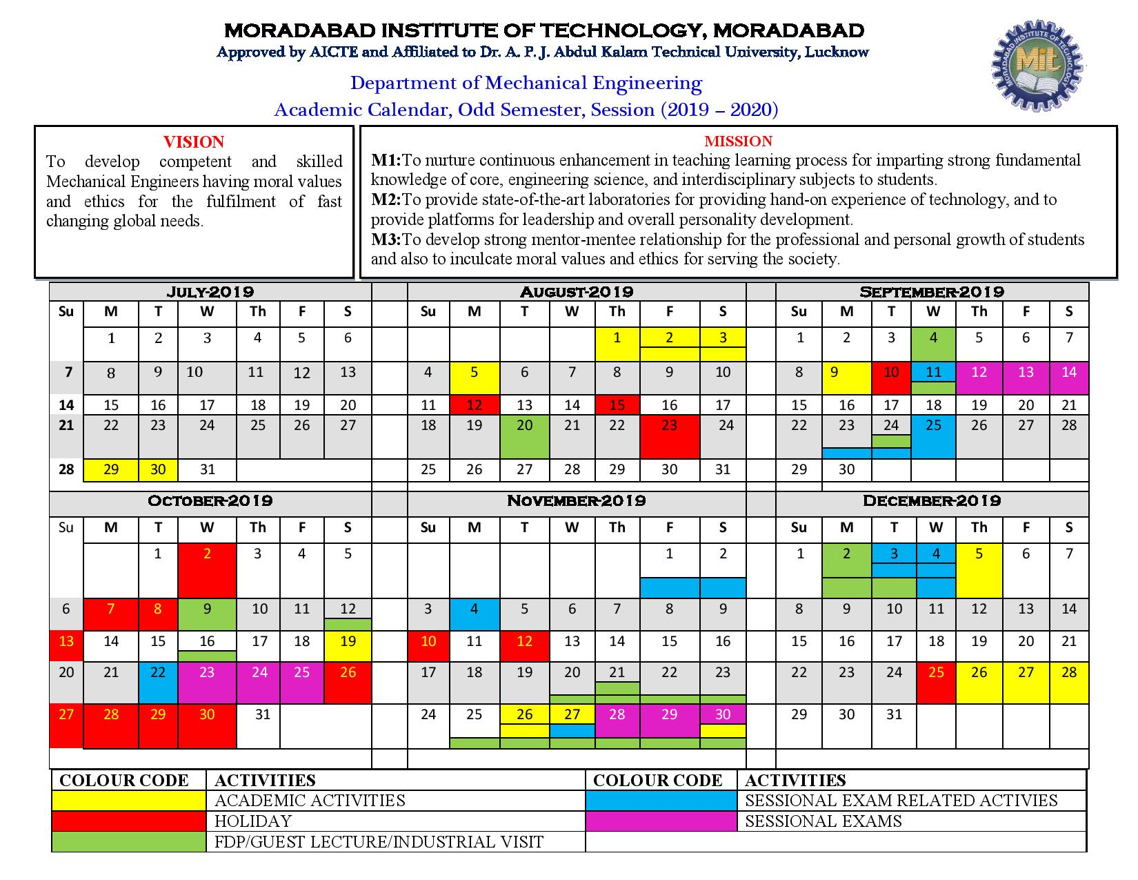
Teaching-Learning Processes
Adherence to Academic Calendar
Academic calendar provided by Dr. APJ Abdul Kalam University
Institute academic calendar
Department academic calendar derived from the Institute academic calendar

Slide 14
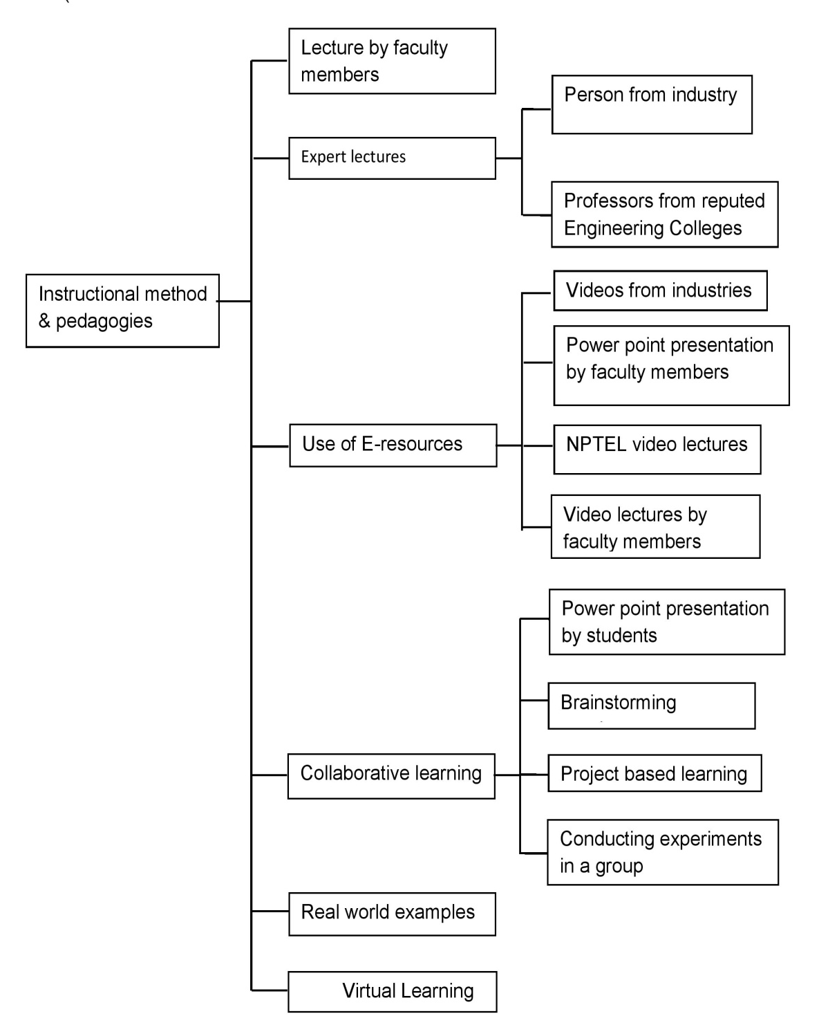
Use of instructional methods and pedagogical initiatives

Slide 15
Methodologies to support weak students
Identified by faculty members during their class room teaching and/or on basis of performance in Class Test -1.
Separate special classes are arranged for re-explaining difficult topics and clarifying the doubts.
Counseled by Mentor.
Regular monitoring and observing them during teaching-learning.
Providing reading material and lecture notes.
Question bank based on previous years question papers.
Methodologies to encourage bright students
The bright students are identified from their participation in classroom discussion, performance in the class tests, university result analysis and interest in co- curricular activities
Additional book facilities are provided in Library.
Encouraged to publish papers and to participate in technical events.
Encouraged to pursue online certifications such as Spoken Tutorial and NPTEL.
Provided more conceptual question set from GATE previous years.

Slide 16
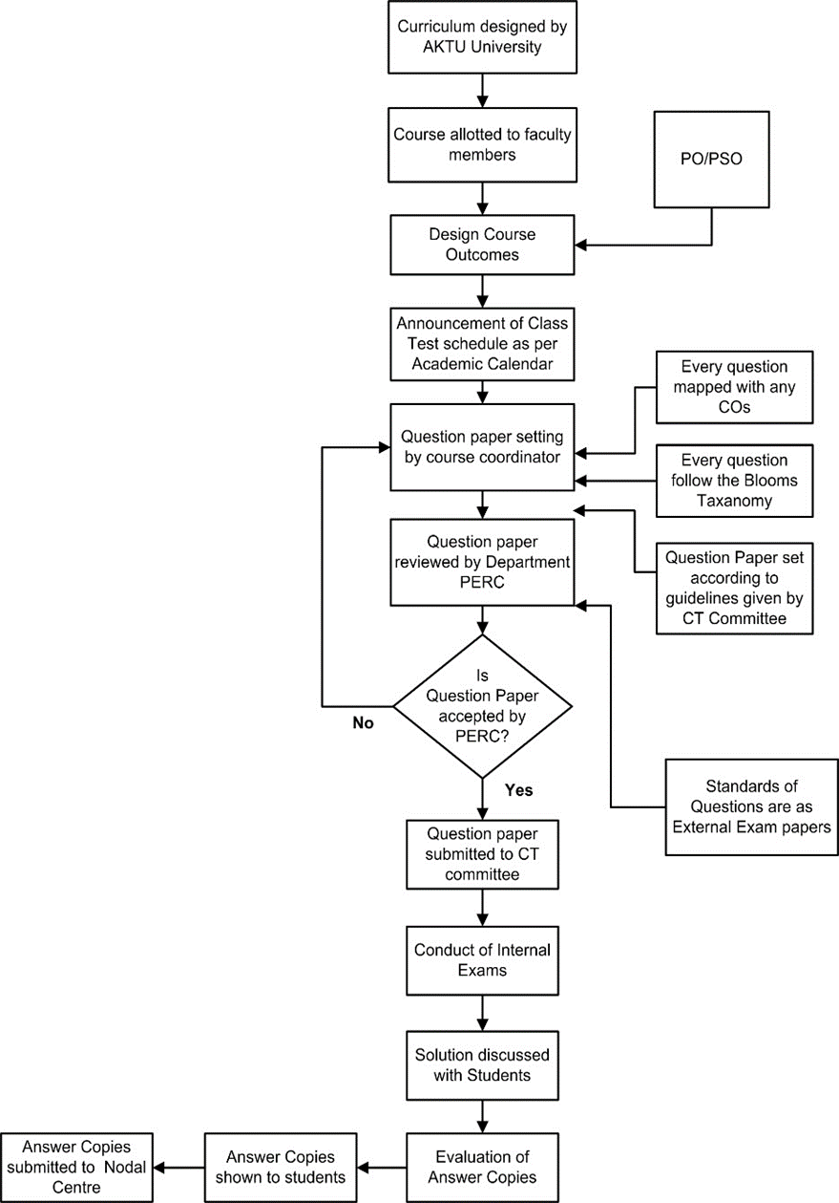
Process of question papers setting, evaluation and effective process implementation

Slide 17
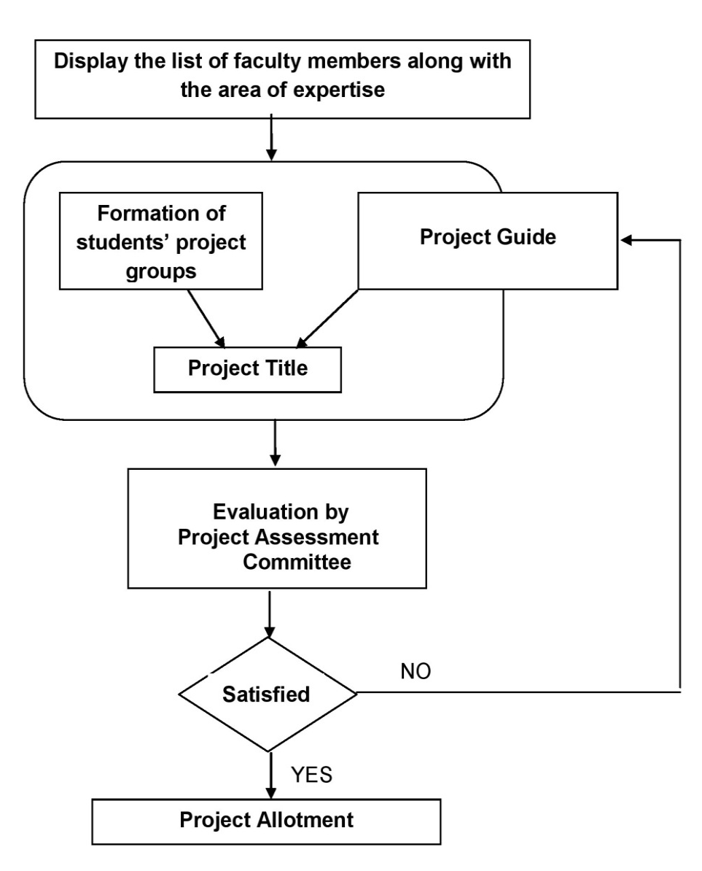
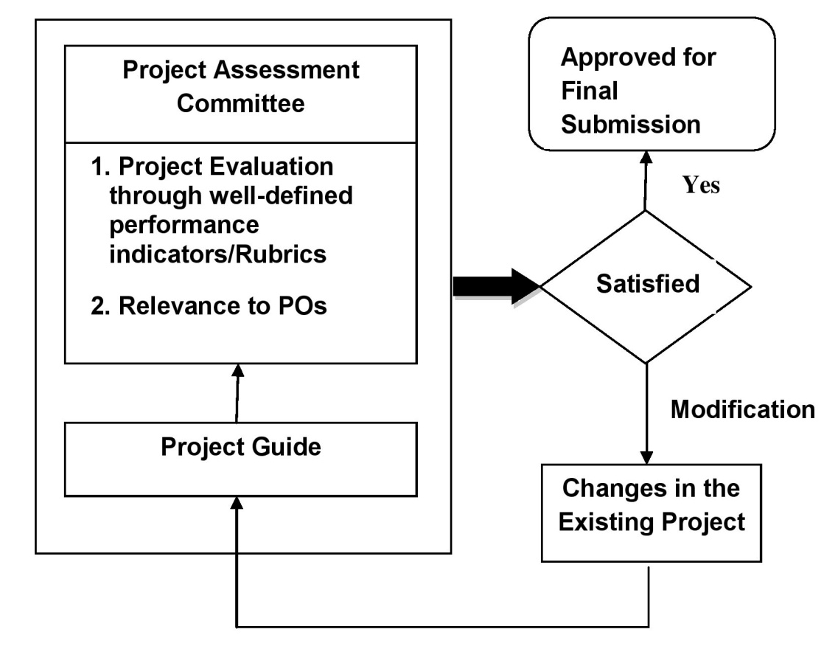
Quality of Student Project
Identification of projects and allocation methodology to Faculty Members

Slide 18
Initiatives Related to Industry Interaction
MOUs with industries and training organisations
Academic Year | Name of the Organization
2017-18 | Metal Handicrafts Service Centre, Moradabad, Govt. of India
2017-18 | AKGEC Skills Pvt. Ltd., Ghaziabad
2017-18 | SofconPvt. Ltd., Delhi
2017-18 | Sainik Enterprises, Moradabad
2019-20 | Excelling Technologies
2020-21 | Centre of Skill & Entrepreneurship Development, Gurugram
Summary of lectures delivered by Industry Experts and Industrial Visits by students
Session | No. of lectures | No. of Industrial visits
2016-17 | 5 | 2
2017-18 | 4 | 5
2018-19 | 6 | 3
2019-20 | 5 | 5
2020-21 | 9 | --
e–Yantra Lab is established in collaboration with IIT Mumbai.
VCR Diesel engine equipped with Engine Performance Analysis software "Enginesoft” collaboration with Apex Innovations Pvt. Ltd.

Slide 19
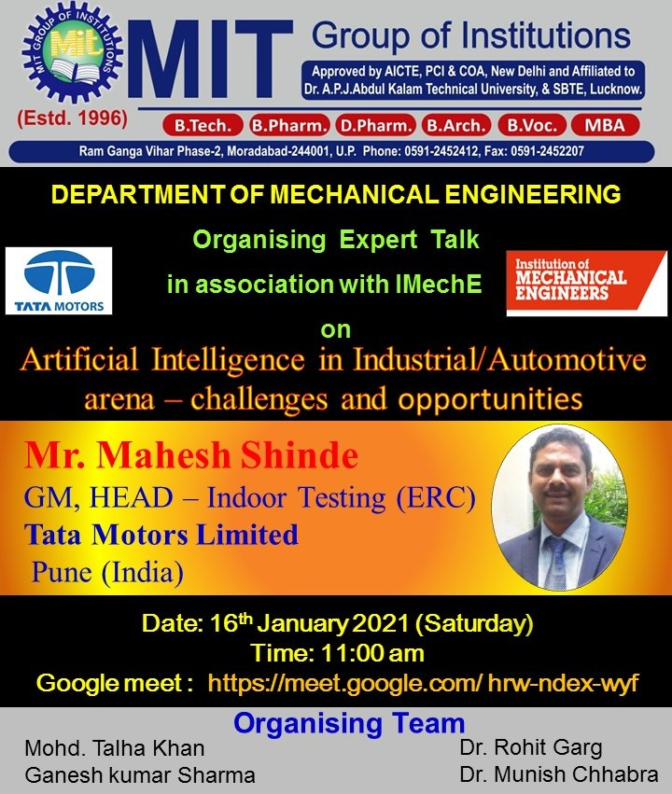


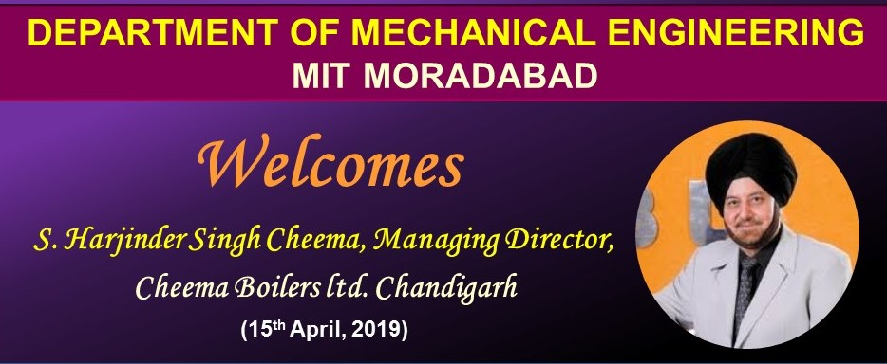
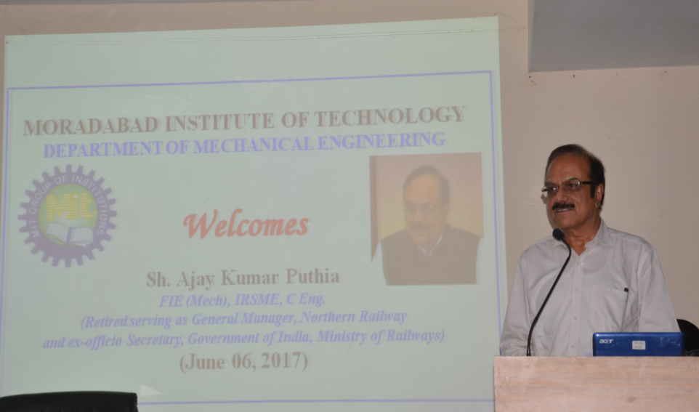
Glimpses of Lectures Delivered by Industry Experts

Slide 20
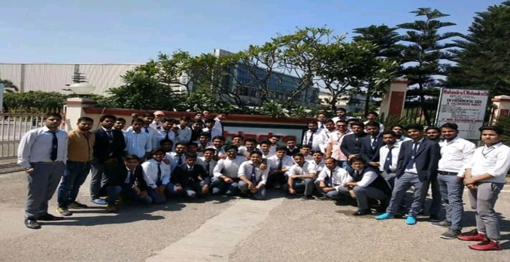
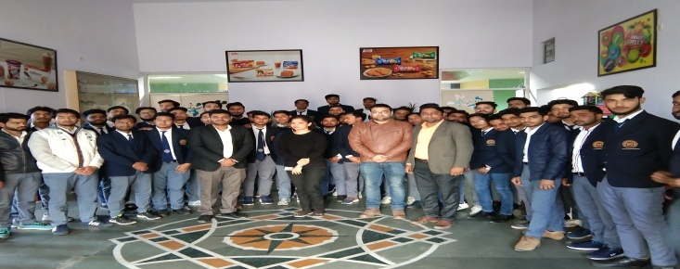
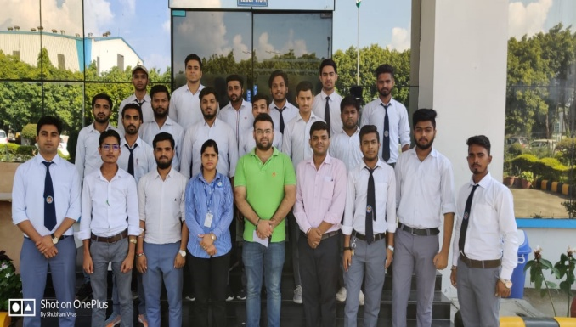
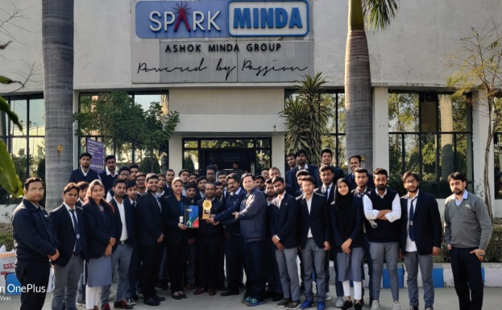
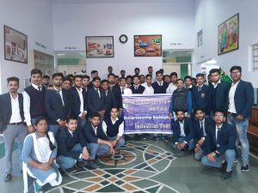
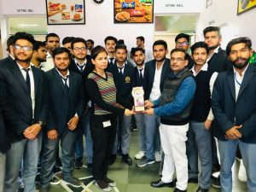
Glimpses of Industrial Visits
Mahindra & Mahindra- 08.03.2018
Parle G – 21.02.2019
UNO MINDA - 24.04.2019
SPARK MINDA– 11.02.2020
Industrial Visit to Parle Biscuits Pvt. Ltd. Pantnagar - 03.03.2020

Slide 21
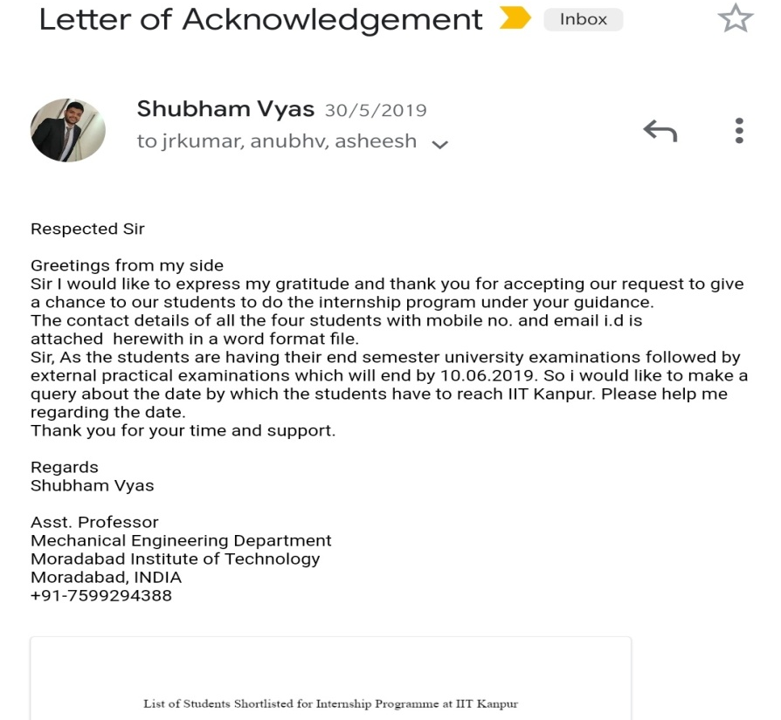
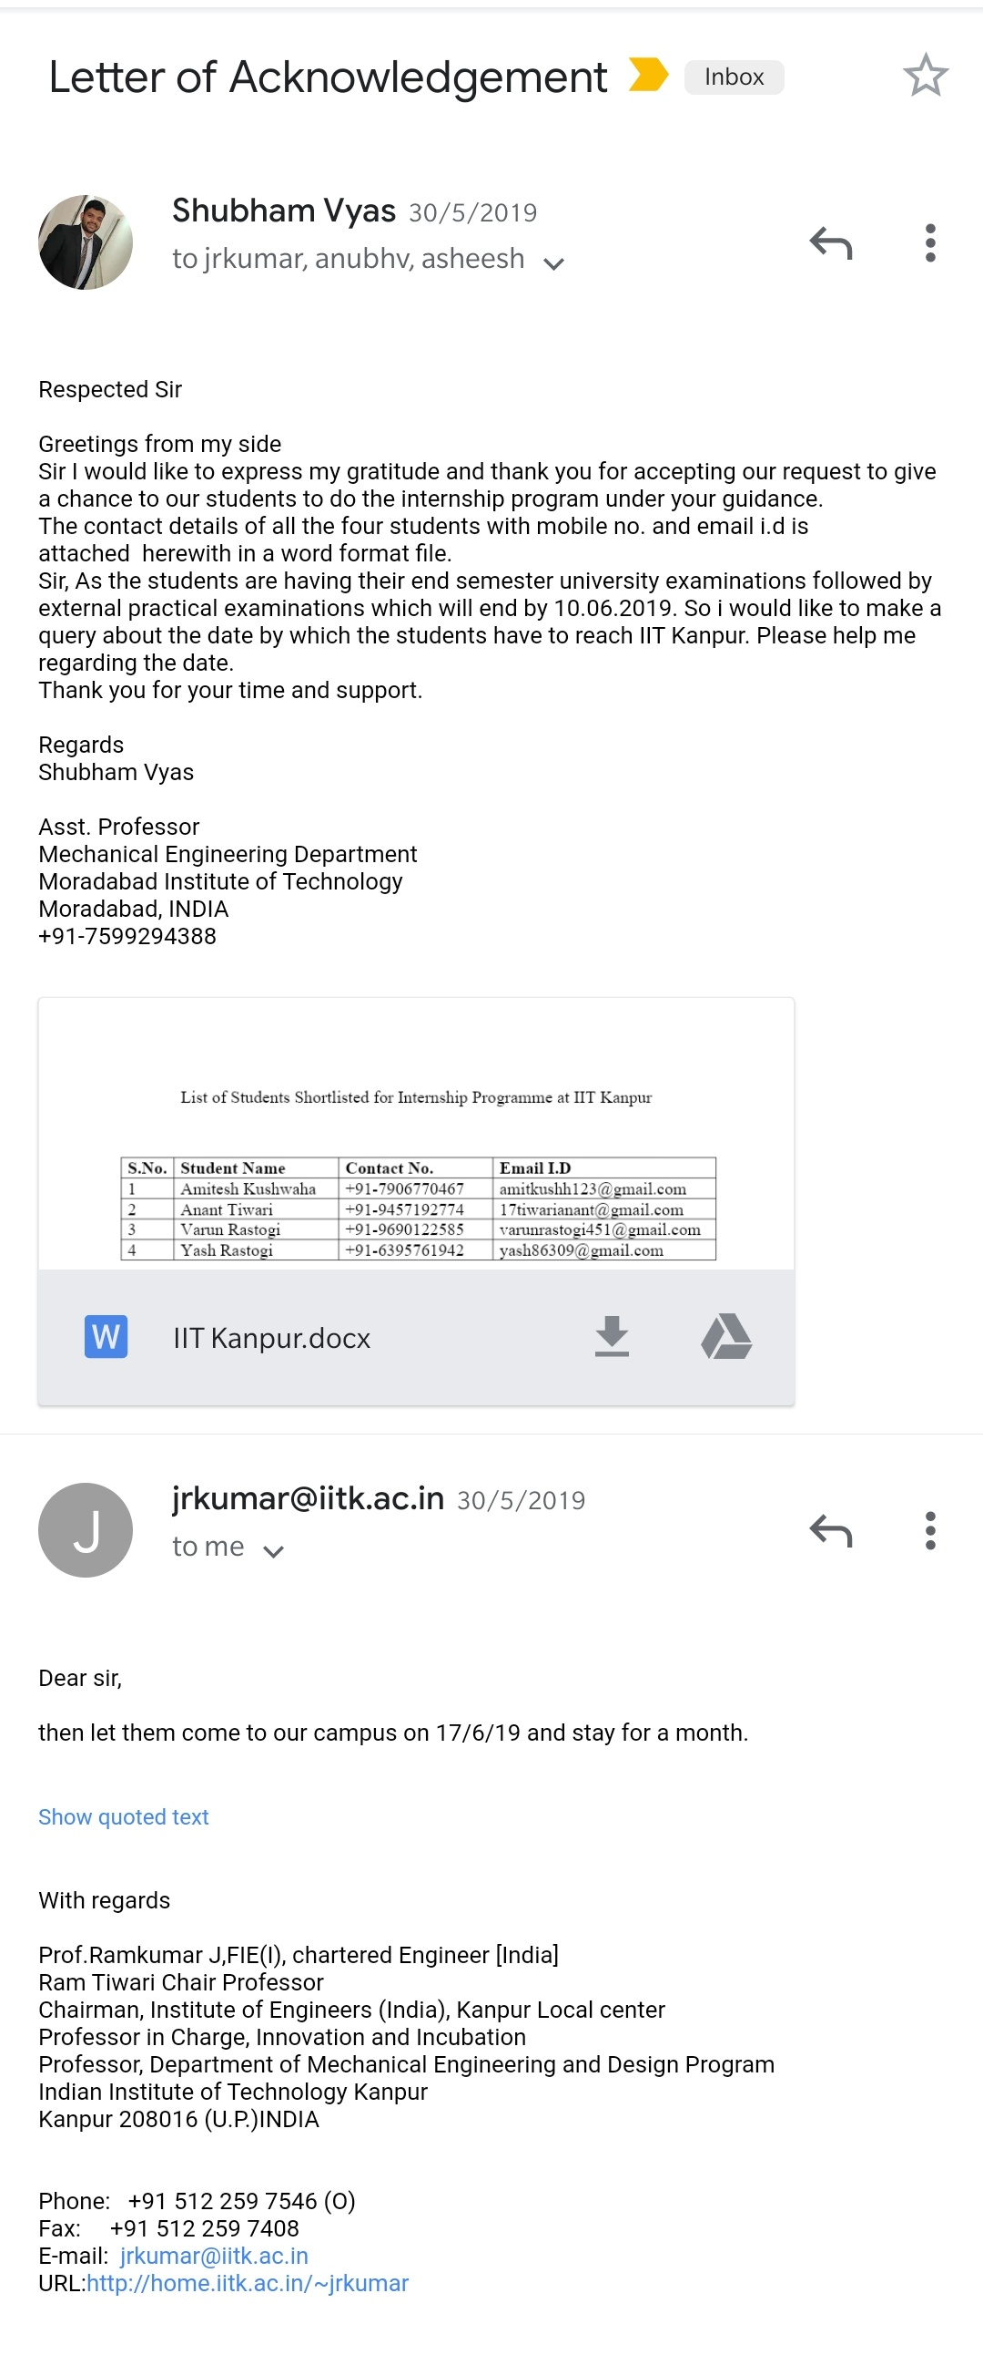
Initiatives Related to Industry Internships/ Summer training
Training/ Internship is the mandatory part of curriculum of mechanical engineering as per AKTU guidelines. Students of second year and third year are required to do Industrial Training or Internship of 4 to 6 weeks compulsorily.
List of trainings done by students
A committee for assessment of industrial training is formed by the department to
assess the learning of students from training.

Slide 22
CRITERIA-3
COURSE OUTCOMES AND PROGRAM OUTCOMES
 | Program Outcomes (POs)
PO1 | Engineering Knowledge
PO2 | Problem analysis
PO3 | Design/development of solutions
PO4 | Conduct investigations of complex problems
PO5 | Modern tool usage
PO6 | The engineer and society
PO7 | Environment and sustainability
PO8 | Ethics
PO9 | Individual and team work
PO10 | Communication
PO11 | Project management and finance
PO12 | Life-long learning
Program specific outcomes (PSOs)
Mechanical Engineering graduates will be able to
PSO1 | Identify and solve problems of thermal engineering, strength of materials, fluid mechanics, refrigeration & air conditioning, Design, dynamics of machines, mathematics and engineering science.
PSO2 | Get fundamental knowledge and hand-on experience of different manufacturing processes, material testing techniques and CAD/CAM tooling to apply in various industries.
PSO3 | Learn quality and industrial management concepts, communication and soft skills along with other interdisciplinary subjects such as programming language, electrical engineering and basic electronics to enhance their employability.

Slide 23
Course Outcome Sample
Course: IC Engine& Compressor (NME-505) Semester: V Year of study: 2017-2018
S. No. | Course outcome
NME505.1 | Demonstrate the ability to perform a thermodynamic analysis of Otto, Diesel, and Dual cycle models.
NME505.2 | Understand the mechanism behind fuel supply and the ignition systems in different types of engines.
NME505.3 | Analyze different electronic fuel injection system, supercharging and its effect on performance of SI and CI engine.
NME505.4 | Interpret data and analysis of alternative fuels and their emission characteristics and also to understand concepts of engine cooling and friction.
NME505.5 | Analyze different types of compressor and effect of various factors on performance of compressor.

Slide 24
CO – PO & PSO Mapping
Each Course Outcome of every subject is mapped with its impact level on the programs’ POs and PSOs.
Correlation levels are taken 1, 2 and 3 : 1: Slight (low) 2: Moderate (medium) 3: Substantial (high)
Average impact of the particular Course on each POs and PSOs is worked out for assessment of total attainments.
Course: IC Engine& Compressor (NME-505) Semester: V Year of study: 2017-2018
Course | PO1 | PO2 | PO3 | PO4 | PO5 | PO6 | PO7 | PO8 | PO9 | PO10 | PO11 | PO12
NME505.1 | 3 | 2 | 2 | 2 | - |  | - | - | - | - | - | -
NME505.2 | 3 | 3 | 3 | 2 | - | - | 2 | - | - | - | - | -
NME505.3 | 2 | 2 |  | 3 | - | - | - | - | - | - | - | -
NME505.4 | 1 | 2 | 3 | 3 | - | - | 3 | - | - | - | - | -
NME505.5 | 3 | 3 | 2 | 2 | - | - | 2 | - | - | - | - | -
NME505 | 2.4 | 2.4 | 2.5 | 2.4 | - | - | 2.3 | - | - | - | - | -
Course : IC Engine& Compressor (NME-505) Semester: V Year of study: 2017-2018
Course | PSO1 | PSO2 | PSO3
NME505.1 | 3 | 2 | 2
NME505.2 | 3 | 2 | 3
NME505.3 | 2 | 3 | 1
NME505.4 | 1 | 2 | 2
NME505.5 | 1 | 2 | 2
NME505 | 2 | 2.2 | 2

Slide 25
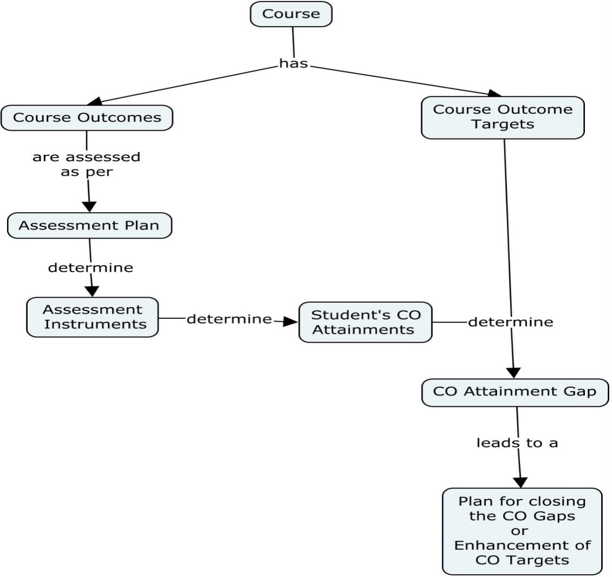
Attainment of Course Outcomes
Course assessment process

Slide 26
Assessment Plan and Assessment Instruments for Evaluation of Courses
Course | Assessment Plan | Assessment Instruments | Attainment (% of students getting set percentage of marks)
Theory Courses | Continuous Internal Evaluation (CIE) | Sessional Exams/Class Tests (Questions are tagged with COs), and Assignments/Quizzes (on each CO) | Direct CO Attainment using CIE, CO_CIE Direct CO Attainment using SEE, CO_SEE Direct CO Attainment, CO_Direct =0.33*CO_CIE+0.67*CO_SEE Indirect CO Attainment using CES, CO_Indirect CO Attainment, CO = 0.9*CO_Direct + 0.1*CO_Indirect
 | Semester End Examination (SEE) | Conducted by university.
 | Course Exit Survey (CES) | Survey on each CO taken from students at the end of course.
Practical Courses | Continuous Internal Evaluation (CIE) | Rubrics based Lab Continuous Evaluation and Lab Internal Examination | CO Attainment using CIE, CO_CIE CO Attainment using SEE, CO_SEE CO Attainment, CO =0.4*CO_CIE +0.6*CO_SEE
 | Semester End Examination (SEE) | Conducted by university.
Project | Continuous Internal Evaluation (CIE) | Rubrics based Phase-wise Evaluation by Project Assessment Committee, and Evaluation by Project Supervisor | CO Attainment using CIE, CO_CIE CO Attainment using SEE, CO_SEE CO Attainment, CO =0.33*CO_CIE +0.67*CO_SEE
 | Semester End Examination (SEE) | Conducted by university.
Seminar | Internal Evaluation | Rubrics based evaluation of Seminar | CO Attainment using Internal Evaluation
Industrial Training | Internal Evaluation | Rubrics based evaluation of knowledge and skills attained during Industrial Training | CO Attainment using Internal Evaluation

Slide 27
Attainment of Program Outcomes(POs) and Program Specific Outcomes(PSOs)
Assessment tools to measure POs and PSOs attainment
Assessment Plan | Assessment Instruments | Attainment calculations
Direct Assessment (DA) Tools | Attainment through University examination Attainment through Internal examination | PO/ PSO attainment is calculated for each course. For Each PO/PSO, PO/PSO Attainment = (Actual mapping strength/ Maximum mapping strength) × average of attainments of relevant COs. Direct PO/PSO Attainment = Average attainments of POs/ PSOs.
Indirect Assessment (IA) Tools | Attainment through Alumni survey Attainment through Program Exit Survey Attainment through Employer survey | Indirect PO/PSO Attainment = 70% of attainment from Student’s Exit Survey + 20% of attainment from Alumni Survey + 10% of attainment from Employer Survey.

Slide 28
Results of evaluation of each PO & PSO
Batch 2015-2019
Course | PO1 | PO2 | PO3 | PO4 | PO5 | PO6 | PO7 | PO8 | PO9 | PO10 | PO11 | PO12
Direct Attainment | 1.7 | 1.43 | 1.49 | 1.37 | 1.32 | 1.11 | 1.06 | 1.37 | 1.17 | 1.11 | 1.23 | 1.24
Indirect Attainment | 2.885 | 2.793 | 2.535 | 2.621 | 2.493 | 2.809 | 2.886 | 2.916 | 2.42 | 2.61 | 2.871 | 2.86
Total Attainment | 1.94 | 1.7 | 1.7 | 1.62 | 1.55 | 1.45 | 1.43 | 1.68 | 1.42 | 1.41 | 1.56 | 1.56
Course | PSO1 | PSO2 | PSO3
Direct Attainment | 1.82 | 1.56 | 1.5
Indirect Attainment | 2.743 | 2.821 | 2.714
Total Attainment | 2 | 1.81 | 1.74

Slide 29
CRITERIA- 4
STUDENTS’ PERFORMANCE
Student Enrolment Ratio
Item | CAY (2019-20) | CAYm1 (2018-19) | CAYm2 (2017-18)
Sanctioned intake of program (N) | 60 | 60 | 120
Total number of students admitted in first year minus number of students migrated to other programs/institutions plus no. of students migrated to this program (N1) | 34 | 39 | 62
Enrolment Ratio = (N1/N)*100 | 56.67 | 65.00 | 51.67
Average Enrolment Ratio | 57.78
Marks | 12

Slide 30
Success Rate in the Stipulated Period of the Program
(Without Backlog)
Item | Last Year Graduate, LYG (CAY m4) (Batch 2015-16) | Last Year Graduate minus 1, LYGm1 (CAY m5) (Batch 2014-15) | Last Year Graduate minus 2, LYGm2 (CAYm6) (Batch 2013-14)
Number of students admitted in the corresponding First Year + admitted in 2nd year via lateral entry and separate division, if applicable (X) | 184 | 201 | 201
Number of students who have graduated without backlogs in the stipulated period (Y) | 63 | 59 | 78
Success Index [ SI= Y/X ] | 0.34 | 0.29 | 0.39
Average SI | 0.34
Average SI = Mean of Success index (SI) for past three batches
Assessment = 25 x Average SI
= 25 x 0.34
= 8.5

Slide 31
Success Rate in the Stipulated Period of the Program
(with backlogs )
Item | Last Year Graduate, LYG (CAY m4) (Batch 2015-16) | Last Year Graduate minus 1, LYGm1 (CAY m5) (Batch 2014-15) | Last Year Graduate minus 2, LYGm2 (CAYm6) (Batch 2013-14)
Number of students admitted in the corresponding First Year + admitted in 2nd year via lateral entry and separate division, if applicable (X) | 184 | 201 | 201
Number of students who have graduated with backlogs in the stipulated period (Y) | 147 | 155 | 166
Success Index [ SI= Y/X ] | 0.80 | 0.77 | 0.83
Average Success Index | 0.80
Average SI= Mean of Success index (SI) for past three batches
Assessment =15 x Average SI
= 15 x 0.80
= 12

Slide 32
Academic Performance in Third Year
Academic Performance | CAYm3 (2016-17) | LYG (2015-16) | LYGm1 (2014-15)
Mean of CGPA or Mean Percentage of all successful students (X) | 6.97 | 6.61 | 6.54
Total no. of successful students (Y) | 95 | 147 | 155
Total no. of students appeared in the examination (Z) | 96 | 149 | 158
API = X* (Y/Z) | 6.90 | 6.52 | 6.42
Average API = (AP1+AP2+AP3)/3 | 6.61
Assessment = 1.5 × Average API (Academic Performance Index)
= 1.5 × 6.61
= 9.92

Slide 33
Academic Performance in Second Year
Academic Performance | CAYm2 (2017-18) | CAYm3 (2016-17) | LYG (2015-16)
Mean of CGPA or Mean Percentage of all successful students (X) | 6.70 | 7.00 | 6.50
Total no. of successful students (Y) | 61 | 96 | 149
Total no. of students appeared in the examination (Z) | 61 | 96 | 153
API = X* (Y/Z) | 6.70 | 7.00 | 6.33
Average API = (AP1+AP2+AP3)/3 | 6.68
Assessment = 1.5 × Average API (Academic Performance Index)
= 1.5 × 6.68
= 10.02

Slide 34
Placement, Higher Studies and Entrepreneurship
Item | LYG (2015-16) | LYGm1 (2014-15) | LYGm2 (2013-14)
Total number of Final Year Students (N) | 147 | 155 | 168
Number of students placed in companies or Government Sector (x) | 59 | 52 | 84
Number of students admitted to higher studies with valid qualifying scores (GATE or equivalent State or National Level Tests, GRE, GMAT etc.) (y) | 6 | 4 | 12
Number of students turned entrepreneur in engineering/technology (z) | -- | 1 | --
x + y + z = | 65 | 57 | 96
Placement Index = (x + y + z )/N | 0.44 | 0.37 | 0.57
Average Placement= (P1 + P2 + P3)/3 | 0.46
Assessment = 40 × Average Placement
= 40 × 0.46
= 18.4

Slide 35
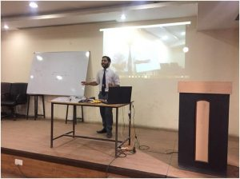
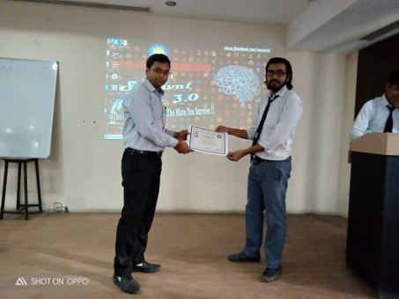
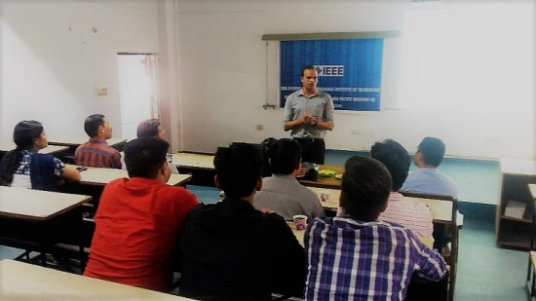
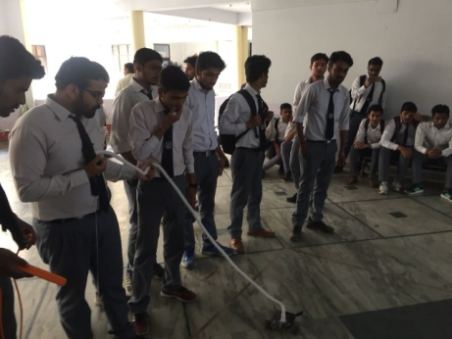
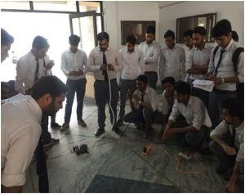
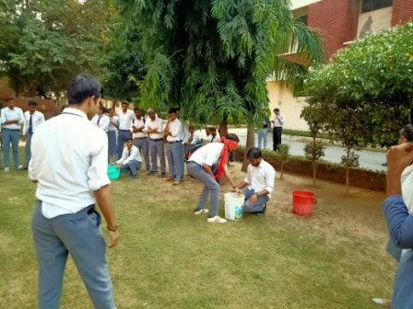
Professional Activities
Professional societies/chapters and organizing engineering events
S. No. | Professional society /Chapter
1. | Institution of Mechanical Engineers (IMechE) Chapter
2. | Institute of Electrical and Electronics Engineers Students’ Chapter (IEEE)
3. | The Institute of Engineers (India) Students’ Chapter (IEI)
4. | Mechanical Engineering Students’ Society (MESS)

Slide 36
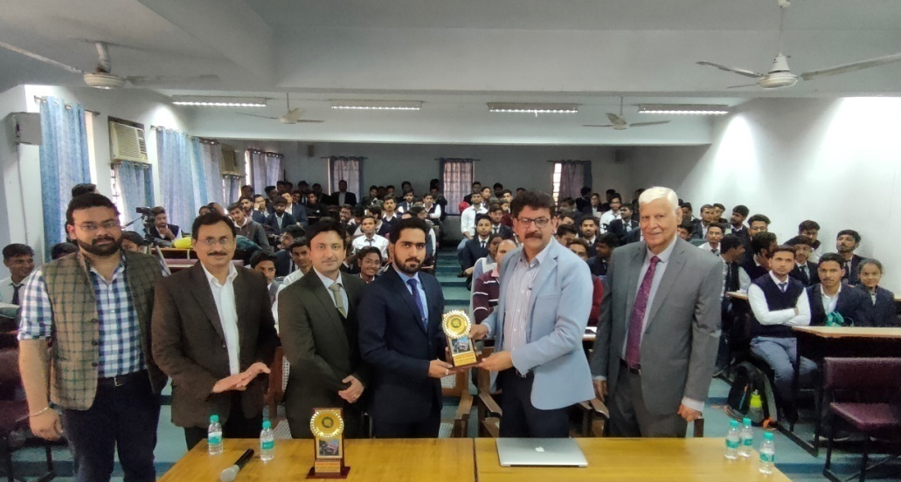
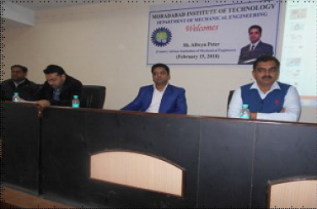
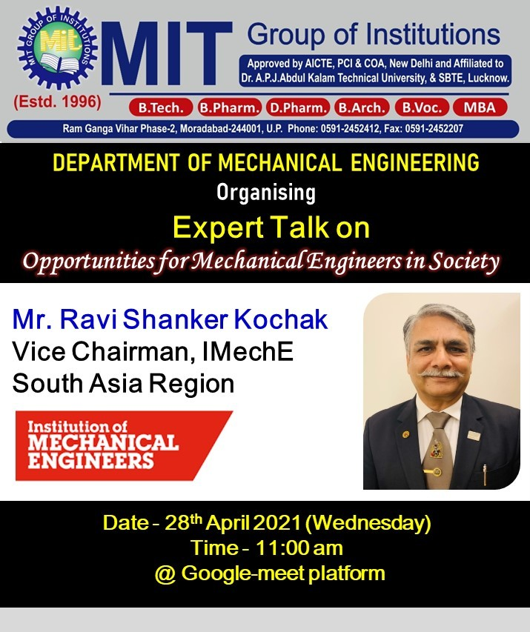
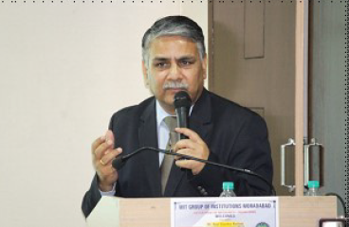
Glimpses of Activities of IMechE Chapter at ME Department MIT

Slide 37
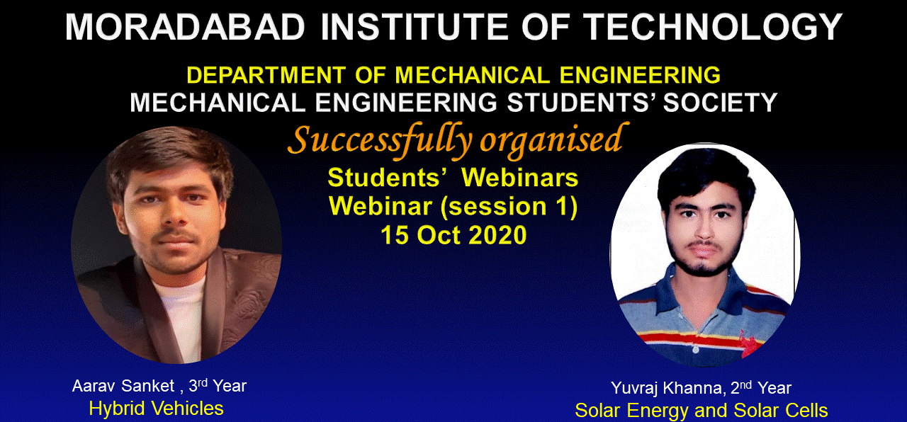
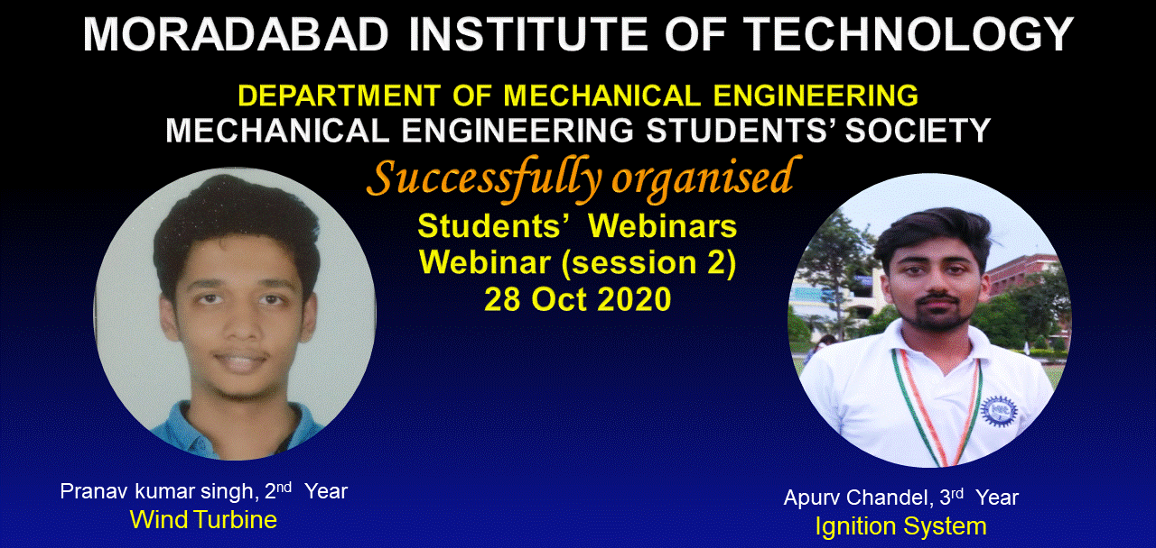

Slide 38
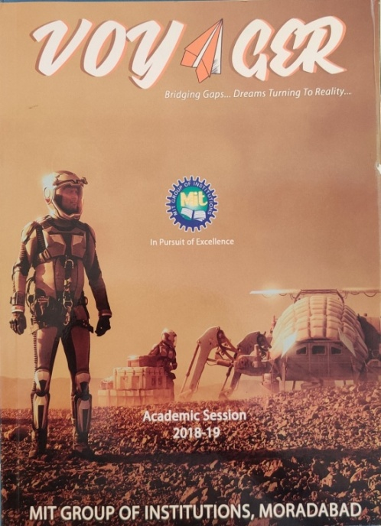
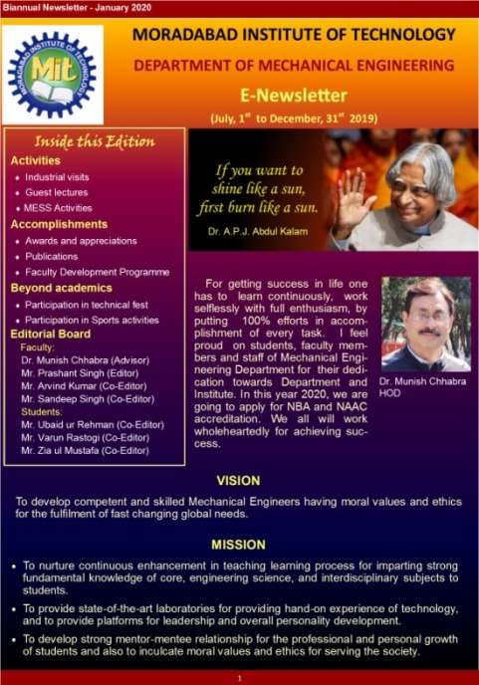
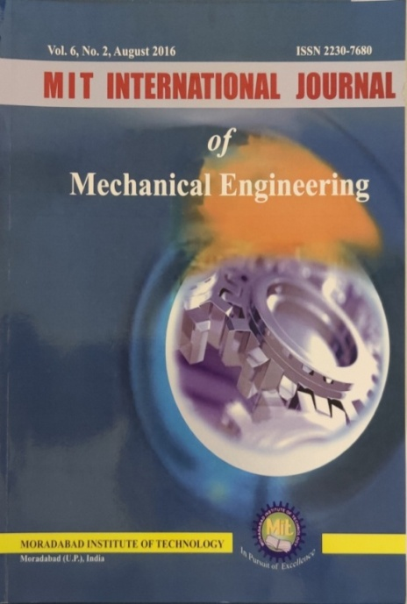
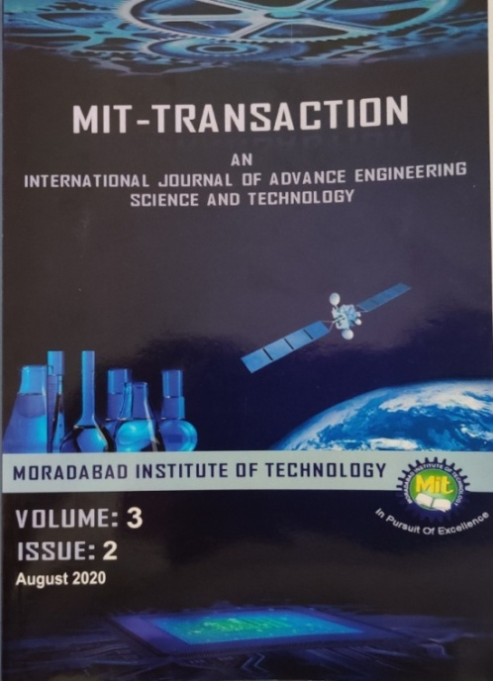
Publication of technical magazines, newsletters etc.
S. No. | Publication Type | Name | Publisher | Frequency
1 | Institute Magazine | VOYAGER | MIT Moradabad | Yearly
2 | E-Newsletter | E-Newsletter | Mechanical Engineering Department | Half-Yearly
3 | Journal | MIT International Journal of Mechanical Engineering | MIT Publications | Half-Yearly
4 | Journal | MIT TRANSACTION | MIT Publications | Half-Yearly

Slide 39
Participation in inter-institute events by students of ME department
Academic Year | Events within the state |  | Events outside the state |  | Total
 | No. of Students Participatio-ns | No. of Students who got prize/award in the events | No. of Students Participatio-ns | No. Of Students who got prize/award in the events | No. of Students Participatio-ns | No. of Students who got prize/award in the events
2020-21 | 13 | 13 | -- | -- | 13 | 13
2019-20 | 31 | 24 | 12 | 03 | 43 | 27
2018-19 | 30 | 20 | 04 | -- | 34 | 20
2017-18 | 18 | 16 | -- | -- | 18 | 16

Slide 40
CRITERIA- 5
FACULTY INFORMATION AND CONTRIBUTIONS
Student-Faculty Ratio (SFR)
Year | CAY 2019-20 | CAYm1 2018-19 | CAYm2 2017-18
u1.1 | 60+3 | 120+2 | 180+9
u2.1 | 120+2 | 180+9 | 180+6
u3.1 | 180+9 | 180+6 | 180+11
UG1 | 374 | 497 | 566
p1.1 | 00 | 00 | 18
p2.1 | 00 | 18 | 18
PG1. | 00 | 18 | 36
Total No. of Students in the Department UG1 + PG1 | 374 | 515 | 602
No. of Faculty in the | F1=20 | F2=21 | F3=27
Department (F)
Student Faculty Ratio (SFR) | 18.7 | 24.52 | 22.30
Average SFR | 21.84

Slide 41
Information about the regular and contractual faculty
 | Total number of regular faculty in the department | Total number of contractual faculty in the department
CAY | 20 | --
CAYm1 | 21 | --
CAYm2 | 27 | --
Average SFR for three assessment years : 21.84
Assessment SFR : 12
Faculty Cadre Proportion
Year | Professors |  |  | Associate Professors |  | Assistant Professors
 | Required F1 | Available |  | Required F2 | Available | Required F3 | Available
CAY (2019-2020) | 02 | 04 |  | 04 | 01 | 12 | 15
CAYm1 (2018-2019) | 02 | 04 |  | 05 | 01 | 17 | 16
CAYm2 (2017-2018) | 03 | 02 |  | 06 | 03 | 20 | 22
Average Numbers | RF1=2.33 | AF1=3.33 |  | RF2=5 | AF2=1.67 | RF3=16.33 | AF3=17.67
Cadre Ratio Marks [ (AF1 / RF1) + [(AF2 / RF2) * 0.6] + [ (AF3 / RF3) * 0.4] ] * 12.5 : 25.00

Slide 42
Faculty Qualification
Years | X regular faculty with Ph.D | Y regular faculty with M.Tech | F regular faculty required to comply 20:1 FSR | FQ=2.5 x [(10X +4Y)/F)]
CAY | 5 | 15 | 18 | 15.28
CAYm1 | 5 | 16 | 25 | 11.4
CAYm2 | 6 | 21 | 30 | 12
 | Average Assessment |  |  | 12.89
Faculty Retention
Description | 2018-19 | 2019-20
No of Faculty Retained in CAY (2019-20) | 19 | 17
Total No of Faculty keeping CAYm2 (2017-18) as base year | 27 | 27
% of Faculty Retained | 70 | 63
Average: 67 Assessment Marks: 15
Notes:
:

Slide 43
Innovations by the Faculty in Teaching and Learning
Demonstration Using Animation
Learning Through Practical Demonstration
Demonstration using Simulation
Demonstration through Lab Activity
Knowledge Sharing Using Case Study
Knowledge sharing Using Research Article
Learning Using Live Video Lectures
Details of Innovative approaches in Teaching-Learning
Virtual Learning Methods adopted in Teaching- Learning

Slide 44
Faculty as participants in Faculty development/training activities/STTPs
 | Max. 5 per Faculty
 | CAYm1 (2018-19) | CAYm2 (2017-2018) | CAYm3 (2016-17)
SUM (Total FDP attended by faculty members) | 83 | 64 | 87
RF = Number of Faculty required to comply with 20:1 Student-Faculty ratio as per 5.1 | 18.7 | 25.75 | 30.1
Assessment = 3 × (Sum/0.5RF) (Marks limited to 15) | 26.63 (15) | 14.91 | 17.34 (15)
Average assessment over three years (Marks limited to 15) = 14.33

Slide 45
Summary of the Publications
Session | SCI Journal | Scopus Journal | Other International Journal | International Conference (Scopus) | International Conference
2020- 21 | 01 | - | 04 | 05 | 01
2019- 20 | 04 | 03 | - | - | -
2018-19 | - | 05 | - | 02 | 02
2017-18 | 01 | 01 | 01 | - | 01
2016-17 | 05 | - | 08 | 01 | -
Details of PhD Guidance by the Faculty
S.No. | Name of Faculty Member | Name of Student | Title of PhD. | Year of Registration | Status
1. | Dr. Parul Gupta | Mr. Mohd. Javed | Study And Evaluation Of Various Gaps of Service Quality And Customer Satisfaction In Four Wheeler Automobile Service Industry | 2015 | In Progress
2. | Dr. Munish Chhabra | Mr. Prabhash Chandra Katiyar | Development of Cobalt Chrome filled PLA filament for FDM technique for Biomedical applications. | 2019 | In Progress
3. | Dr. Nitin Agarwal | Mr. Arvind Kumar Singh | Thermal Performance Evaluation of Different Heat Storage Materials with Extended Geometries in Solar Air Heater | 2015 | In Progress
4. | Dr. Abhishek Saxena | Mr. Avnish Kumar | Design Optimization of a Solar Cooker and Feasibility Analysis for Uttarakhand. | 2019 | In Progress
5. | Dr. Abhishek Saxena | Mr. Nand Kishore | Design and performance Investigation of a solar air heater with helical tube patterned in different configuration | 2017 | In Progress

Slide 46
Faculty Performance Appraisal and Development System
Faculty Assessment Process
Self Assessment by the Faculty Members
Student Feedback Form
Result Analysis
Self Appraisal Form duly filled by the Faculty Members
Review of Self Appraisal Form by Head of Department
Assessment and Evaluation of Overall Performance of Faculty Member during an Academic Year by HoD
Compilation and Submission of Self Appraisal Forms to Director of the Institute for Review
Actions taken based on the marks gained by the faculty members

Slide 47
CRITERIA- 6
FACILITIES AND TECHNICAL SUPPORT
Adequate and well equipped laboratories and technical Manpower
S. No. | Name of Laboratory | Technical Manpower Support
 |  | Name of Technical Staff with Designation | Qualification
1 | CAM Lab | Mr. Neeraj Kumar, Lab Technician | Diploma in Mechanical Engineering (20 years of work experience)
2 | CAD Lab &Machine Design Lab | Mr. Sanjeet Kumar, Lab Technician | Diploma in Mechanical Engineering (24 years of work experience)
3 | Material Science & Testing Lab | Mr. Brahma Swaroop, Lab Technician | I.T.I Fitter, (30 years of work experience)
4 | Fluid Mechanics & Hydraulics Lab | Mr. Brahma Swaroop, Lab Technician | I.T.I Fitter, (30 years of work experience)
5 | Refrigeration and Air- conditioning Lab | Mr. Neeraj Kumar, Lab Technician | Diploma in Mechanical Engineering (20 years of work experience)
6 | Manufacturing Science- I Lab | Mr. Krishan G.,Lab Assistant | BA, I.T.I, (22 years of work experience)
7 | Manufacturing Science-II Lab (Machine Shop) | Mr. Prakash Chandra, Lab Assistant | I.T.I., (18 years of work experience)
8 | Applied Thermodynamics Lab | Mr. Suraj Bhan, Lab Assistant | 6 month Automobile Diploma (16 years of work experience)
9 | Automobile Lab | Mr. Sanjeet Kumar, Lab Technician | Diploma in Mechanical Engineering (24 years of work experience)
10 | Mechanics of Machine Lab | Mr. Prakash Chandra, Lab Assistant | I.T.I., 6 months Diploma in computer (18 years of work experience)
11 | Heat & Mass Transfer Lab | Mr. Suraj Bhan, Lab Assistant | 6 Month Automobile Diploma (16 years of work experience)
12 | Measurement and Metrology Lab | Mr. Sanjeet Kumar,Lab Technician | Diploma in Mechanical Engineering (24 years of work experience)
13 | Engineering Mechanics Lab | Mr. Brahma Swaroop, Lab Technician | I.T.I Fitter, (30 years of work experience)
14 | Computer Aided Engineering Graphics Lab | Mr. Sanjeet Kumar, Lab Technician | Diploma in Mechanical Engineering (24 years of work experience)
15 | Workshop Practice Lab | Mr. Satish Kumar, Lab Assistant | I.T.I, (28 years of work experience)
 |  | Mr. Krishan G. Saxena, Lab Assistant | B.A., I.T.I, (22 years of work experience)
 |  | Mr. Suraj Bhan, Lab Assistant | 6 month automobile Diploma (16 years of work experience)
Details of Major Equipments of all labs are given in section 6.1, pp 223-228 of SAR

Slide 48
Additional Facilities Created for Improving the Quality of Learning Experience in Laboratories
S. No. | Facility Name | Details | Relevance
1 | Advance Material Testing Machines | Computerized Brinell hardness Tester . Computerized micro Vickers Testing Machine Computerized Vickers Hardness Tester Dewinter/ Trinocular Inverted Metallurgical Microscope Pin & Disc Wear Apparatus | To provide exposure of learning and performing research on latest material testing equipments.
2 | Squeeze casting Setup | Hydraulic Press 100 Tons Electric Resistance Furnace Muffle Furnace | To provide exposure of metal casting technique.
3 | I.C. Engine (Engine Performance Analysis, Fuel & Pollution testing) | Computerized VCR Engine 4Stroke Multi-Cylinder Petrol Engine Test Rig. Exhaust Gas Heat Exchanger Pollution Testing Equipment Calorimeter Bomb Calorimeter | To provide exposure of latest facilities of analyzing performance and combustion parameters of IC engine, testing of fuels and pollution in the field of IC engine.
4 | Renewable Energy –Thermal Analysis of Solar PV modules | Solar panel 200Wp, Thermal image camera, Infrared temperature sensor gun, Digital multimeters, Pyranometer | To provide exposure of tools and equipments used for evaluating the performance of solar cells and panels.
5 | Internet Facility | LAN connection in class rooms as well as in all faculty rooms and Wi-Fi is available in whole campus. | Facility is provided to students and faculty members to use e-learning material.

Slide 49
CRITERIA- 7
CONTINUOUS IMPROVEMENT
POs & PSOs Attainment Levels

Slide 50
POs & PSOs Attainment Levels and Actions for improvement – (2015-19)
POs | Target Level | Attainment Level | Observations
PO-I: Engineering knowledge:
PO1 | 1.92 | 1.94 | Target achieved Target 1.92 is achieved and more efforts will be made to increase the target and attainment level for the next academic year.
Actions: 1. Faculty members were advised to use ICT tools in teaching learning process effectively and also to put maximum efforts on clearing the concepts of Mathematics, Physics, and Chemistry. 2. More emphasis on tutorial classes and assignments containing complex problems will be given to improve the target.
PO-2: Problem analysis:
PO2 | 1.71 | 1.70 | Target not achieved Students find difficulty in identifying and analyzing problems of complex engineering topics. Students have low aptitude and reasoning ability
Actions: 1. Video lectures and animation for above courses are scheduled to strengthen the ability to identify, formulate and analyze the problems of Thermodynamics, Engineering Mechanics, Strength of Materials, Kinematics of Machines and other courses of mechanical engineering. 2. Students are encouraged to identify and work on solving real life problems. 3. Additional classes were also conducted to improve aptitude and reasoning ability.
PO 3-12 and PSO 1-3 attainment levels and Action for Improvement

Slide 51
Academic Audit system/process and its implementation in relation to Continuous Improvement
IQAC
PERC/ PAQIC
The Institute has well defined process of Academic Audit to evaluate the performance of different departments. In the implementation of this process, the Internal Quality Assurance Cell (IQAC) constitutes a Academic Audit Committee (AAC) to audit each department twice in a semester, i.e., one at just before the commencement of semester while the other is just before the end of that semester.
The members of AAC are:
Chairperson of IQAC.
Coordinator of IQAC.
One Professor/Associate Professor from the respective department.
One Professor/Associate Professor from the other department
Academic Audit Report 2019-20

Slide 52
Improvement in Placement, Higher Studies and Entrepreneurship

Slide 53
Improvement in the Quality of Students Admitted to the Program
Item |  | CAY 2019-20 | CAYm1 2018-19 | CAYm2 2017-18 | CAYm3 2016-17
National Level Entrance Examination (JEE) | No. of Students admitted | - | - | - | -
 | Opening Score/Rank | - | - | - | -
 | Closing Score/Rank | - | - | - | -
State/University/Level Entrance Examination/Others (UPSEE) | No. of Students admitted | 08 | 10 | 18 | 18
 | Opening Score/Rank | 11423 | 12701 | 11349 | 8288
 | Closing Score/Rank | 77980 | 82070 | 100383 | 93577
Name of the Entrance Examination for Lateral Entry or lateral entry details | No. of Students admitted | 01 | - | 04 | 01
 | Opening Score/Rank | 5202 | - | 942 | 5694.1
 | Closing Score/Rank | 5202 | - | 4355 | 56941
Average CBSE/Any other Board Result of admitted students (Physics, Chemistry & Maths) |  | 61.84% | 64.62% | 66.04% | 68.55%

Slide 54
Part II
OBE Philosophy of the Department
Outcome Based Education (OBE) Philosophy followed by the Department in attainment of COs and POs and Assessment Methodology
Assessment
Course Outcome (COs)
Program Outcome (POs)
Program Specific Outcomes
(PSOs)
CO Attainment Process for
Theory Courses
Practical courses
Project
Seminar
Industrial training

Slide 55
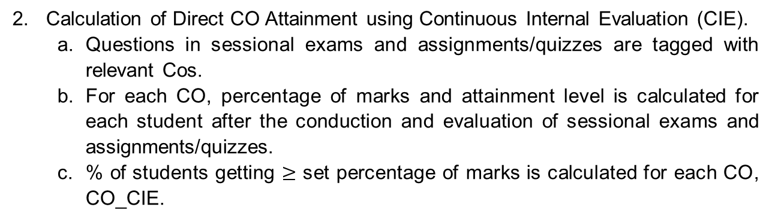
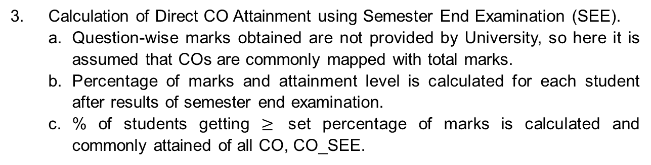
A. CO Attainment Process for Theory Courses
Course Outcomes, COs, are defined by the faculty member for the allotted course and tagged with cognitive levels.
2. Calculation of Direct CO Attainment using Continuous Internal Evaluation (CIE).
Questions in sessional exams and assignments/quizzes are tagged with relevant Cos.
For each CO, percentage of marks and attainment level is calculated for each student after the conduction and evaluation of sessional exams and assignments/quizzes.
% of students getting $≥$ set percentage of marks is calculated for each CO, CO_CIE.
3. Calculation of Direct CO Attainment using Semester End Examination (SEE).
Question-wise marks obtained are not provided by University, so here it is assumed that COs are commonly mapped with total marks.
Percentage of marks and attainment level is calculated for each student after results of semester end examination.
% of students getting $≥$ set percentage of marks is calculated and commonly attained of all CO, CO_SEE.

Slide 56
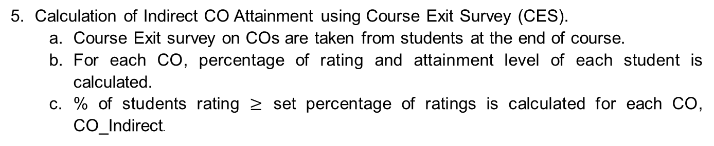
CO Attainment Process for Theory Courses
4. Direct CO Attainment is calculated as 33% of CO attained using Continuous Internal Evaluation, CO_CIE and 67% of CO attained using Semester End Examination (SEE), that is, CO_Direct = 0.33*CO_CIE + 0.67*CO_SEE
5. Calculation of Indirect CO Attainment using Course Exit Survey (CES).
Course Exit survey on COs are taken from students at the end of course.
For each CO, percentage of rating and attainment level of each student is calculated.
% of students rating $≥$ set percentage of ratings is calculated for each CO, CO_Indirect.
6. CO Attainment is calculated as 90% of Direct CO attainment and 10% of Indirect CO Attainment, that is, CO = 0.9*CO_Direct + 0.1*CO_Indirect.
7. CO Attainment gap is determined by comparing CO attainments with CO Targets.
8. Action Plan is prepared for next offering of course in case of gap, otherwise Targets are enhanced.

Slide 57
Process of question papers setting, evaluation and effective process implementation
Class Test-1
(15)
ATTENDANCE (10)
Class Test-2
(15)
CLASS TEST (30)
INTERNAL MARKS (50)
Class Test-3
(15)
TUTORIAL (10)

Slide 58
B. CO Attainment Process for Practical Courses
1. Course Outcomes, COs, are defined by the faculty member and tagged with cognitive levels.
2. Calculation of CO Attainment using Continuous Internal Evaluation (CIE).
Rubrics are defined for Lab Continuous Evaluation and Lab Internal Examination.
COs are mapped with rubrics.
For each CO, percentage of marks and attainment level is calculation for each student.
% of students getting set percentage of marks is calculated for each CO, CO_CIE.
3. Calculation of CO Attainment using Semester End Examination (SEE).
Rubrics/CO-wise marks obtained are not provided by University, so here it is assumed that COs are commonly mapped with total marks.
Percentage of marks and attainment level is calculation for each student after results of semester end examination.
% of students getting set percentage of marks is calculated and commonly attained of all CO, CO_SEE.

Slide 59
B.CO Attainment Process for Practical Courses
4. CO Attainment is calculated as 40% of CO attained using Continuous Internal Evaluation, CO_CIE and 60% of CO attained using Semester End Examination (SEE), that is, CO = 0.4*CO_CIE + 0.6*CO_SEE.
5. CO Attainment gap is determined by comparing CO attainments with CO Targets.
6. Action Plan is prepared for next offering of course in case of gap, otherwise Targets are enhanced.
Rubrics used for Practical courses for Continuous Internal Evaluation are as:
Continuous Internal Evaluation of Practical Courses | Rubrics
Lab Continuous Evaluation | R1: Conduction
 | R2: File Record
 | R3: Regularity
Lab Internal Examination | R4: Execution
 | R5: Write-up
 | R6: Viva-Voce

Slide 60
C. CO Attainment Process for Project
Course Outcomes, COs, are defined by Project Assessment Committee and tagged with cognitive levels.
2. Calculation of CO Attainment using Continuous Internal Evaluation (CIE).
Rubrics are defined for phase-wise Evaluation by Project Assessment committee and Evaluation by Project Supervisor.
COs are mapped with rubrics.
For each CO, percentage of marks and attainment level is calculation for each student.
% of students getting set percentage of marks is calculated for each CO, CO_CIE.
3. CO Attainment is calculated as 33% of CO Calculation of CO Attainment using Semester End Examination (SEE).
Rubrics/CO-wise marks obtained are not provided by University, so here it is assumed that COs are commonly mapped with total marks.
Percentage of marks and attainment level is calculation for each student after results of semester end examination.
% of students getting set percentage of marks is calculated and commonly attained of all CO, CO_SEE.
4. CO Attainment is calculated as 33% of CO attained using Continuous Internal Evaluation, CO_CIE and 67% of CO attained using Semester End Examination (SEE), that is, CO = 0.33*CO_CIE + 0.67*CO_SEE.

Slide 61
5. CO Attainment gap is determined by comparing CO attainments with CO Targets.
6. Action Plan is prepared for next offering of course in case of gap, otherwise Targets are enhanced.
Rubrics Used for Evaluation in 7th Semester
No. | Rubrics | No. | Rubrics | No. | Rubrics
R1 | Title & Feasibility | R2 | Abstract & Depth of Knowledge | R3 | Presentation as team and as an Individual
R4 | Questions and Answer | R5 | Design, Analysis and Work Distribution among Team Members | R6 | Implementation strategy
R7 | Assessed Project Progress up to satisfaction level | R8 | Individual Contribution | R9 | Sincerity towards Work as Team
Rubrics Used for Evaluation in 8th Semester
No. | Rubrics | No. | Rubrics | No. | Rubrics
R1 | Refine the Requirements to Incorporate Suggestions | R2 | Objectives Meet/ Results as per the Expected time plan | R3 | Presentation as team and as an Individual
R4 | Questions and Answer | R5 | Final Report | R6 | Final Demonstration
R7 | Research Paper Writing Based on Project | R8 | Assessed Project Progress | R9 | Development of Prototype/ Model upto satisfaction level
R10 | Individual Contribution | R11 | Sincerity towards Work as Team |  | Project Report/Demo Preparation as per guidelines

Slide 62
D. CO Attainment Process for Seminar
Course Outcomes, COs, are defined and tagged with cognitive levels.
2. Calculation of CO Attainment using Internal Evaluation (IE).
Rubrics are defined for Evaluation of seminar.
COs are mapped with rubrics.
For each CO, percentage of marks and attainment level is calculated for each student.
3. CO Attainment gap is determined by comparing CO attainments with CO Targets.
4. Action Plan is prepared for next offering of course in case of gap, otherwise Targets are enhanced.
Rubrics used for Internal Evaluation of Seminar
Internal Evaluation of Seminar | Rubrics
Internal Evaluation | R1: Understanding of the topic.
 | R2: Organization of Presentation.
 | R3: Presentation Skills.
 | R4: Question and Answers.
 | R5: Seminar Report

Slide 63
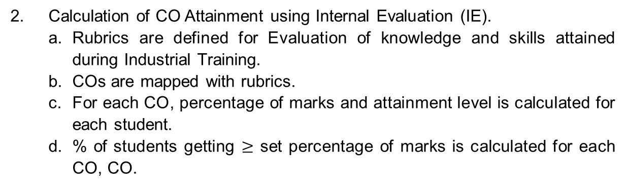
E. CO Attainment Process for Industrial Training
Course Outcomes, COs, are defined and tagged with cognitive levels.
2. Calculation of CO Attainment using Internal Evaluation (IE).
Rubrics are defined for Evaluation of knowledge and skills attained during Industrial Training.
COs are mapped with rubrics.
For each CO, percentage of marks and attainment level is calculated for each student.
% of students getting $≥$ set percentage of marks is calculated for each CO, CO.
CO Attainment gap is determined by comparing CO attainments with CO Targets.
4. Action Plan is prepared for next offering of course in case of gap, otherwise Targets are enhanced.
Rubrics used for Internal Evaluation of Industrial Training
Internal Evaluation of Seminar | Rubrics
Internal Evaluation | R1: Knowledge and understanding of core topics of training.
 | R2: Organization of Presentation.
 | R3: Presentation Skills.
 | R4: Question / Answers handled.
 | R5: Training Report

Slide 64
Process for PO/PSO Attainment
Program Outcomes (POs) are given by National Board of Accreditation (NBA) and Program Specific Outcomes are defined by Program.
Program runs curriculum given by University.
PSO/PO Targets are defined for Program.
Calculation of Direct Attainment of POs/PSOs
a. For Each Course, PO attainment is calculated as
Course Outcomes are defined by faculty and tagged with cognitive levels.
CO is mapped with POs and PSOs.
Mapping Strength of each PO and PSO is computed.
CO attainment is computed as per process.
For Each PO/PSO, relevant COs are Identified.
For Each PO/PSO, PO/PSO Attainment = (Actual Mapping Strength/ Maximum Mapping Strength) *Average of attainment of relevant COs.
b. Direct Attainment = Average of attainments of POs and PSOs.

Slide 65
5. Calculation of Indirect attainment of POs/PSOs.
Student’s Exit Survey for all POs/PSOs is taken from graduating students.
Attainment from Student’s Exit Survey is computed by taking average of all entries for each PO/PSO.
Alumni Survey for all POs/PSOs is taken from Alumni’s.
Attainment from Alumni Survey is computed by taking average of all entries for each PO/PSO.
Employer Survey for all POs/PSOs is taken from Employers.
Attainment from Employer Survey is computed by taking average of all entries for each PO/PSO.
Indirect Attainment = 70% of Attainment from Student’s Exit Survey + 20% of Attainment from Attainment from Alumni Survey + 10% of attainment from Employer Survey.
6. For Each PO/PSO,
Total Attainment = 80% of Direct Attainment + 20% of Indirect Attainment.

Slide 66
Thank you

